Slide 1



STS41A Temperature sensors
Automotive qualified sensor
with best-of-class performance
PM Temperature | September 2025
Notes:
Hello everyone, today we have the pleasure of presenting the last proud member of the Sensirion temperature sensors, the first automotive qualified AEC-Q100 the STS41A.

Slide 2
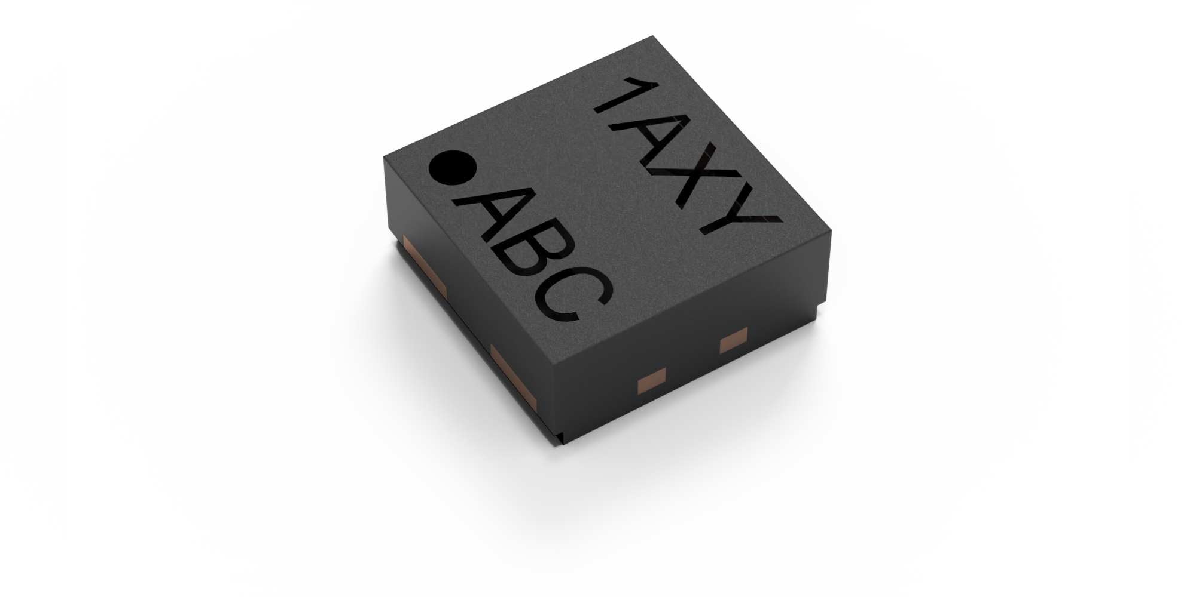
STS41A: Automotive Temperature sensor
Traceable, Reliable, AEC-Q100 Qualified
Reliability made sensor. AEC-Q100 requires strict qualification protocol, which STA41A passes with flying colors.
Wettable Flanks, allowing for easier visual inspection
Extreme 0.2 °C Temperature Precision
Integrated heater allowing for on-board diagnostics (OBD)
Automotive grade qualified
allowing better reliability and traceability
Notes:
The STS41A sensor has fulfilled the AEC-q100 automotive qualification. The qualification protocol includes extensive stress testing to ensure the reliability and traceability of the sensor, which STS41A passes with flying colors.
Some of the outstanding capabilities of the STS41A include a precision of 0.2 degrees Celsius, Wettable flanks that allow easier visual soldering inspection. The STS41A has on top of that an integrated heater that allows on board diagnostics, further ensuring the reliability of the sensor.

Slide 3
STS41A CHARACTERISTICS
Designed for automotive applications, reliability for everyone
Flat temperature accuracy specifications
On-board diagnostics capable (OBD)
Operating range -40 to 125°C
I2C fast communication mode
Supply voltage 1.08 to 3.6V
Two I2C command addresses available
Shape and command compatible with SHT4xA
Notes:
The specific characteristics that we would like to highlight from the STS41A sensor include:
Flat accuracy specifications throughout all the operative range, which allow seamless integration.
On-board diagnostics thanks to the integrated heater, matches the safety requirement trend and allows integration to critical applications.
The wide operating range from -40 to 125°C suits perfectly the harsh conditions the automotive industry expects
The I2C standard communication protocol is further enhanced thanks to the fast communication protocol and even includes cyclic redundancy check to ensure that even with extreme speed transfer the sensor is still accurate and reliable.
The wide supply voltage ranging from 1.08 to 3.6 V is compatible with most automotive application requirements.
The STS41A has two distinct orderable addresses 0x45 and 0x44 to have easier integration.
Finally we would like to highlight the shape and command compatibility with the SHT4x humidity and temperature sensors, which for some applications could simplify assembly lines, bringing huge efficiency benefits.

Slide 4

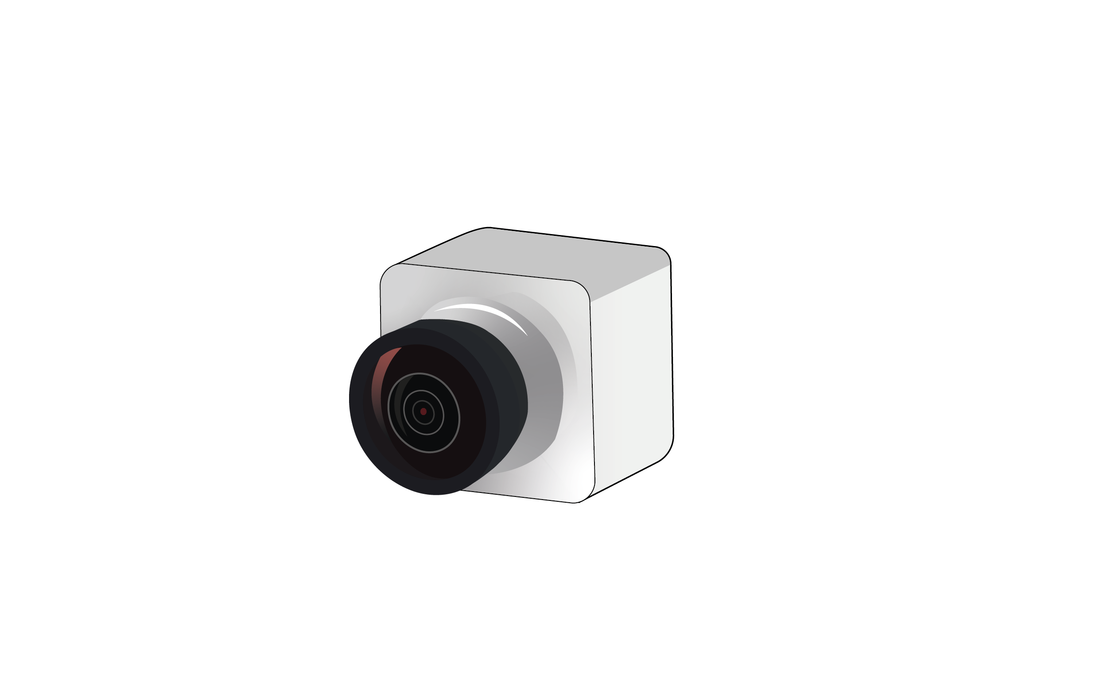

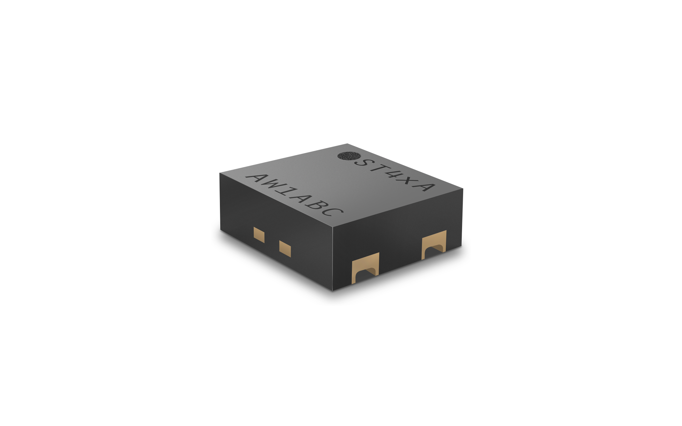
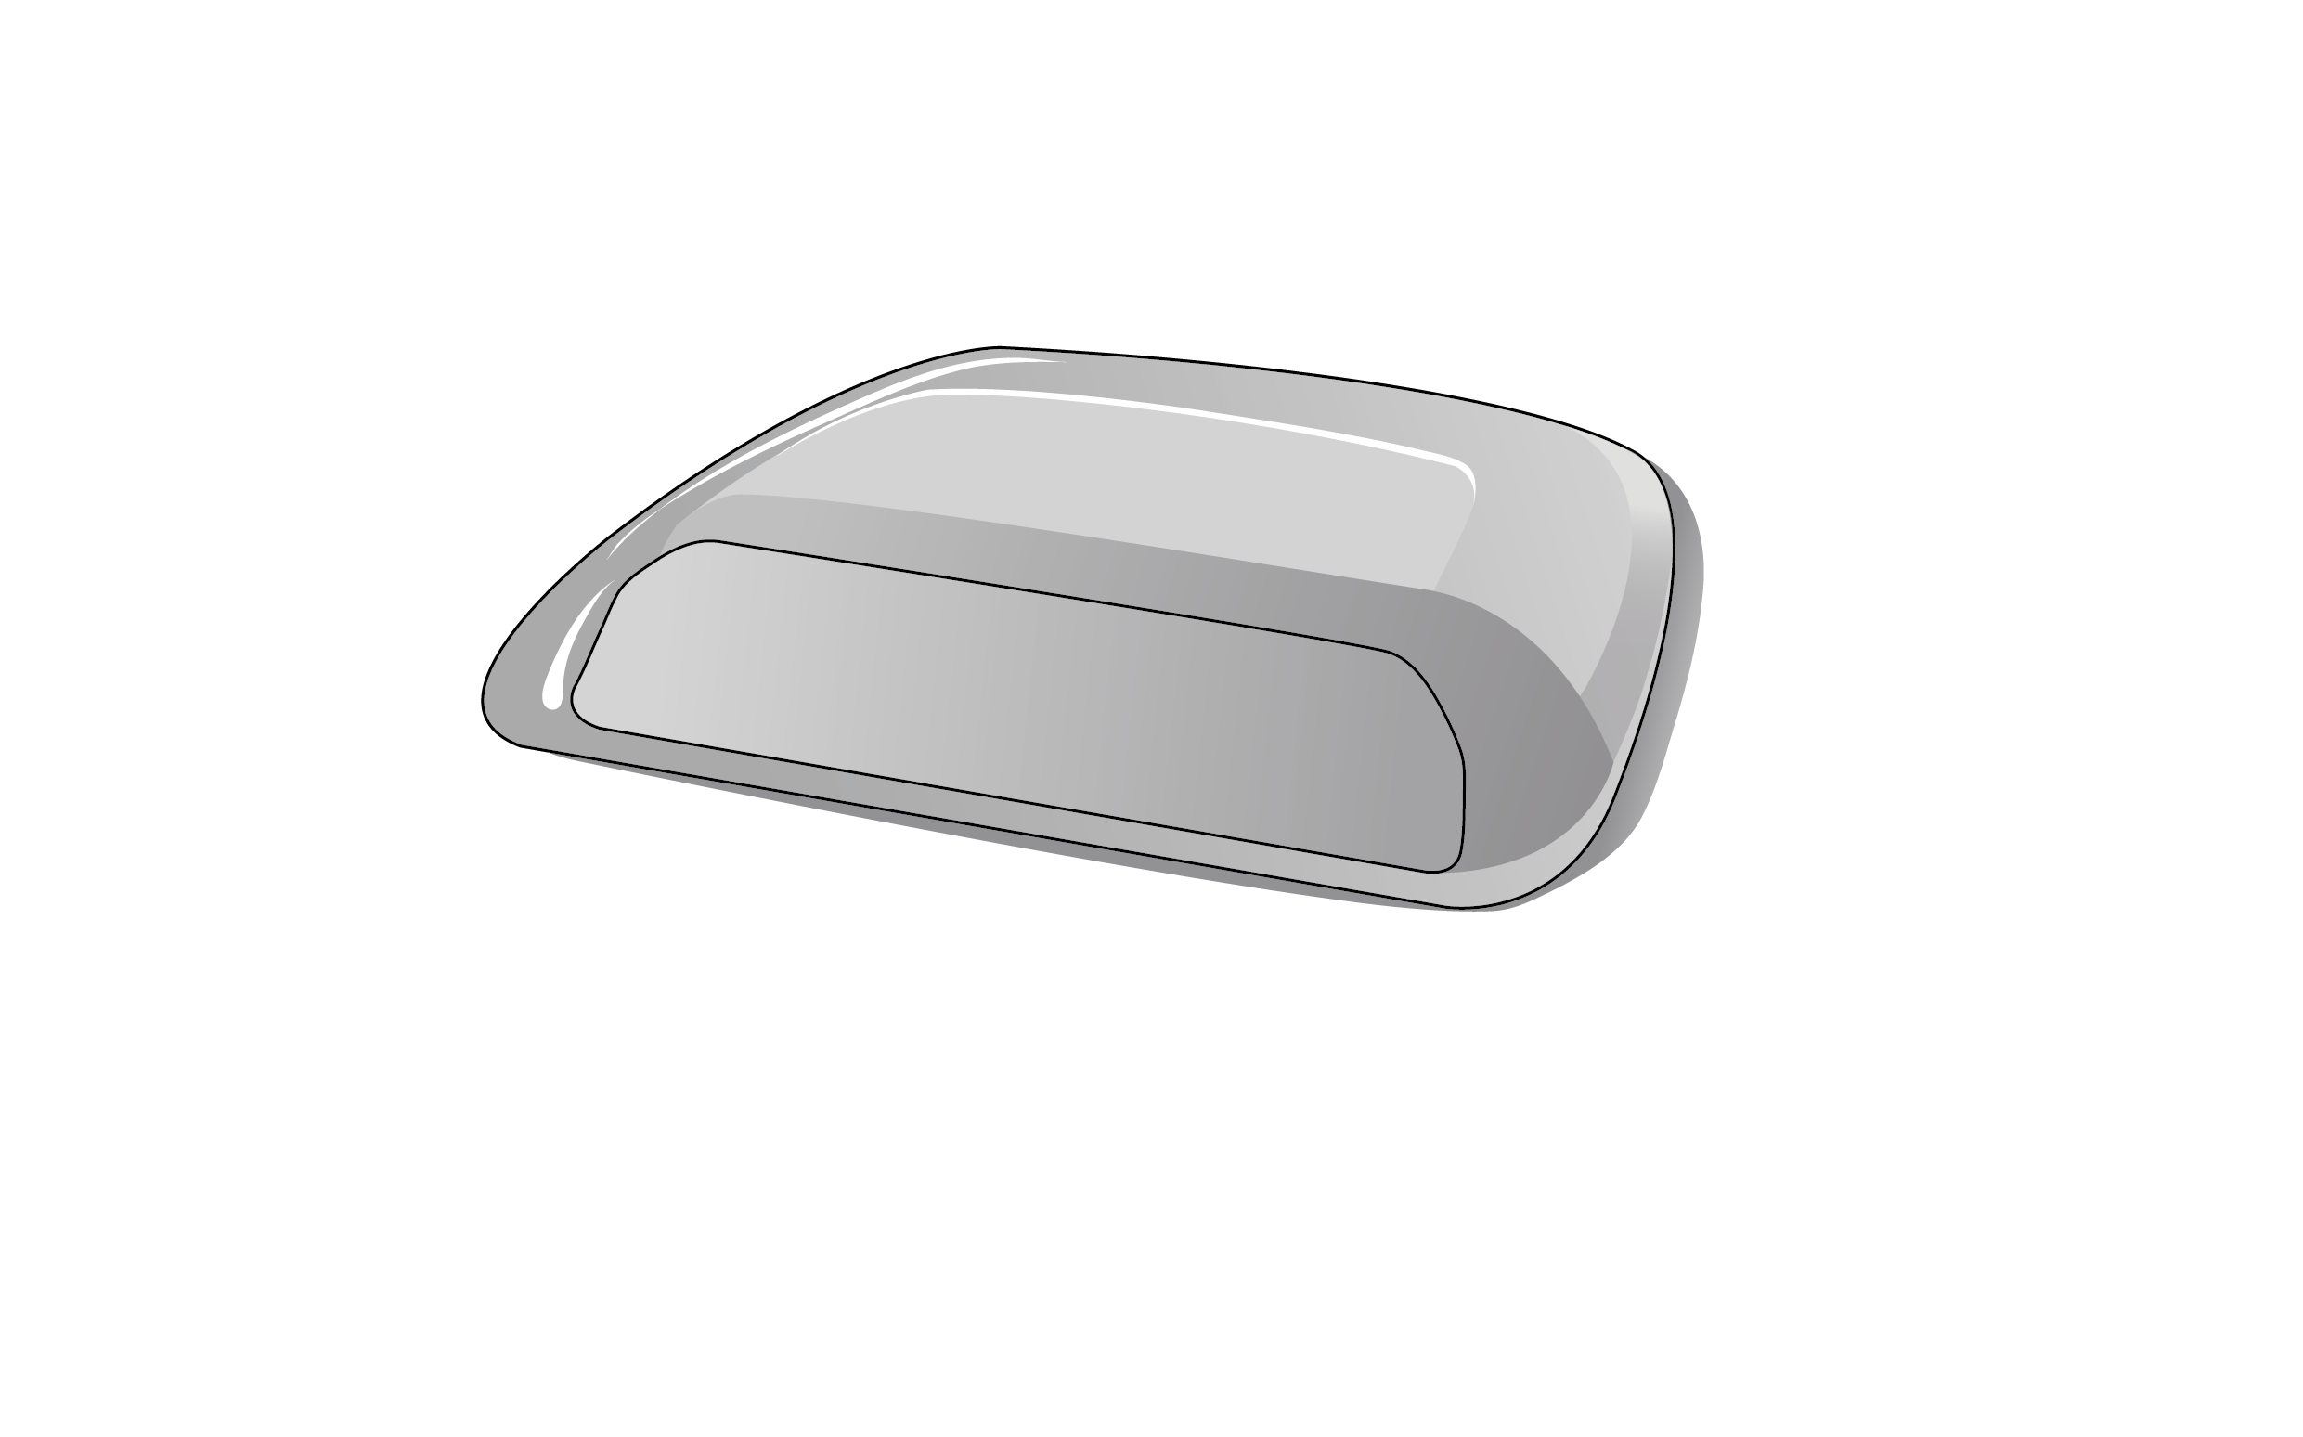
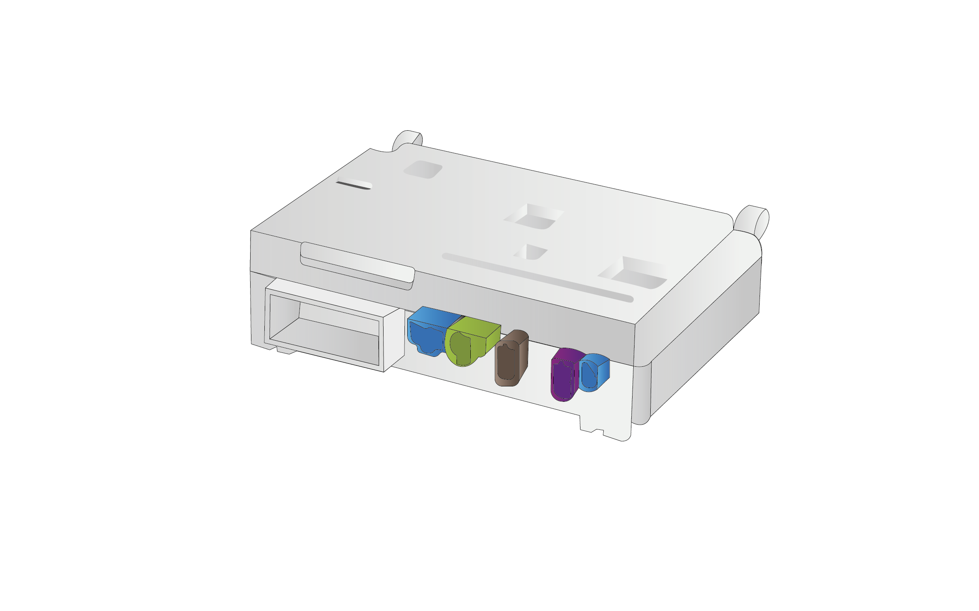
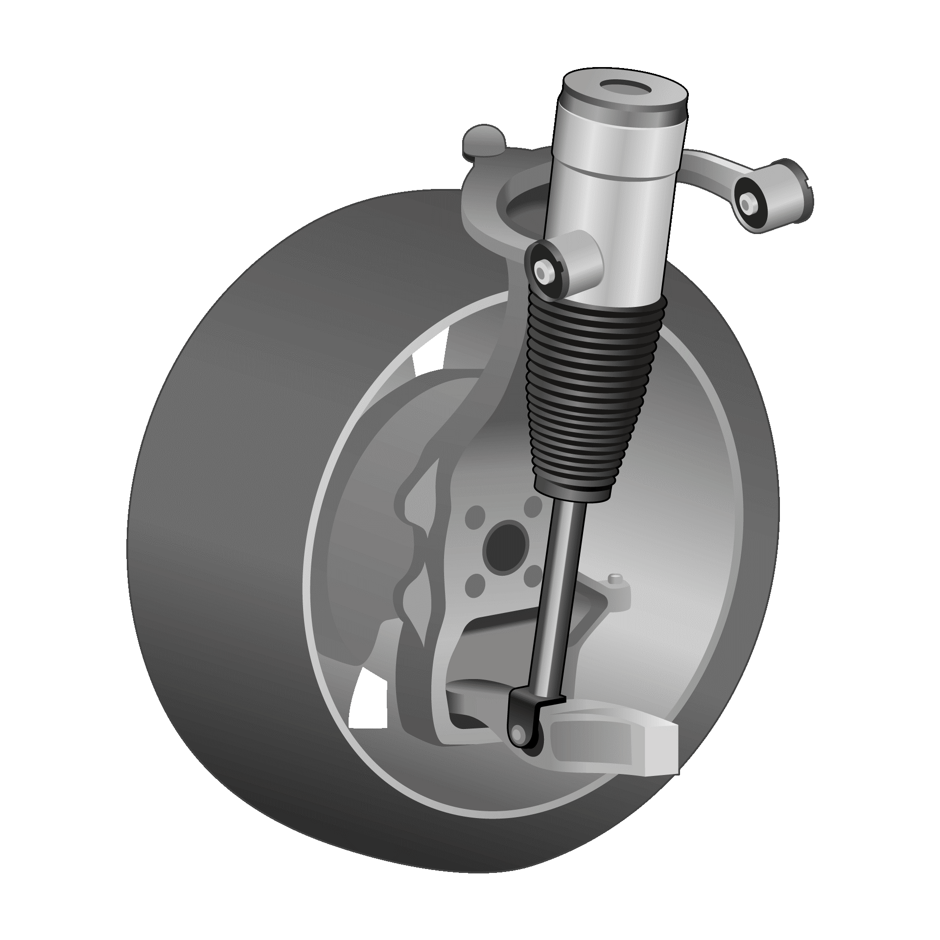
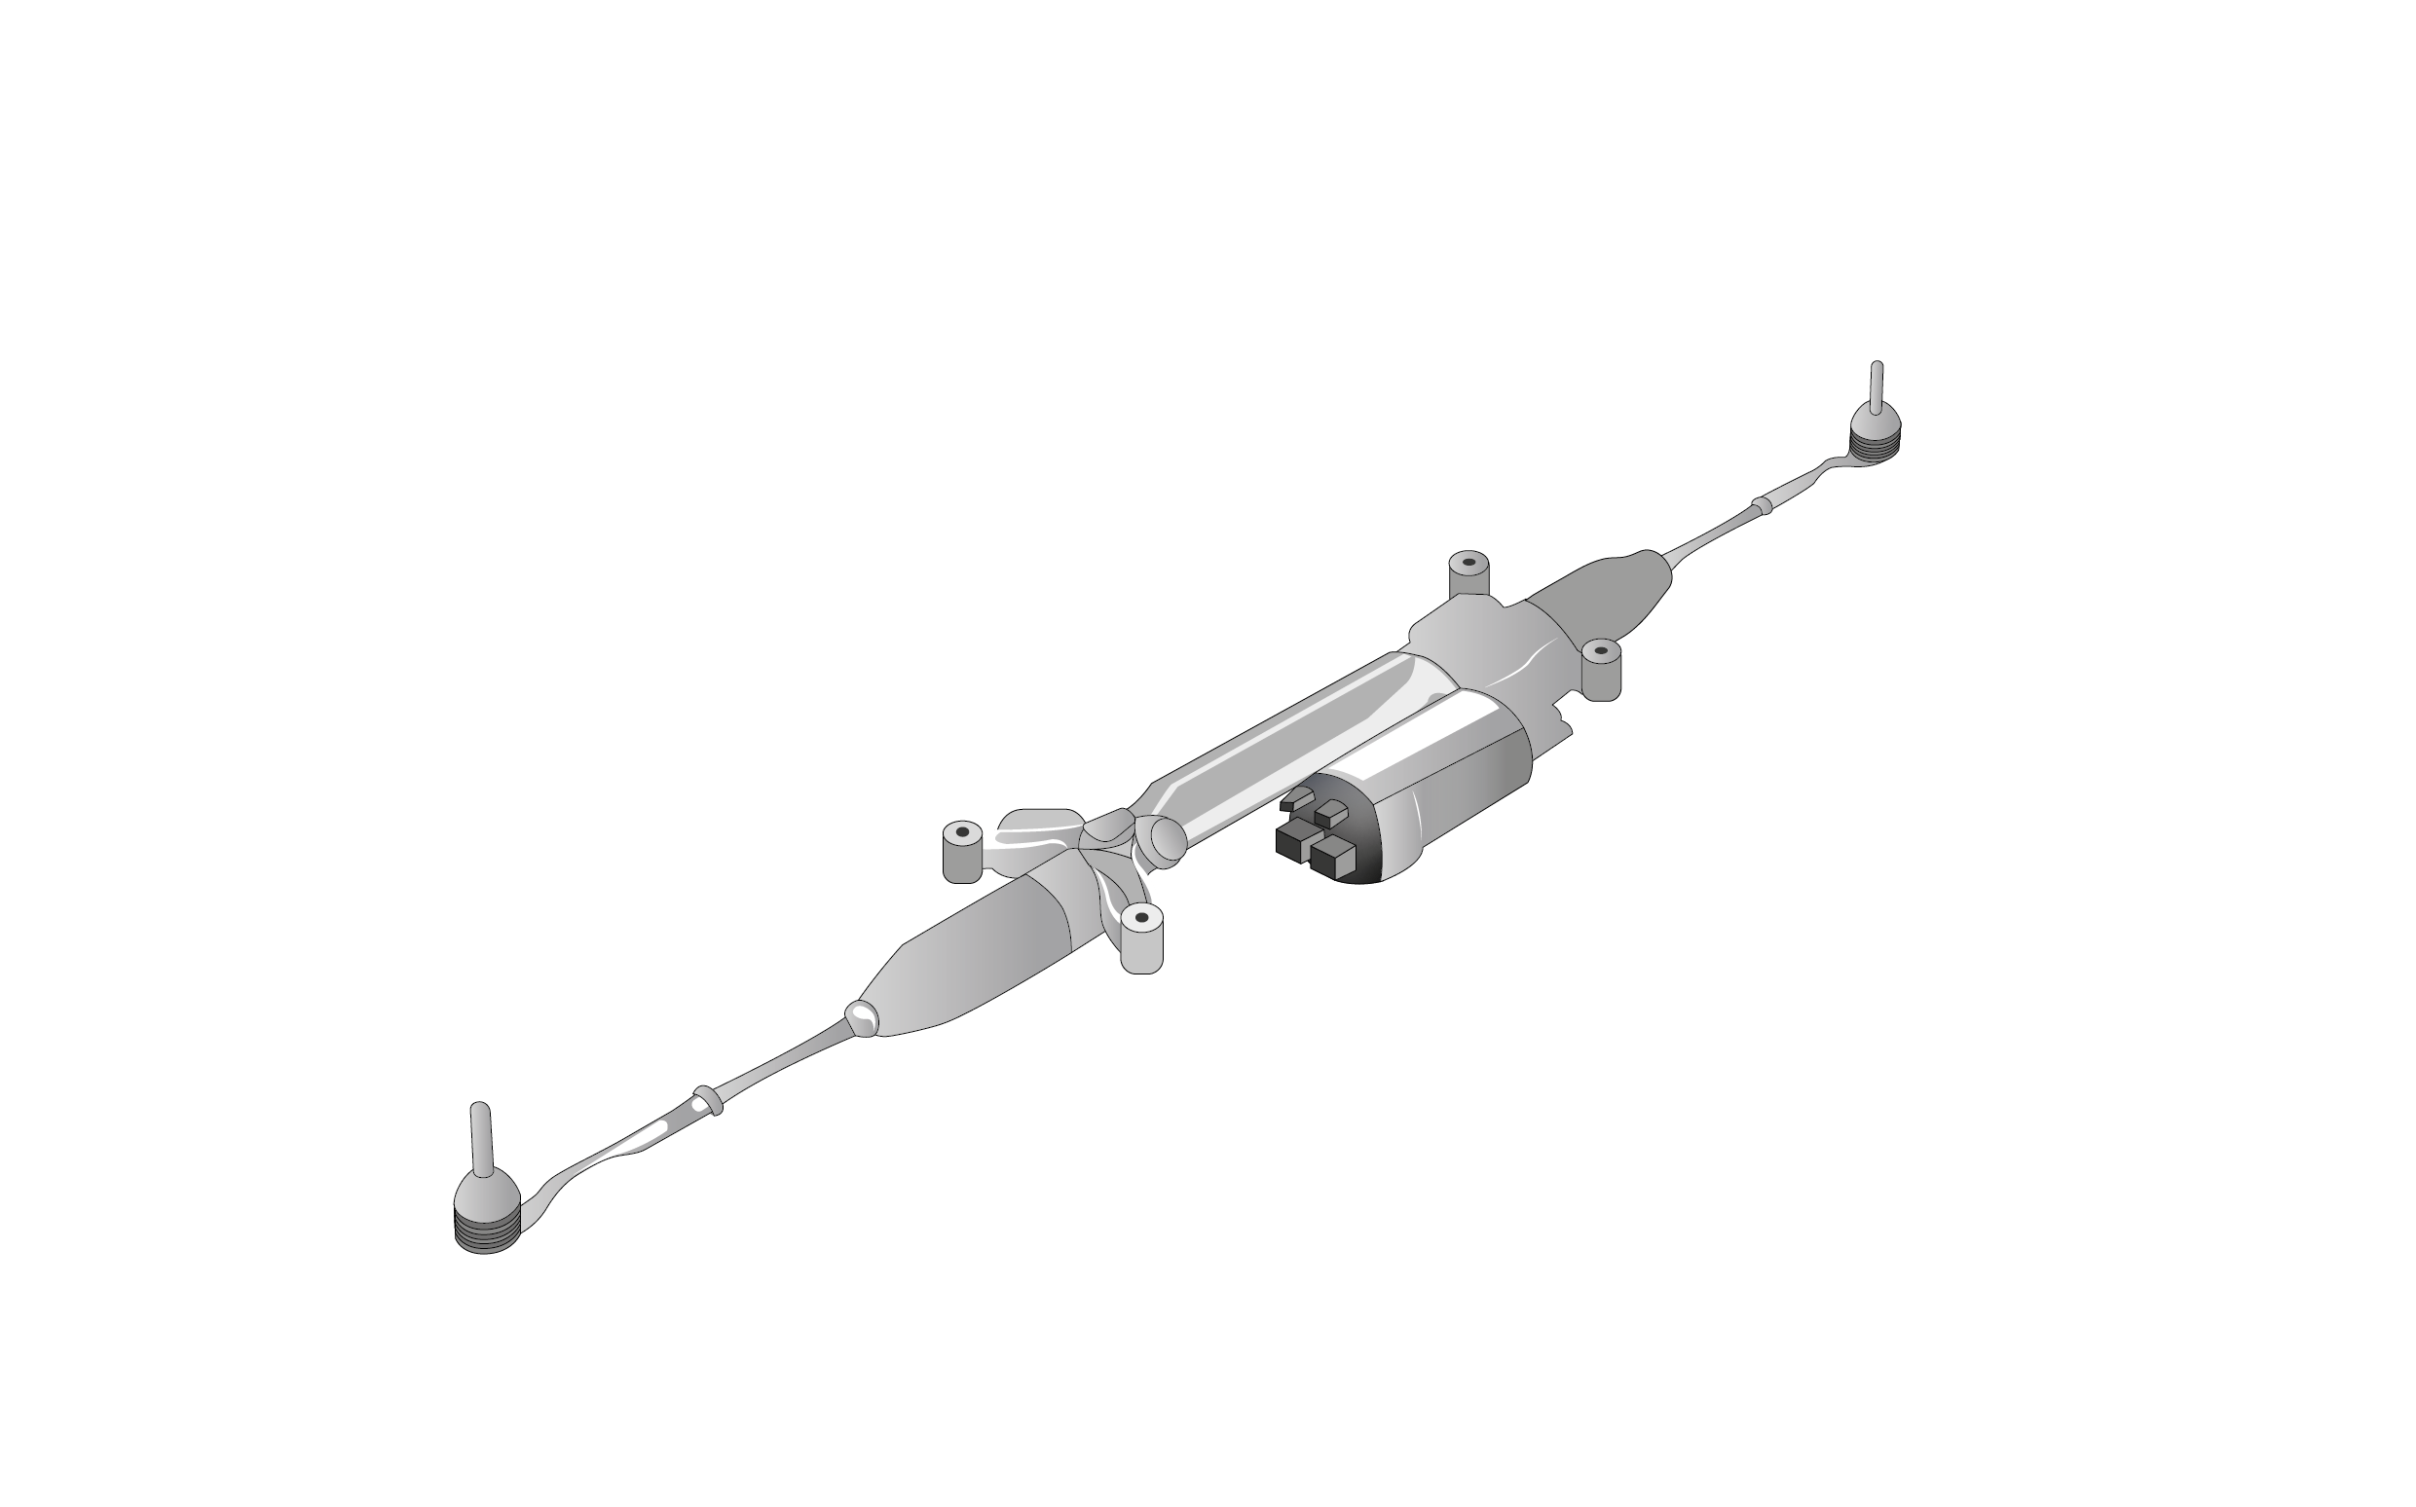
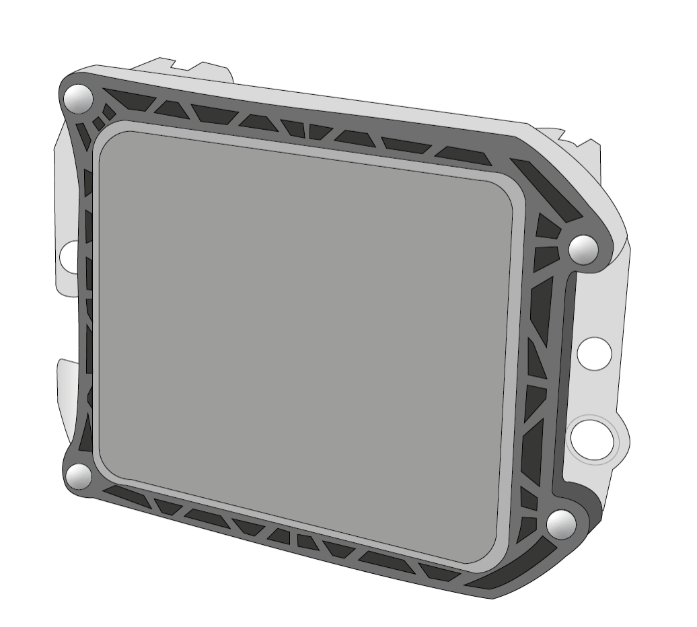
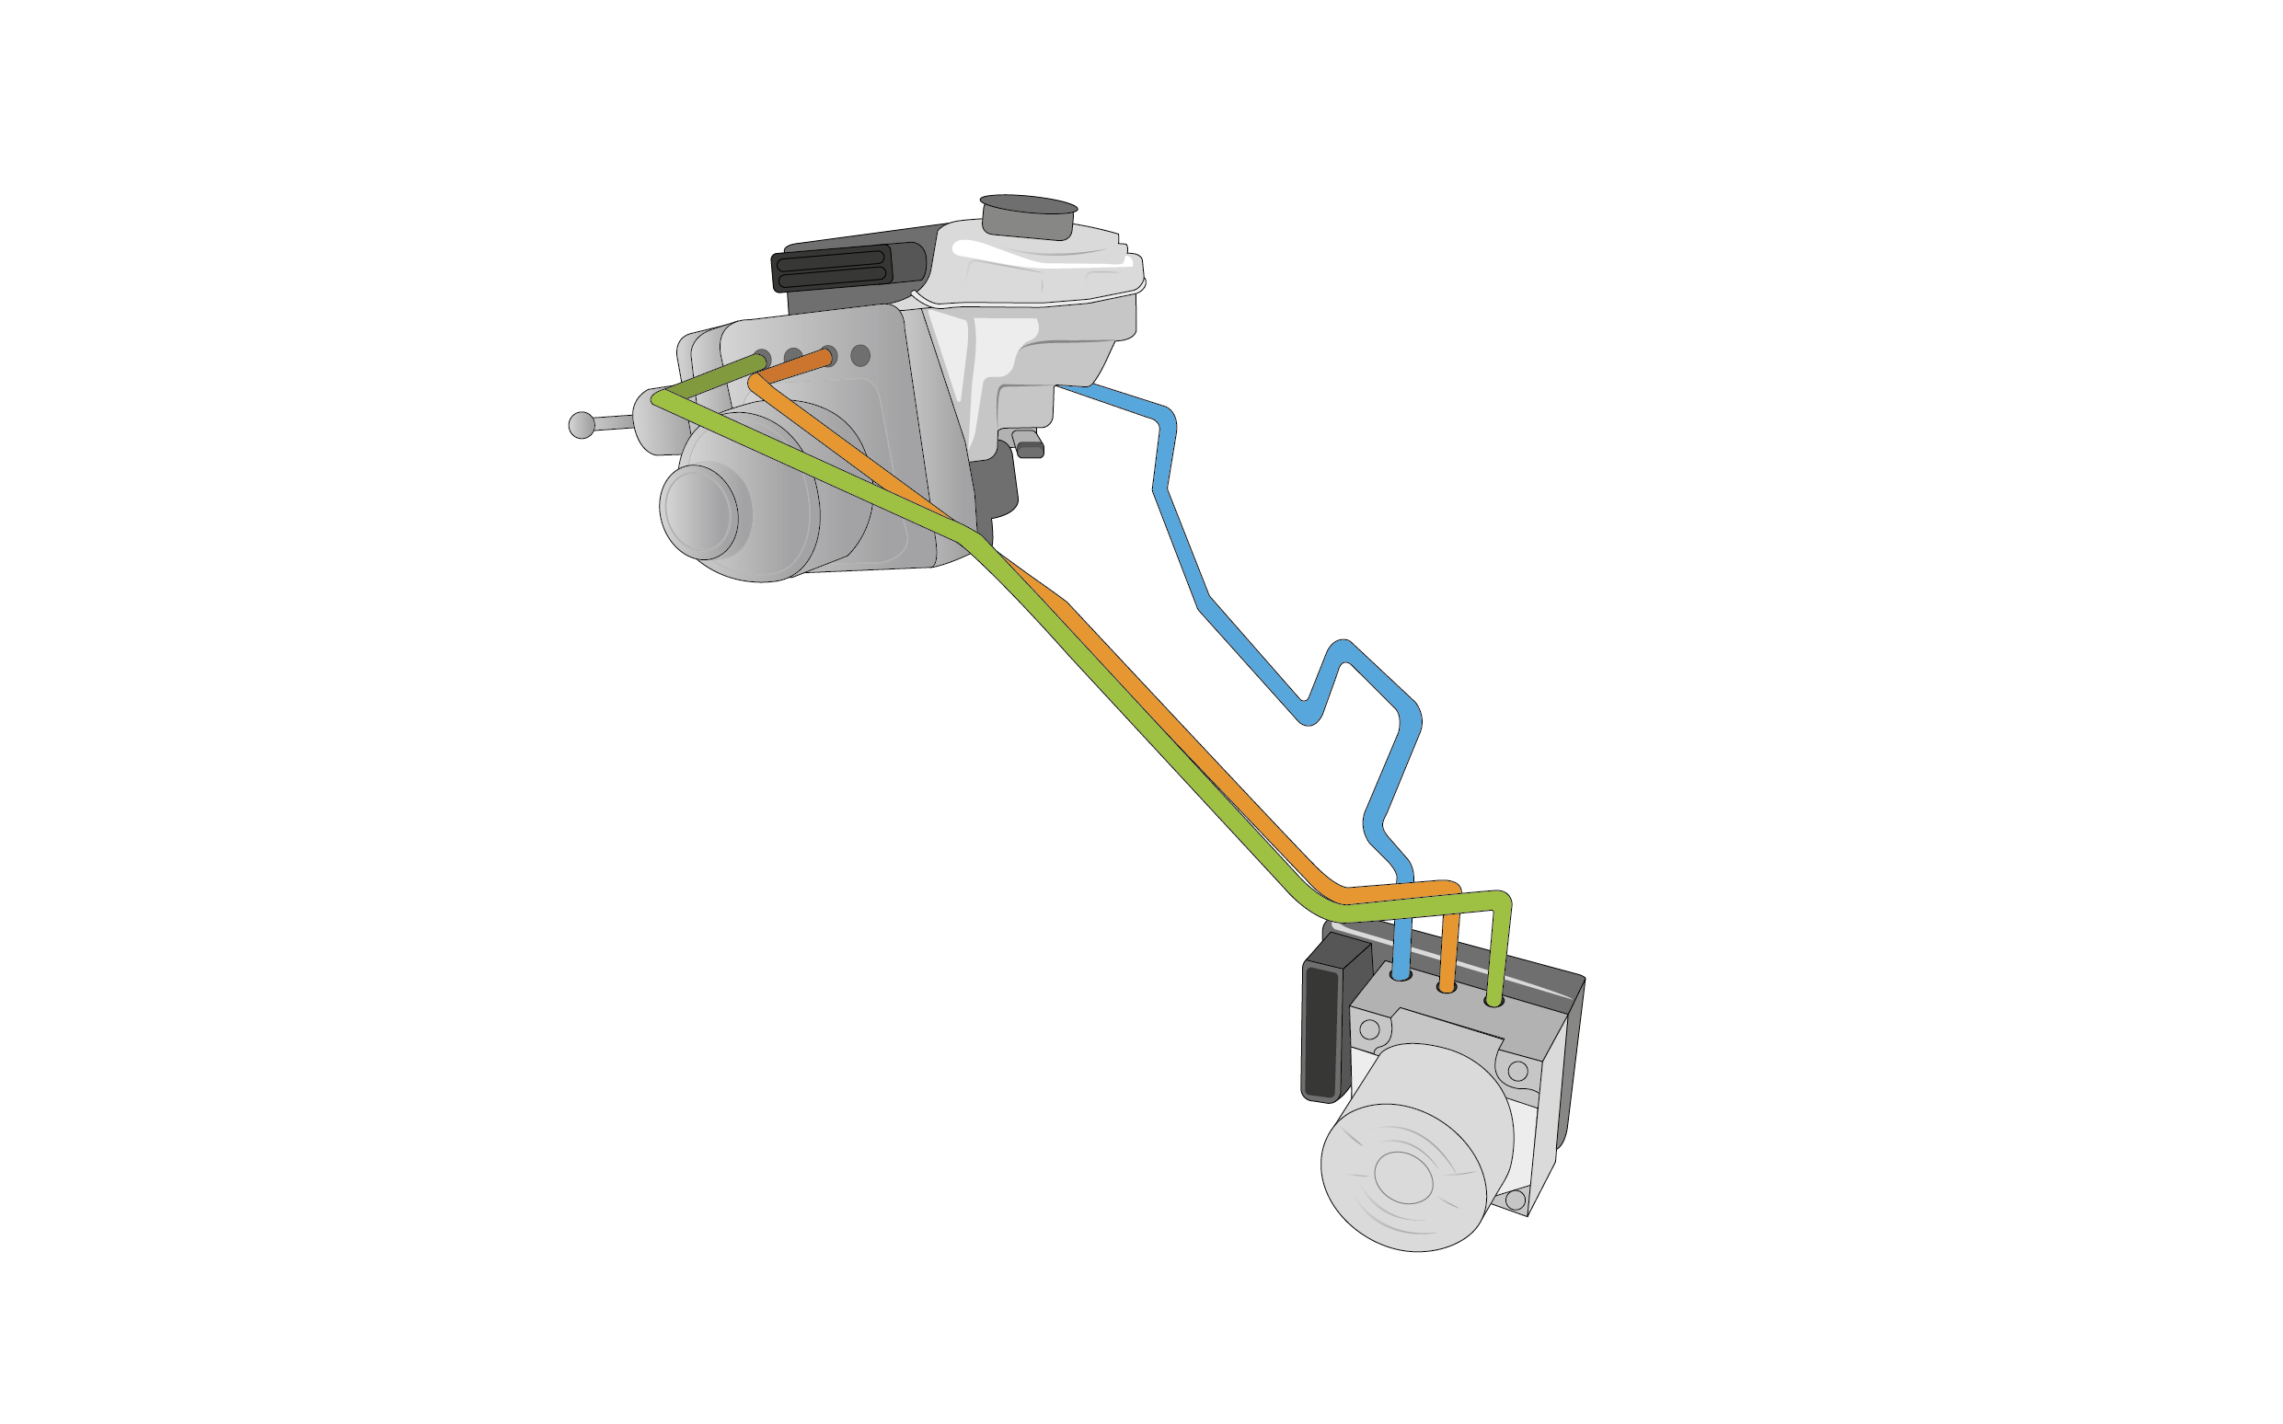
STS41A Suggested applications
LiDAR applications
Camera detectors
Radar applications
Steer-by-wire
Break-by-wire
Temperature trackers
Negative Temperature Coefficient
STS41A
Camera
Lidar
STS41A
ADAS/AD CCU
STS41A
STS41A
Air suspension system
STS41A
Radar
STS41A
Steer-by-wire
STS41A
Brake-by-wire
Notes:
And with this many capabilities the audience might be wondering, which applications would this magnificent sesor be suitable for?
In general temperature applications for automobiles or automotive industries, some of those examples include:
LiDAR applications
Camera detectors
Radar applications
Steer-by-wire
Break-by-wire
Temperature trackers
Negative Temperature Coefficient

