Slide 1
Arrow ACT - Sensirion - 2023
Gary McNelly, Regional Sales Manager
Rick Zanardo, Regional Sales Manager
Gina Greco, Director Global Channel Sales
Diane Haynes, Channel Manager – Americas
"Global trends in sensing, learn how Sensirion's products are crucial for key IoT and Air quality applications"
Notes:
Sensirion overview
What’s New at Sensirion ?
Product Overview
Application Overview
Demos
Success Stories
Registration/Design Wins

Slide 2
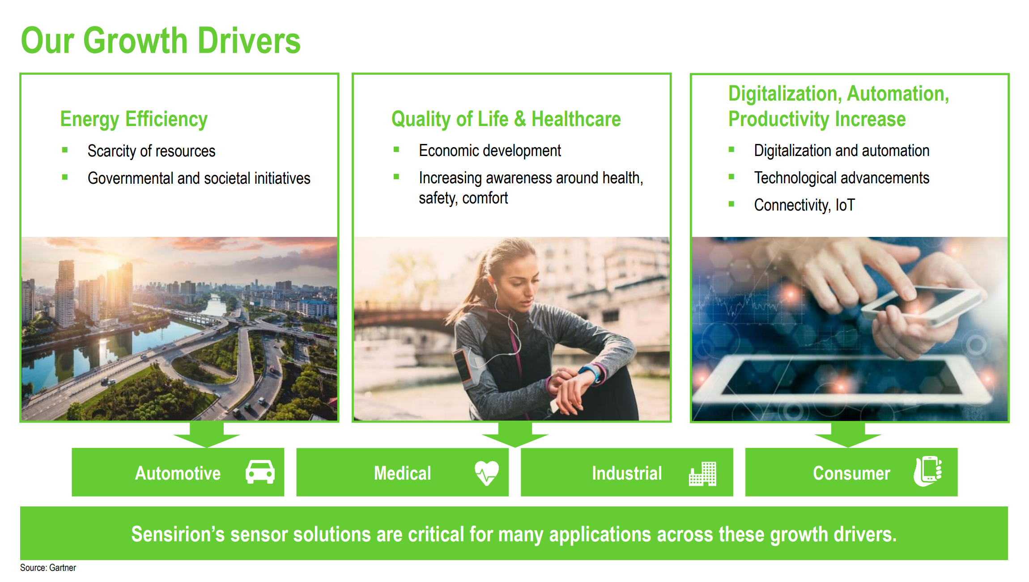

Slide 3







Facts & figures
1998
founded
2018
public
1000+*
Full-time equivalents (FTEs)
287.5M CHF
Revenue (FY21)
> 200
Patent families
310-340M CHF (projected)
8–18% growth over 2021
1 Billion sold
600k sensors produced/day
16%
Of revenue invested in R&D

Slide 4

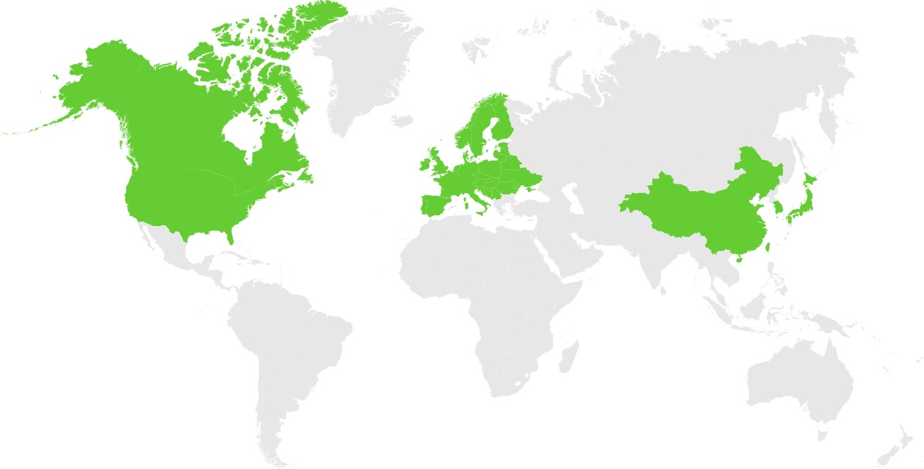
Global footprint
974 FTEs*
Netherlands
Germany
South Korea
Hungary
Japan
Switzerland
(Headquarters)
United States
China
Taiwan
Production
R&D
Sales
New
Singapore
  * As of 31 Dec 2021
Notes:
Color code – Americas as Green

Slide 5




Our Growth Drivers: Megatrends
Digitalization and automation
Energy efficiency
Quality of life
Environmental protection
    Scarcity of resources
    Governmental and societal initiatives
    Economic development
    Increasing awareness around health, safety, comfort
    Industry 4.0
    Technological advancements
    Connectivity, IoT
    Air quality
    Climate change
    Water quality
Sensirion’s sensor solutions are critical for many applications across these megatrends

Slide 6





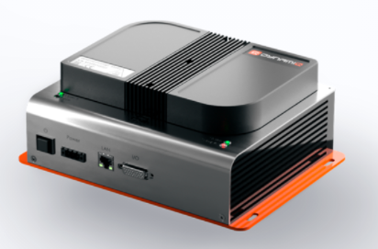






Wide range of solutions across diverse end markets
End market
Automotive
Medical
Industrial
Consumer
% of FY 2021 revenue (excl. COVID-19-related ventilator business)
24%
17%
49%
10%
Humidity/temperature (RHT)
✓
✓
✓
✓
Gas (VOC, formaldehyde)
Environmental
sensing solutions
Carbon dioxide (CO₂)
Particulate matter (PM2.5)
Gas analyzers
Auto Custom Modules
Differential pressure
✓
✓
✓
✓-
Mass flow
Flow sensing solutions
Gas metering
Liquid flow
Key applications
  Auto defogging, RLS
  Air quality, Temp
  Engine control
  BMS, ADAS / LIDAR
  CPAP (sleep apnea)
  Ventilators, Anesthesia, Nitric Oxide, Smart Resuscitation
  Smart Inhaler, Breath Analysis
  Air purifiers, air exchangers, refrigerators, HVAC
  Gas metering
  Building ventilation (VAV)
  Air Quality
  Consumer gadgets
  Smart thermostats
  IP/security cameras
Not in the channels

Slide 7
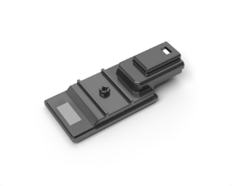
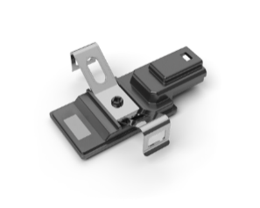


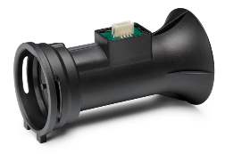
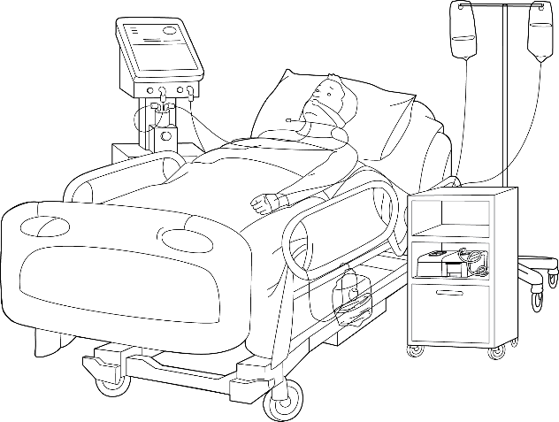
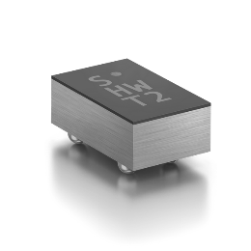
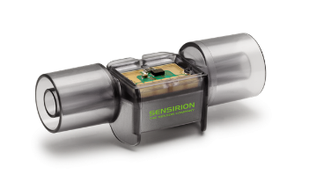
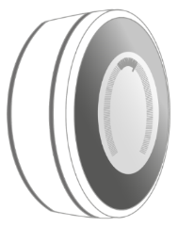
Solving complex problems everywhere today
Anti-fogging
Natural gas
Providing antifogging, engine and climate control to approximately one in three cars manufactured worldwide.
Reliable real-time monitoring of gas consumption for more than 5 million households.
Mass flow
Humidity & temperature
Monitoring the breathing of more than 15 million patients in hospitals and at home.
High precision monitoring of temperature and air quality for millions of households.

Slide 8

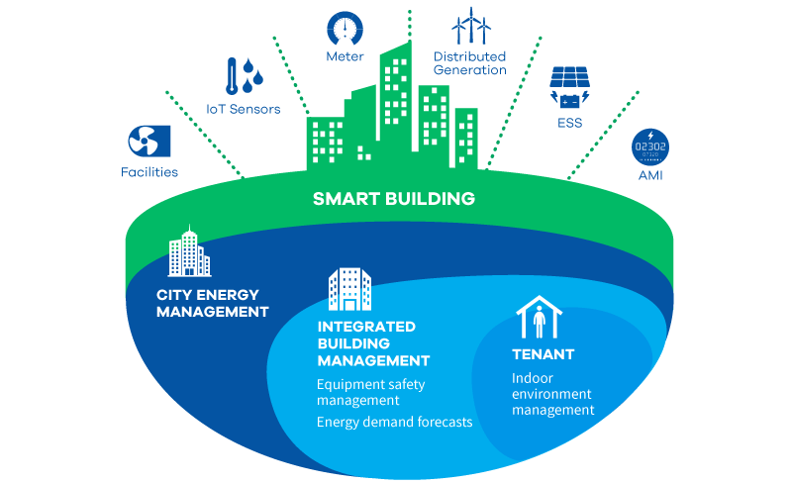
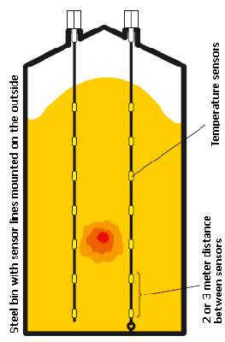
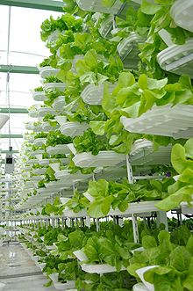
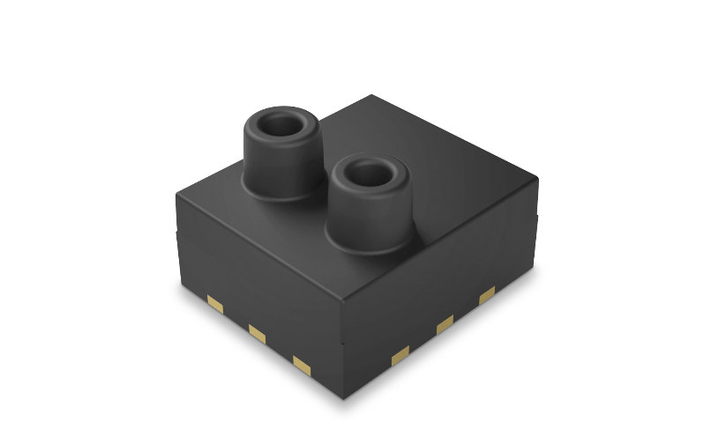
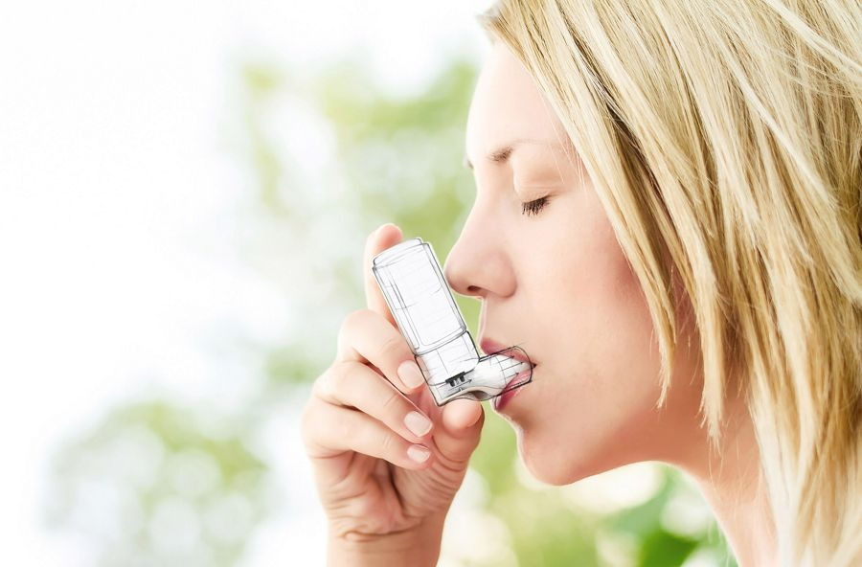
Looking towards the complex problems of tomorrow
Electronics Safety & Antifogging for LiDAR & ADAS
Building Automation Systems
Air Quality: In-cabin & Outside
VAV Controllers & DCV Systems
EV Battery Management Safety
IoT Farming and Growing
Smart Lighting and Monitoring
Smart Inhalers
Point-of-Care

Slide 9














































Our Key Customers are catalyst to our innovation
You probably own or use a product with one (or more) of our sensors inside!
Notes:
Our customers are distributed across these markets. Single source for all of these companies but for one (seagate), this one will transistion within this year

Slide 10
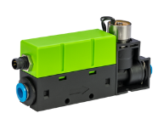
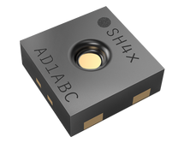
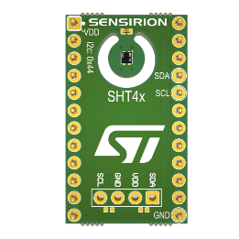
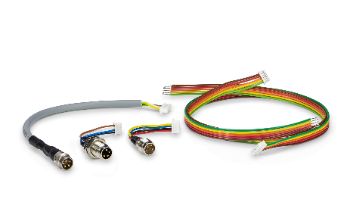
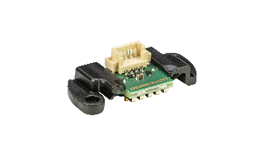
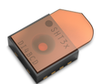

NPI Status and more than 15% revenue YoY into R&D projects
2022: 16 NPIs
2023 NPIs and technology trends, next 12 months:
Q1:
    SFC6000D Mass Flow Controller & SFM6000D Mass Flow Meter: Compact MFC with unbeatable price-performance ratio, lightweight, choice of interface, fittings 500 sccm - 50 slm
    SHT43 Humidity and Temperature Sensor: Market leading electrical and physical performance, digital 3-point temperature calibration certificate which enables cost-efficient manufacturing of high volume dataloggers.
    SHT40 ST Evaluation Board to easily and quickly test our sensor in ST compatible systems, 1.08 V to 3.6 V supply voltage and ultra-low power consumption
    SCC1 Connectivity Kit + LPG10 Connector Cap for easier use of the LPG10 after testing it with the evaluation kit
Q2:
    SHT4x variants
    SHT4x Gadget
    SHT4xx Humidity and Temperature Sensor with Protective Cover
Q3/Q4:
    Further Market Solutions (Industrial) Under expansion

Slide 11
Product Updates

Slide 12
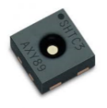
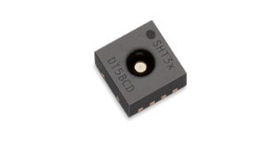

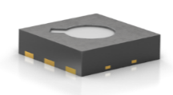
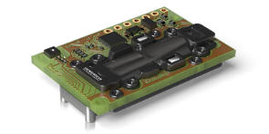
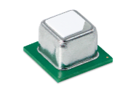
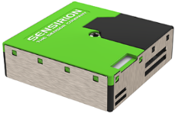
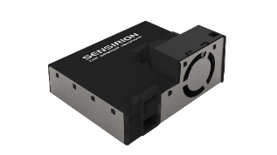
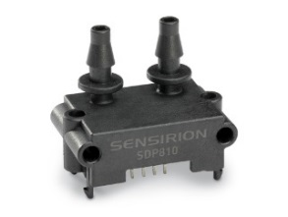
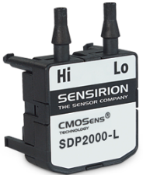
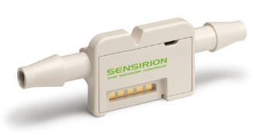
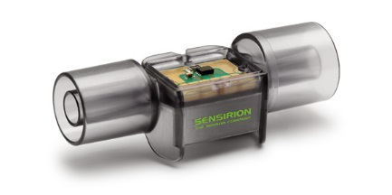
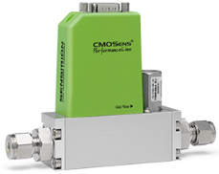
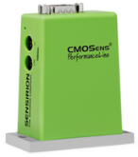
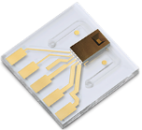

Sensirion Product Lines
Environmental Sensors and Modules
SEN5x
Environmental node sensor
SHTCx, SHT3x
STS3x,STS4x
SGP4x
SCD30 & SCD4x
SPS3x
Humidity & Temperature
^{(RH + T)}
Temperature
^{(T-only)}
Gas
^{(tVOC, CO2eq(N))}
Carbon Dioxide
^{(CO2 + RH + T)}
Particulate Matter
^{(PM2.5-10)}
Environmental
Node Sensor
Flow Sensors and Modules
SDP3x, SDP8x, SDP2000*
LD20, LPG10
SFM series
SFC5400, SFC5300
Differential Pressure
(Mass flow DP, +/-500Pa, +3500Pa*)
Liquid Flow
(microfluidics nl-ml/min)
Gas Flow
(Air, N2, O2, etc. +/- 250slm)
Mass Flow Controller
(Air/N₂, H₂, O₂, He, Ar, CO₂₎

Slide 13
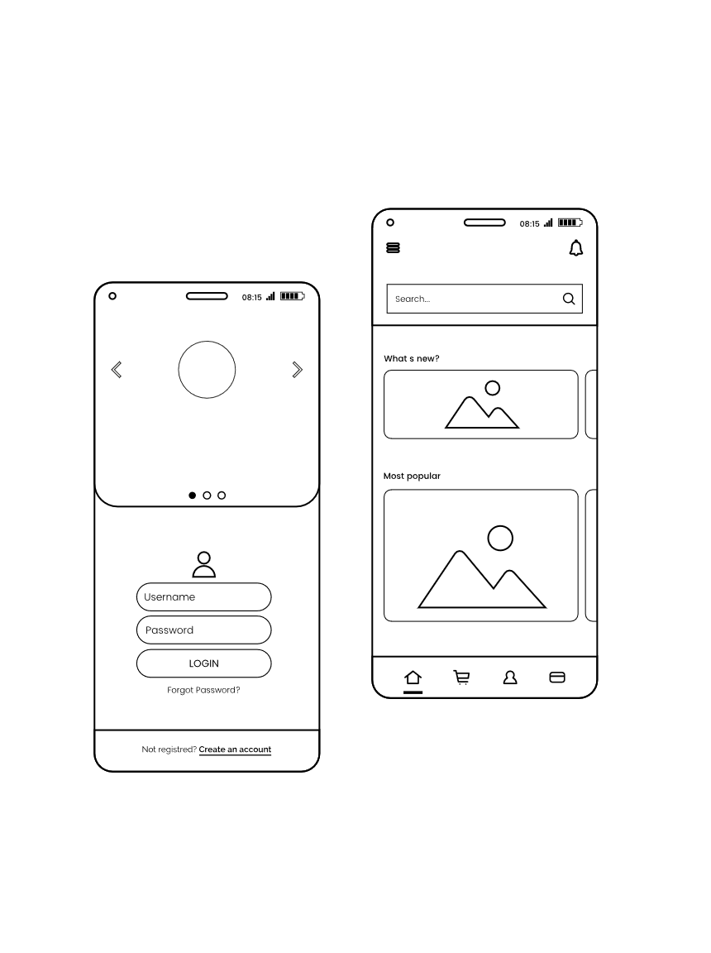
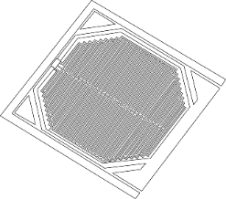
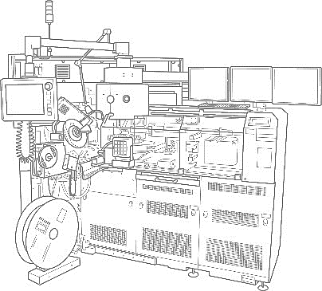



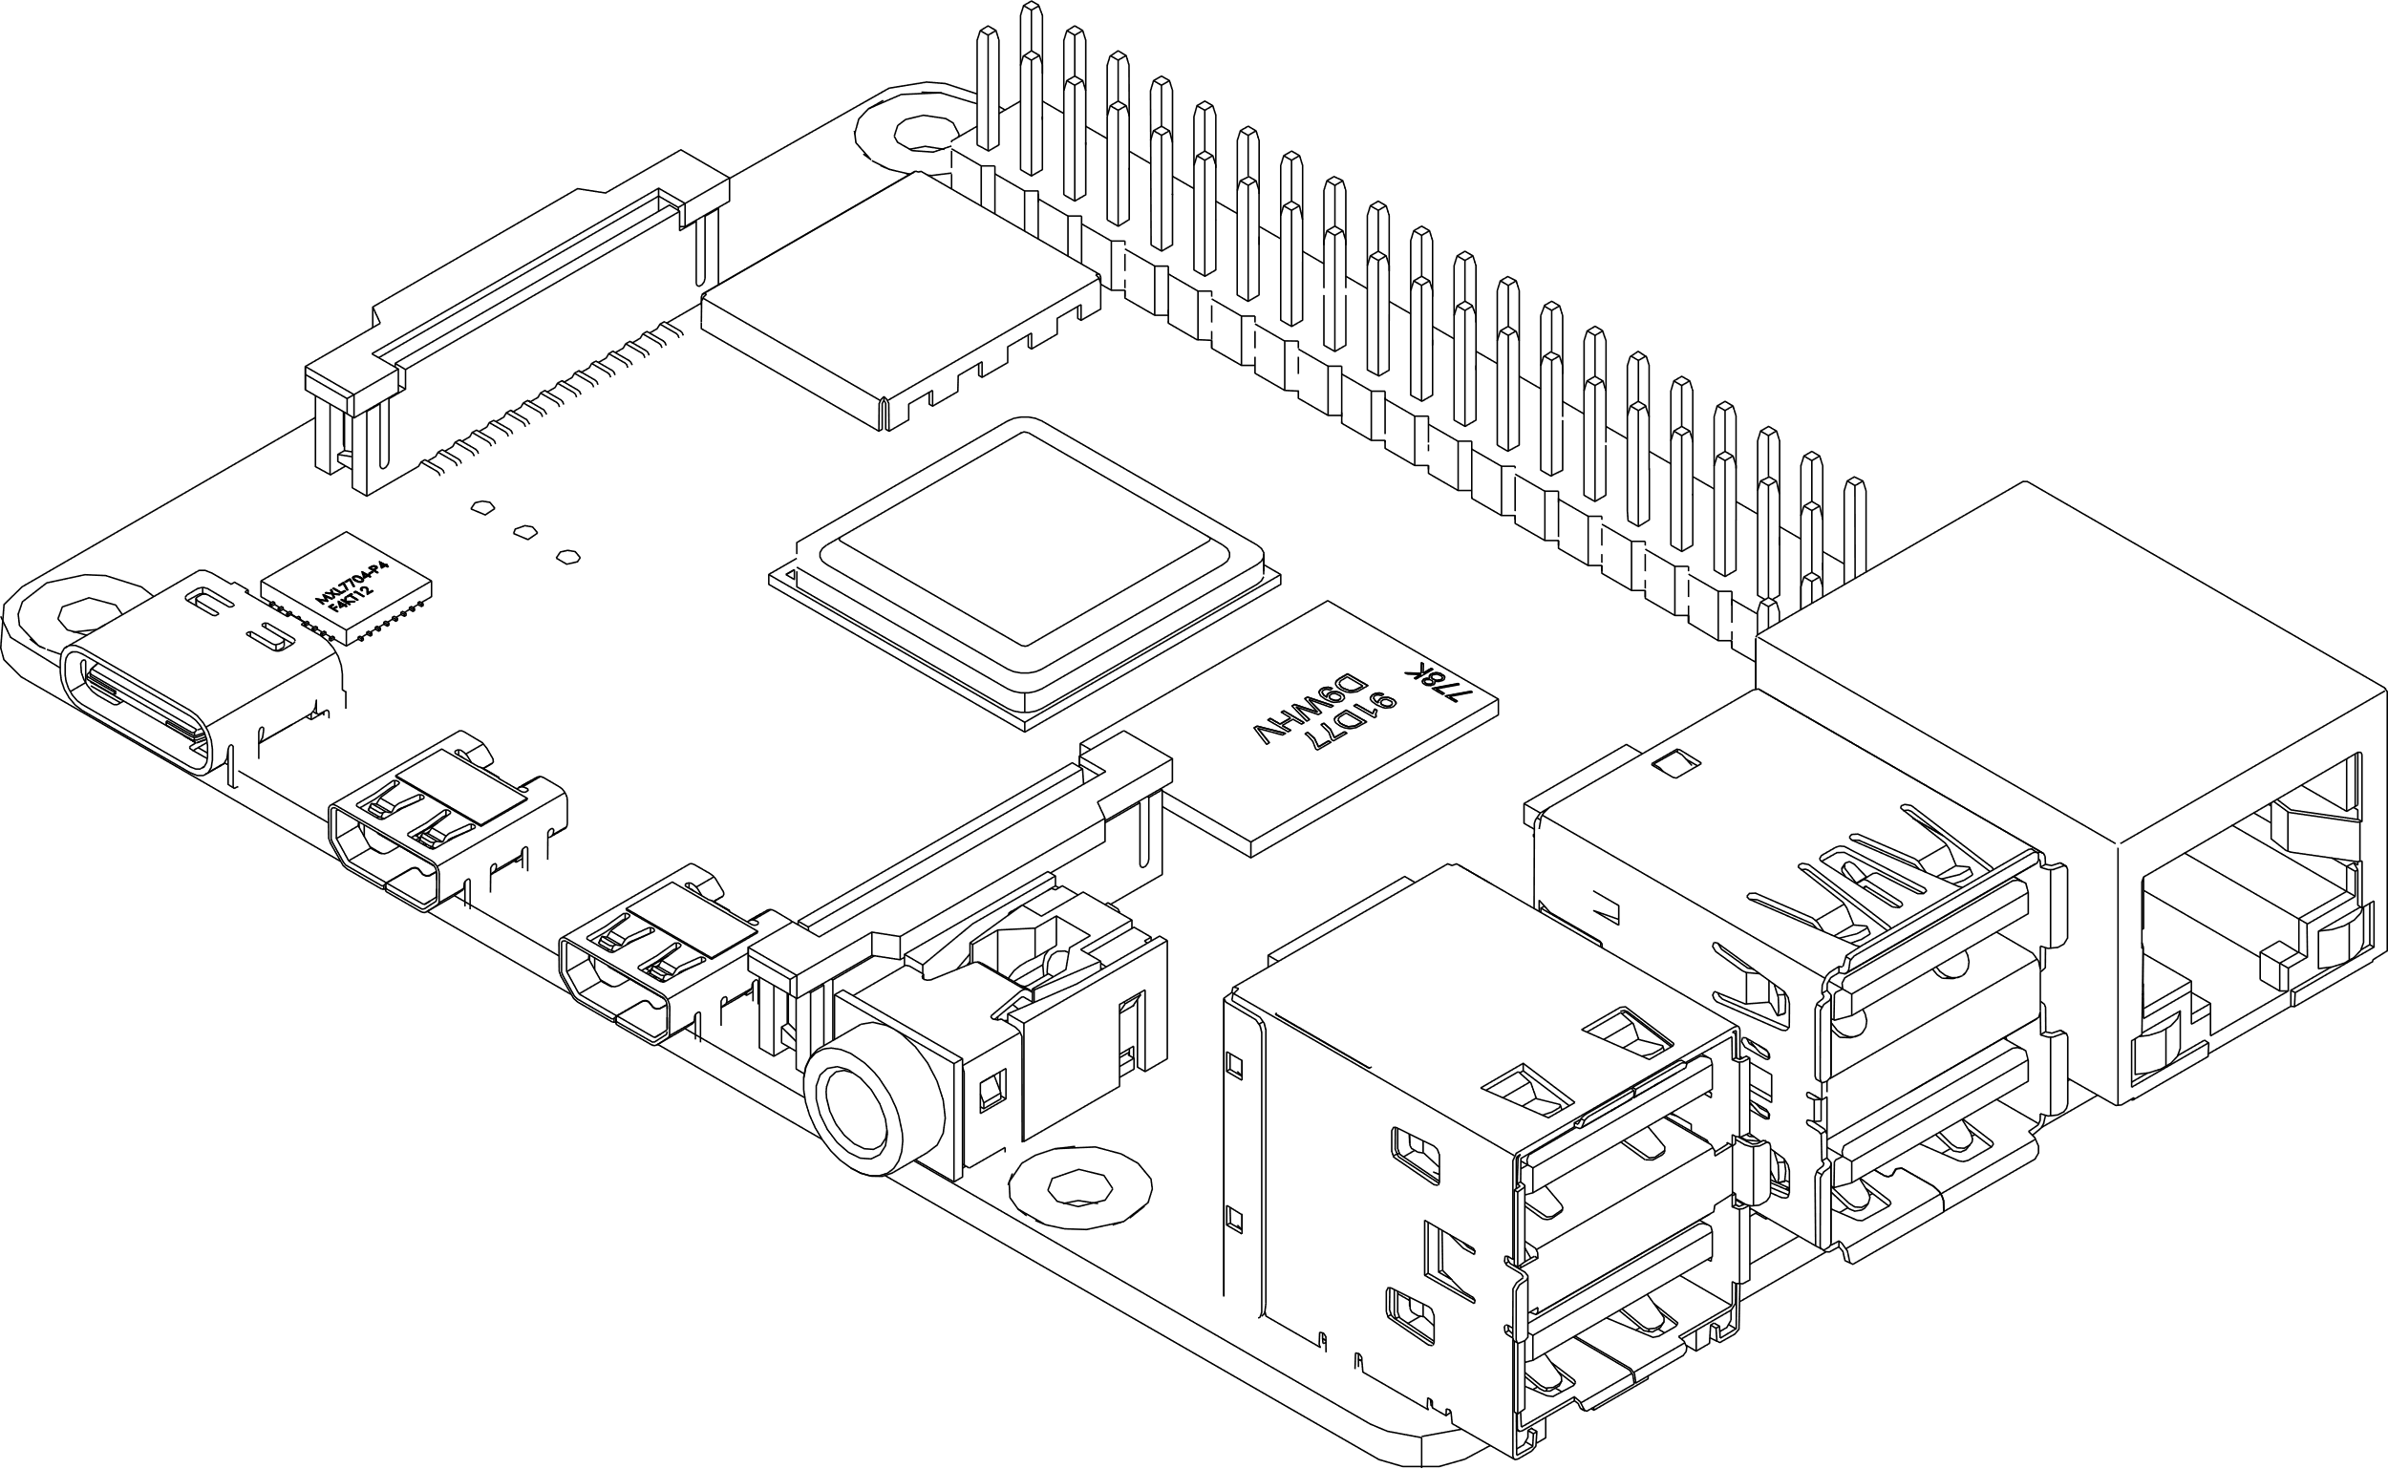
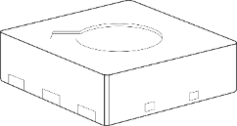

Sensirion advantage: expertise across entire value chain
Development of design and processes
Calibration
expertise
Application
expertise
ASIC
MEMS
Packaging
Automation
Hardware
Software
Market and Cloud Solutions
Field application support
  Wafer manufacturing is outsourced

Slide 14
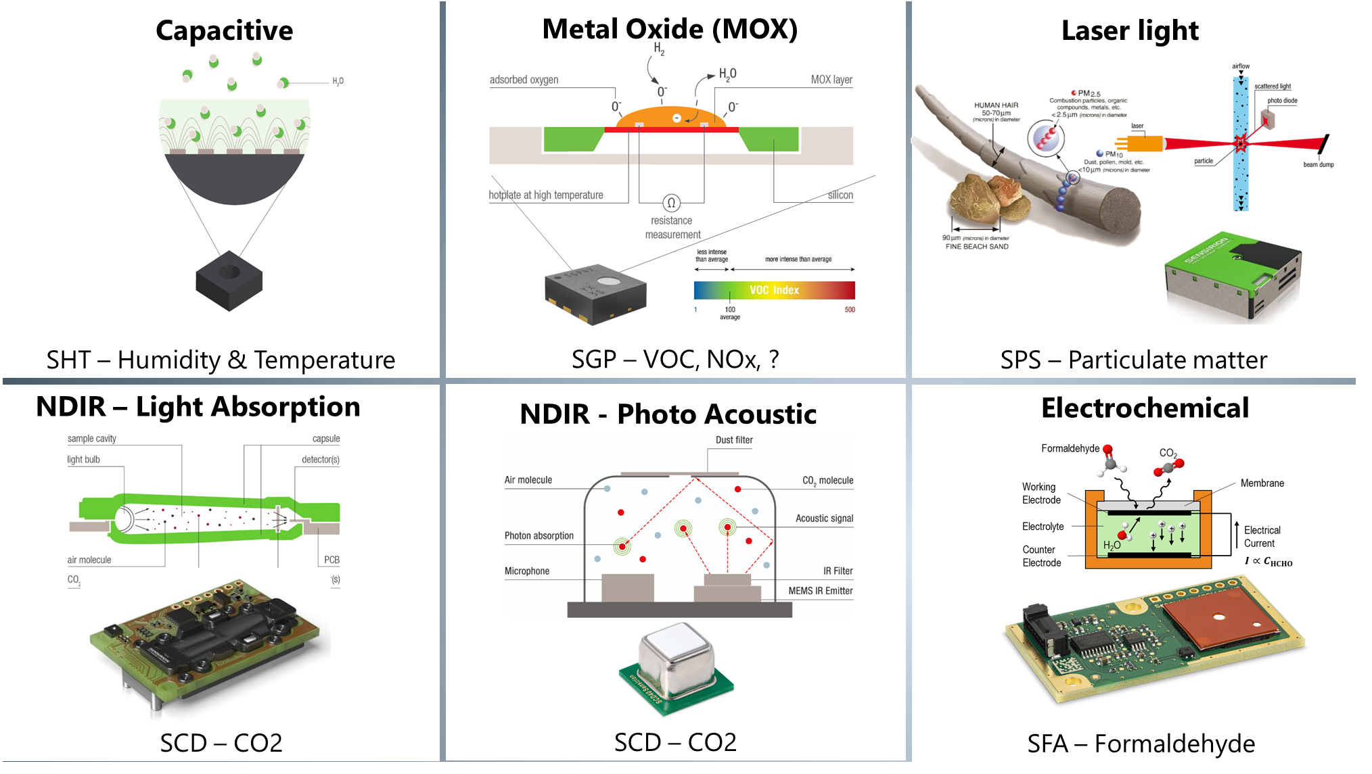
Sensirion has vast technology capabilities and expertise

Slide 15
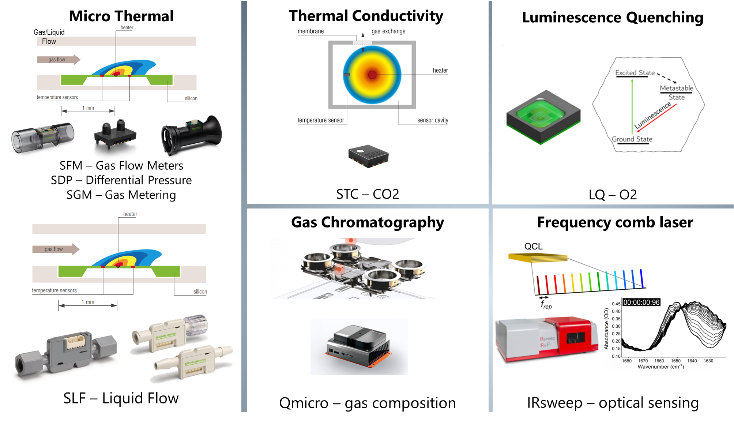
Sensirion has vast technology capabilities and expertise

Slide 16
Indoor Air Quality

Slide 17











Three reasons why we should care about Indoor Air Quality
Hundreds of billions of dollars in federal funds can be used to improve indoor air quality.
Belgium’s “ventilation plan”: CO₂ meters need to be placed in every public room.
Classrooms are equipped with air purifiers including CO₂ monitoring
90,000 CO2 sensors were installed in classrooms across Quebec
So far, schools have received over 300,000 CO2 monitors
Investing €500m in improving ventilation systems
  > 50 %
  3.2 million
  of COVID-19 infections are associated with bad indoor air quality
  people die each year as a result of indoor air pollution exposure
  + 61 %
  Cognitive performance increase in good vs. bad indoor air
96%
of homes have at least one indoor air quality problem
Most people spend
90% of their time indoors
17

Slide 18






Indoor Air Quality Trend is a great business opportunity
  Rapidly growing market.
  Even ‘small’ projects can result in large revenue (illustrative Example):
  Application: Air Purifier
  End customer: Schools
  Annual volume: 5 k units
  Sensors: SEN54 (sale price: USD 17.50)
  SCD42 (sale price: USD 20.00)
  Annual $: USD 187’500
  Many new air quality sensor slots.
  Short project support phase.
“The megatrend towards clean indoor air combined with Sensirion’s competitive air quality sensor portfolio represents a unique opportunity for large business grow in a short time”

Slide 19
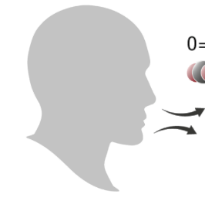

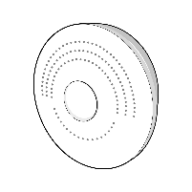
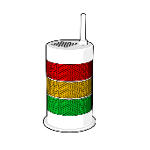
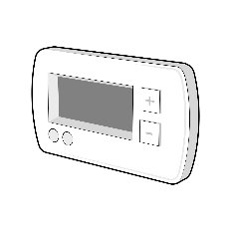







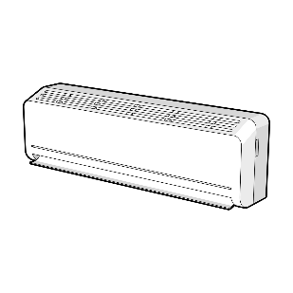
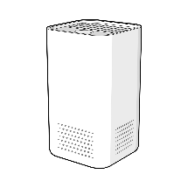




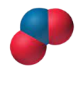
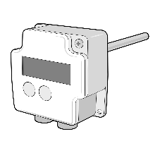





Indoor Air Quality: Sources, Pollutants, and how to improve
Carbon Dioxide (CO₂)
Monitor → Understand
Aerosols / Pathogens
Volatile Organic Compound (VOC)
Filter → Clean
Formaldehyde
Mold
Carbon Monoxide
Nitrogen Oxide (NO_{x})
Ventilate → Dilute
Particulate Matter (PM_{x})
Pollen / Allergens (PM_{x})

Slide 20








What are the key parameters to evaluate air quality?
Particulate Matter (PM)
Nitrogen Oxides (NOx)
Carbon Dioxide (CO2)
- Mixture of solid particles and liquid droplets
- They can be inhaled and cause serious health problems.
- Originate from the burning of fuel and as result of combustion.
- Irritate airways in the respiratory system
- High CO2 levels ​cause health symptoms, reduced cognitive performance and compromised well-being
PM10
PM2.5
PM1
PM0.1
Volatile Organic Compounds (VOCs)
Humidity and Temperature (RHT)
- Some VOCs are dangerous to human health (toxicity and long-term effects)
- RH and T affect daily performance, comfort, and virus/bacteria transmission.

Slide 21






Which applications should we focus on?
Air Quality Monitor
How to measure?
Capacitive
  Call to action for building owners and operators:
  “basic principles and general actions recommended to improve indoor air quality (IAQ) in buildings and reduce the risk of airborne spread of viruses and other contaminants”
HVAC
1
2
Create Action Plan
Optimize Air Ventilation
3
4
Enhance Air Filtration
Get your community engaged
Air Cleaners

Slide 22







Sensirion: reliable one-stop-shop for Indoor Air Quality sensors
CO2
SCD4x CO₂ Sensor
Photoacoustic NDIR Technology
63%
+80%
PM2.5
NOx
RCHO
VOC
RH/T
H
Faster lead-time than industrial average
Output increased
from 2019 to 2021
SEN5x Environmental Node
SFA30 Formaldehyde Sensor
Electrochemical Technology
Industrial average: 43 weeks, Sensirion: 16 weeks

Slide 23






Leverage SHTxx reputation to upsell air quality sensors

Slide 24






All you need to know about Indoor Air Quality in a single presentation
https://partners.sensirion.com/
Applications
Products
Pollutants / Technologies
Go to presentation

Slide 25







Six take home messages to remember
  Bad indoor air quality is a severe, global threat to human health & productivity.
  Three applications to focus on: HVAC, Air Cleaners, and IAQ Monitors.
The megatrend towards clean indoor air represents a gigantic business opportunity.
Relevant IAQ information available on Partner's Access
  Sensirion has an extremely competitive and complete IAQ sensor portfolio.
  Watch public webinar “Indoor air quality: trends and market opportunities” to expand your knowledge

Slide 26




Four trends that shape Indoor Air Quality in 2022 and beyond
Public Awareness is skyrocketing
Governments become active IAQ-players
Corporates realize the economics of IAQ
Climate Change affects IAQ and vice-versa

Slide 27






Six business opportunities for measuring Indoor Air Quality
Reduce airborne transmission
Boost energy efficiency
Comply w/ governmental regulation
People presence / density
Healthy building standards
Boost comfort / well-being

Slide 28
Combo Module
Sensor

Slide 29








SEN5x – Sensirion’s Next Generation Air Quality Combo Module
Temperature
Particulate Matter
Humidity
Gas pollutants
VOC & NO_{x}
Algorithms integrated
Fast hardware design
Dust-protection &
Long Lifetime

Slide 30














How to measure PM, VOC, NOx, RH, and T if not with the SEN5x Node?
Particulate Matter
Volatile Organic
Compounds
Humidity
Nitrogen Oxides
Temperature
Notes:
Know that I introduced these 5 parameters, let’s talk about how to measure all of them.
You will need 5 separate sensors to address them, in addition they need to be connected with cables and controlled with electronic cards and PCBS

Slide 31
Particulate matter - USPs and specs
  Same PM performance as SPS30
  High precision over a wide range of aerosols
  Patented sheath-flow dust resistance
  Best-in-class precision
  Quiet operation
  Mass concentration range: 0-1000 µg/m3
  Resolution: 1 µg/m3
  Precision PM1, PM2.5: ±5 µg/m3 + 5% @ 0 to 100 μg/m³
  ±10 % @ 100 to 1000 μg/m³
  Precision for PM4, PM10 ±25 µg/m3 @ 0 to 100 μg/m³
  ±25 % @ 100 to 1000 μg/m³

Slide 32

Product Variants – SEN5x Product Family
SEN55 – PM, RHT, VOC, NOx
all-in-one solution for high-end APs & IAQ monitors
SEN54 – PM, RHT, VOC
all-in-one solution for most APs & IAQ monitors
SPS50 – PM
focus solely on particulate matter
Identical dimensions for all variants
Compatible firmware & driver

Slide 33

Key SEN5x Combo Sensor Features
Algorithms integrated
Temperature compensation
VOC/NO_{x} Index calculation
Humidity compensation
Fast hardware design
Optimized and tested flow channel geometry
Optimized and tested design-in example
Dust-protection & long lifetime
Sheath-flow technology
High quality components (incl. SHT and SGP)

Slide 34
Integrated Algorithms – RH/T, PM, and VOC/NOx Sensors
Communication NOx sensor
Communication RHT sensor
Customer microcontroller
Communication PM sensor
Communication VOC sensor
RHT
VOC Index
T Compensation
PM
NOx Index
VOC
NOx

Slide 35










Accelerate the design-in process
Adapter cable
Jumper wire set
SEN5x environmental node
Quicker software design due to the single interface and implemented algorithm
Simplified engineering by optimized flow control and sensor compensation
SEN5x
Quicker and more compact design of multiple components

Slide 36
Competition and market dynamics
  Main competion: PM-only (price pressure): Call to Action here is to….
  → Push Sensirion’s combo approach and solution.
  Competitors are launching combo sensors
  → Sensirion’s first mover - advantage and expertise. Underline our added values with sensor fusion.
  What is our differentiation
    Performance (D2D, binning)
    Lifetime and dust resistance
    Combo approach
    Facilitate the design-in
    Integrate more and more sensors…

Slide 37









SENxx – PM2.5 Sensors and Environmental Nodes
SPS30:
PM
SEN5x: “Accelerate time-to-market while reducing the total cost of ownership”
Unique Selling Points
Long-life time
Superior D2D
Fast Design-In
Temperature Acceleration Algorithm
SEN55:
    PM1, PM2.5, PM4, PM10
    RH & T
    VOC & NO_{x}
SEN5x:
PM, RHT, VOC, NOx
NO_{x}
yes
no
($)$$
SEN54:
    PM1, PM2.5, PM4, PM10
    RH & T
    VOC
RHT & VOC
yes
https://www.youtube.com/watch?v=ZWgm5ve_lsY
$$
How to Evaluate
Useful Links
no
SEN50:
    PM1, PM2.5, PM4, PM10
Tutorial SEN5x Eval. Kit
Size irrelevant
yes
SEK-SPS30
SEK-SEN5x + SEK-SensorBridge
no
$
Basic Documents
Datasheet SEN5x
Datasheet SPS30
Engineering guidelines
Handling Instructions
Mechanical assembly guidelines
SPS30:
    PM1, PM2.5, PM4, PM10
Drivers
Arduino Driver
Embedded Driver
Raspberry Pi Driver12
Temperature acceleration and compensation instructions
$$

Slide 38


Slide 39



Slide 40


Slide 41








SGP4x – VOC and NO_{x} Multipixel Gas Sensors
SGP4x: “Sensirion facilitates the design-in and handling of the challenging MOX technology for its customers”
Selectivity/
absolute
concentration?
Check out Sensirion’s other gas sensors products: SCDxx, SFA30
yes
Customer Value Proposition
Reliable user experience throughout lifetime thanks to siloxane resilience
Save design-in and BOM costs thanks to proven multipixel technology
Optimal, customized user experience thanks to tunability of best-in-class algorithms
no
SGP41:
    VOC (indoor air pollutant)
    NO_{x} (indoor + outdoor air . pollutant)
VOC + NO_{x}?
yes
no
$$
SGP40:
    VOC (indoor air pollutant)
https://www.youtube.com/watch?v=ZWgm5ve_lsY
$
Useful Links
Basic Documents
Datasheet SGP40
Datasheet SGP41
Handling and Assembly Instructions
Design-In Guide
Quick Testing Guide SGP40
Quick Testing Guides SGP41
Drivers & Tools
Drivers SGP4x
Drivers SVM41
Technical Description SEK-SVM4x
I²C Interface Description SVM41
UART Interface Description SVM41
Reference Design SVM41
https://www.youtube.com/watch?v=ZWgm5ve_lsY
How to Evaluate
Tutorial: Introduction
Tutorial: tuning of the algorithm
SEK-SVM4x
landing page

Slide 42


SFA30 – Formaldehyde Sensor
“Win customer trust with unprecedented sensor accuracy in the field”
Improve indoor air quality with the help of an SFA30 formaldehyde sensor
Optimised for low-ppb detection of formaldehyde in an indoor environment:
Meets WHO recommendations
Ideally suited for air purifiers and indoor air quality monitors
Key Features
Low cross-sensitivity to common indoor VOCs, e.g. EtOH <0.5%
Long lifetime of >6 years
Integrated RHT sensor
SFA30:
HCHO sensor
Formaldehyde sensing made easy
https://www.youtube.com/watch?v=ZWgm5ve_lsY
How to Evaluate
Useful Links
SEK-SFA30
Basic Documents
SFA30 Flyer
Datasheet SFA30
Handling and Assembly Instructions
Design-in Guide
Drivers & Tools
Arduino Driver I2C
Arduino Driver UART
RaspberryPi Driver I2C
RaspberryPi Driver UART
Embedded Drivers

Slide 43




Possible IAQ Applications
Air Treatment (includes air purifiers, humidifiers, dehumidifiers, air conditioners, PTAC, HVAC Systems, vent hoods, fume hoods, exhaust fans in bathrooms)
Air Quality Monitors (Wall mount sensors, IAQ device/monitors that plug into smart speaker, mobile phones, etc.)
Air Purifier
De-Humidifer
Sensor Node
Smart Air Quality Monitor

Slide 44













Summary
SPS30
VOCs
NO_{x}
CO₂
PM2.5
SEN5x
Highest number of different sensors in a node ever
Highest performance in final product
Air quality parameters
SEN5x
Simplest and quickest hardware and software implementation
Compact solution
Fast go-to-market
Robust supply chain
Applications and Markets
Success stories

Slide 45



Demonstrations – Seeing is Believing
SEK-SEN5x
SEK - SensorBridge
SEK - ControlCenter

Slide 46

































IAQ Application Overview: Clean Air in Buildings Challenge
Call to action for building owners and operators:
“basic principles and general actions recommended to improve indoor air quality (IAQ) in buildings and reduce the risk of airborne spread of viruses and other contaminants”
Create Action Plan
Optimize Air Ventilation
Enhance Air Filtration
Get your community engaged
1. Indoor Air Quality Monitor
“Ideally there’d be some machine that beeps if the virus is in the air; CO₂ is something that provides an affordable and very meaningful shortcut.” ^{[1]}
2. HVAC Systems
«ventilation can reduce COVID-19 infection risk by up to 80 %»^{[2]}
3. Air Purifier
“Portable HEPA cleaners usage allowed the removal of SARS CoV-2 […] displaying a 80% device effectiveness” ^{[3]}
https://www.epa.gov/system/files/documents/2022-03/508-cleanairbuildings_factsheet_v5_508.pdf
MERV-13
> USD 10 Billion of ARPA funding available
Notes:
1 Jose-Luis Jimenez, aerosol scientist at the University of Colorado Boulder, New York Times Article October 11, 2021
2 <https://www.reuters.com/world/europe/italian-study-shows-ventilation-can-cut-school-covid-cases-by-82-2022-03-22/>
3 https://www.sciencedirect.com/science/article/pii/S0048969721023718

Slide 47




Indoor Air Quality Monitoring
yes
Targeted pollutant?
Market Overview​
USD 4.5 Bn Market in 2021​
8% growth per year expected until 2025​
Fragmented market with many players
no
High-end monitor?
yes
SEN54 / SEN55
(PM2.5, RH, T,
VOC, NOx)
SCD40 / SCD41
(CO₂)
Low power
+
no
Mid-end monitor
yes
SEN54 / SEN55
(PM2.5, RH, T,
VOC, NOx)
Environmental Sensors are the core
IAQ monitors enable users to know the quality of the air they breathe. With this knowledge, end users can take action to improve their environment, such as opening a window or running an air purifier.
Clean air has a positive long-term impact on health and also brings immediate benefits, such as greater mental clarity and concentration.
no
Low-end monitor
yes
SGP40 / SGP41
(MOX)
SHT4x
(Humidity and Temperature)
+
CO2
PM
VOC (+NOx)
SCD40 / SCD41
(CO₂)
Low power
SEN50
(PM2.5)
SGP40 / SGP41
(MOX)

Slide 48





HVAC Systems (Heating, Ventilation, and Air Conditioning)
Market Overview
USA market is $16.54bn in 2021 with an expected 5.6% CAGR to 2030.
Segmented in Cooling (50%), Heating (35%) and Ventilation (15%).
Key trends:
Energy efficiency: Demand-controlled ventilation
Global warming: Change of refrigerant
Indoor air quality: COVID-19, health, and productivity
Key players: Carrier, Lennox, Mitsubishi, Daikin, Johnson Controls, Trane, Emerson. Moderately consolidated market
Heating/ Cooling
yes
Humidity and Temperature
SHT4x
Outdoor air intake?
yes
Environmental node (PM2.5, VOC, NOx)
SEN55 (+SCDxx)
Ventilation
yes
Carbon Dioxide (CO2)
SCD30
SCD4x
Sensors make HVAC systems energy efficient and performant
Cooling / Heating
RH&T sensors feedback environment information to the BMS
Norms are pushing towards more climate-friendly refrigerant gases that must be controlled for safety (leakage detection).
Ventilation
Demand-controlled ventilation based on CO₂ sensor readings optimize ventilation’s energy efficiency and indoor air quality.
Variable Air Volume
The airflow is controlled with variable air volume controllers that leverage differential pressure sensors
Smart Thermostat
yes
Volatile Organic Compounds
SGP40 (+SCDxx)
Variable Air Volume
yes
Differential pressure
SDP8x
Variable Air Volume (VAV)
Demand-controlled ventilation (DCV)
Notes:
Optimize energy consumption (reduce indoor air intake), VAV controllers (demand controlled ventilation with SDP and CO2), know when to pull in outside air (CO2, VOC)
Know when to pull-in outside air (which is not always clean)
ASHRAE 62.1 (contaminants of concern and limits for acceptable IAQ), LEED, WELL,
Sources
U.S. HVAC Systems Market Size Report, 2022-2030 (grandviewresearch.com)

Slide 49


Air Purification
Market Overview
USD 10 Bn Market in 2021
10% growth per year expected until 2030
Fragmented market with many players
Regional differences in which air pollutants are relevant for the customer
no
SEN50
(PM2.5)
Filters VOCs? *
yes
SEN54 / SEN55
(PM2.5, RH, T, VOC, NOx)
Upselling Opportunities
End-customer: Schools/offices?
High-end / catalytic filter?
Filter monitoring?
Sensors enhance user experience and function
User gets feedback on AP performance
Automated fan control reduces energy consumption and noise emission
Filter monitoring ensures performance and reduces cost of ownership
Sensors enable smart features in premium APs
+ SCD40
(CO₂)
+ SFA30
(Formaldehyde)
SDP810
(Differential
Pressure)
* Activated carbon, ionization, ozone
Links
Air Purifier
IAQ Brochure

Slide 50
Carbon Dioxide
Sensors

Slide 51













Why Measure CO₂ Concentration?

Slide 52







Viral Infections: Source and Impact of CO₂
Humans increase CO2 concentration in confined spaces
Viral particles are attached to water droplets exhaled along with CO2
High CO₂ levels can be an indication of airborne viruses

Slide 53


Measuring CO₂ Levels to Reflect Medical Risks
  Minor Medical Symptoms
    Mood swings, anxiety, nausea, headaches
    Lethargy and drowsiness
    Decreased cognitive ability (CO2 > 750ppm)
  Major Medical Threat
    Studies revealing correlation between levels of exhaled CO2 and risk of catching COVID-19

Slide 54







Sensirion CO₂ Sensor Portfolio
STC31
SCD30 / SCD4x
0.1 %
1 %
10 %
100 %
10 ppm
100 ppm
1’000 ppm
10’000 ppm
Log CO₂ concentration
HVAC / Demand-Controlled Ventilation
Indoor Air Quality Monitor
CO₂ Traffic Lights
Smart Home / Consumer Electronics

Slide 55










Sensirion CO₂ Sensor: More Use Cases & Applications
IAQ Monitoring Device
Industrial Safety / Leakage
Demand Controlled Ventilation
Incubator
Greenhouse
Fat Burning
Battery Management System
Food Storage / Cargo
Grain Bin / Agricultural
STC31
SCD30 / SCD4x
0.1%
1%
10%
100%
10 ppm
100 ppm
1’000 ppm
10’000 ppm
© Copyright Sensirion AG, Switzerland
Confidential

Slide 56




Why can Sensirion deliver while competitors cannot?
→ Critical SCD4x components are produced by Sensirion
Sensirion MEMS IR emitter to realize fast emittance modulation and high long-term stability
Sensirion ASIC leverages advanced signal processing to ensure highest accuracy and lowest noise level
Sensirion humidity and temperature sensor - Superior RH and T compensation to realize accurate readings across entire RH and T range
© Copyright Sensirion AG, Switzerland

Slide 57



SCD4x - Before breaking the rules you must master them
SCD30
success story
SCD4x miniature CO₂ sensor
Dual channel NDIR CO₂ sensor
Highest performance and superior long-term stability
Integrated temperature and humidity sensor
Thinnest package on the market
SCD4x mission: break the size and cost barrier to revolutionize the CO₂ sensing market to enable new use-cases
SCD4x powered by novel photoacoustic sensing technology: PASens®
Integrated temperature and humidity sensor
© Copyright Sensirion AG, Switzerland
Confidential

Slide 58


SCD4x: a truly disruptive CO₂ sensor
  SCD4x Features
Smallest CO₂ sensor: 10 x 10 x 7 mm³
Up to 10 times smaller than other CO₂ sensors!
© Copyright Sensirion AG, Switzerland
Confidential

Slide 59



SCD4x: a truly disruptive CO₂ sensor
  SCD4x Features
Smallest CO₂ sensor
SMD soldering, tape & reel package
Automated, low cost and reliable assembly
© Copyright Sensirion AG, Switzerland
Confidential

Slide 60





SCD4x: a truly disruptive CO₂ sensor
  SCD4x Features
Measurement range:
0 ppm – 40’000 ppm
Accuracy:
±(40 ppm + 5%)
Fully calibrated and linearized output
Digital I²C interface
Smallest CO₂ sensor
SMD soldering, tape & reel package
Great sensing performance
Highly selective, on-chip RH/T compensation
© Copyright Sensirion AG, Switzerland
Confidential

Slide 61




SCD4x: a truly disruptive CO₂ sensor
  SCD4x Features
Smallest CO₂ sensor
SMD soldering, tape & reel package
Great sensing performance
Unmatched sensor robustness
Robust against mechanical stress, condensation and dust
© Copyright Sensirion AG, Switzerland
Confidential

Slide 62


SCD4x: a truly disruptive CO₂ sensor
  SCD4x Features
Smallest CO₂ sensor
SMD soldering, tape & reel package
Great sensing performance
Unmatched sensor robustness
Large supply voltage range: 2.4 V – 5.5 V
Features low power mode and single shot mode
Includes RH and T output signal
Highest sensor versatility
© Copyright Sensirion AG, Switzerland
Confidential

Slide 63







SCD4x Product Family Upgrade
SCD40
SCD41
SCD42
Drop-in replacement from 04.2023
SCD40
SCD41
NRND
+ higher peak reflow soldering temperature
+ 2nd source microphone for supply chain resilience
+ laser marking for easy identification

Slide 64

Sensirion SCD30 and SCD4x Roadmap
samples
available
SOP
NRND
EOL
2020 | 2021 | 2022 | 2023 | 2024 | 2025
S
NDIR Gas Sensing
SCD30 – CO₂
New features implemented
Photoacoustic Gas Sensing
SCD40
Samples 02.2023
SCD41
New SCD41 compliant with relevant norms
S
SOP 04.2023
Last time buy
30.06.2023
SCD42
Last shipment 30.09.2023

Slide 65
SCD4x CO₂ Accuracy Specifications
CO₂ Concentration Range: | 400 -1000 ppm | 1001 – 2000 ppm | 2001 – 5000 ppm
SCD40 (no change) | ±(50 ppm + 5% of reading) |  | Not specified
SCD41 today | ±(40 ppm + 5% of reading)
SCD42 today | ±75 ppm | ±(40 ppm + 5% of rdg.) | Not specified
New SCD41 (April ‘23) | ±(50 ppm + 2.5% of rdg.) | ±(50 ppm + 3% of rdg.) | ±(40 ppm + 5% of rdg.)

Slide 66


Why SCD41? ‘California Title 24’ Compliance
“California Title 24” facts and relevance
Building Energy Efficiency Standards for Residential and Nonresidential Buildings
“[…]The Standards contain energy and water efficiency requirements (and indoor air quality requirements) for newly constructed buildings, additions to existing buildings, and alterations to existing buildings […]”
Other US states adapted (parts) of the Californian Title 24
Requirement on CO₂ sensor: Section 120.1 – 4 F
“CO2 sensors […] accurate within plus or minus 75 ppm at a 600 and 1000 ppm concentration […] to require calibration no more frequently than once every 5 years [...]”
© Copyright Sensirion AG, Switzerland

Slide 67
New SCD4x CO₂ Accuracy Specifications
RESET Standard
±(50 ppm + 3% rdg) between 400 - 2000 ppm CO₂
±(50 ppm + 5% rdg) between 2001 - 5000 ppm CO₂
California Title 24
±75 ppm between 400 - 1000 ppm CO₂

Slide 68
Existing SCD40 Customer Points
  Increase of peak reflow soldering temperature from 235°C to 245°C
  2nd source microphone for supply chain resilience
  Laser marking on cap for product identification
  No material number change: current customers receive all the benefits without any hassle
  Only new visual appearance (laser marking) for current customers from April 2023*
  No price change
  Customers don’t need to change anything!
  Timeline
    12.2022: Distribute Infonote to customers
    04.2023*: SCD40 shipments with changes
    * Exact date of implementation will depend on supply/demand situation.

Slide 69
Existing SCD41 Customer Points
  Increase of peak reflow soldering temperature from 235°C to 245°C
  2nd source microphone for supply chain resilience
  Laser marking on cap for product identification
  Improved specifications below 2000 ppm to meet California Title 24 and RESET Standard
  No material number change: current customers receive all the benefits without any hassle
  New visual appearance (laser marking) and improved specifications for current customers from April 2023
  No price change
  Customers don’t need to change anything!
  Timeline
    12.2022: Distribute Infonote to customers
    02.2023: Updated datasheet and samples available
    04.2023: SCD41 parts shipped will meet new datasheet specifications.

Slide 70
SCD42 Customer Points
  Obsolesce due to improved SCD41 specifications
  Datasheet and SCD41 samples with improved specifications available February 2023
  SCD41 available as a drop-in replacement from April 2023
  SCD42 customers get more with improved SCD41 (wider accuracy range, RESET-compliance)
  Open PO’s can be shifted to SCD41
  Customers must update their systems to order the SCD41 instead of the SCD42 starting from April 2023.
Timeline
12.2022: not recommended for new designs (NRND), distribute Infonote to customers
30.06.2023: last time buy (LTB)
30.09.2023: last time ship (LTS)

Slide 71
Distribution Points
Only positive enhancements to SCD4x portfolio
Specification improvements to SCD41 lead to obsolesce of SCD42
Inventory advice:
  Run out stock on current SCD41, SCD42 and SEK-SCD41
  Current stock does not need to be scrapped
  Any open SCD42 PO’s outside frozen window can be adapted to SCD41
  No material number change: announcement of first new SCD41 shipments possible

Slide 72





SCD4x CO₂ Sensor Strategy
Customer Requirements
UART or PWM?
SCD30 - Highest accuracy, long-term stable variant
yes
Markets: HVAC, High-end monitors
Regions: global
no
BS EN 50543
Relevant Standard?
yes
CA Title 24
WELL
SCD41 - Low power, air quality standard variant
no
RESET
Markets: HVAC, IAQ-Monitors
Regions:
Low Power?
yes
no
Extended Spec. Range?
yes
SCD40 - Product variant for cost sensitive markets
Markets: Consumer, Appliances
Regions: global
no

Slide 73



















Why SCD40?
tomorrow
yesterday
today

Slide 74



Resources: www.sensirion.com/my-scd-ek
Quick Start Guide Evaluation Kit
Important Documents Evaluation Kit SEK-SCD41
SEK-SCD41 Technical Description
SEK-SCD41 STEP File
Important Documents SCD40 and SCD 41
Documentation
Datasheet SCD4x
SCD4x STEP file
SCD4x Altium Footprint
Handling Instructions
Design-In Guideline
Testing Guideline
Overview: The most important Design-in Recommendations
Good coupling to ambient
Decoupling from vibration sources
Shielding from direct sunlight
a
c
e
Isolation from air turbulences
Decoupling from external heat sources
Ensure stable supply voltage
b
d
f
© Copyright Sensirion AG, Switzerland
Confidential

Slide 75









SCDxx – Optical Carbon Dioxide Sensors
SCD30 - Highest accuracy, long-term stable variant
Markets: HVAC, High-end monitors
Regions: global
SCD30: State-of-the-Art Transmissive NDIR Sensor
Highest Accuracy: ± (30 ppm + 3%)
Dual Channel detection for superior long-term stability
SCD4x: Miniature Photoacoustic NDIR Sensor
World’s smallest optical CO₂ Sensor
SMD solderable: Enables cost-efficient and highly reliable automated manufacturing
UART / PWM
yes
no
BS EN 50543
Relevant Standard
yes
no
CA Title 24
WELL
https://www.youtube.com/watch?v=ZWgm5ve_lsY
RESET
How to Evaluate
Useful Links
Tutorial SCD4x SEK
SEK-SCD30 + SEK-SensorBridge
SEK-SCD4x + SEK-SensorBridge
Tutorial Control Center
Low Power Mode?
yes
SCD41 - Low power, air quality standard variant
Markets: HVAC, IAQ-Monitors
Regions:
Basic Documents
SCD40 & SCD41 Datasheet
SCD42 Datasheet
SCD4x Design-In Guide
SCD4x Handling Guide
SCD30 Datasheet & Interface
no
Drivers & Tools
SCD4x Arduino Driver
SCD4x Embedded Driver
SCD4x Raspberry Pi Driver
SCD30 Sample Code
Extended Spec. Range?
yes
SCD40 - Product variant for cost sensitive markets
no
Markets: Consumer, Appliances
Regions: global

Slide 76


Demonstrations – Seeing is Believing
SEK - SCD4x
SEK - SensorBridge
SEK - ControlCenter

Slide 77







Summary for SCD4X
  CO₂ is a good proxy for indoor air quality. High CO₂ concentration compromises our well-being, cognitive performance and health.
  The SCD4x is available now! High volumes have been shipped to lead customers throughout 2021.
  Sensirion’s miniaturized CO₂ sensor SCD4x based on the PASens® technology breaks the size barrier to enable wide-spread adaptation of CO₂ sensing.
  The SEK-SCD41 evaluation
  kit enables easy sensor evaluation and prototyping. Documentation, drivers
  and tutorials: www.sensirion.com/my-scd-ek
© Copyright Sensirion AG, Switzerland
Confidential

Slide 78





Top-five CO₂ Market Opportunities for CO2 Sensors
Air purifier with CO₂ sensor
Air purification & CO₂ monitoring to prevent Covid-infections
Hot topic in Asia (subsidized)
CO₂ output as differentiator
Connected consumer electronics devices
Public awareness for IAQ and CO₂ exploded
Small formfactor and lower price point make CO₂ tangible for consumer applications
Commercial and Residential HVAC systems
Large, sustainable market
Competitors cannot deliver
High price-point: large driving factor to switch sensor
CO₂ traffic lights
Increasing number of national norms/standards
Commercial buildings following
Availability is often key
Greenhouse CO₂ monitoring / supplementation:
Efficiency gain > sensor costs
Cannabis legalization US
Often SCD30 best suited
© Copyright Sensirion AG, Switzerland

Slide 79







Five reasons why the SCD4x is ahead of its competitors
Smallest CO₂ sensor →
Maximum freedom of design
SMD soldering, tape & reel package →
Highly automated manufacturing
Optical, highly selective technology →
Stable, reliable sensor output
Large supply voltage range: 2.4 V – 5.5 V →
No need for additional circuitry
Market proven & large production capacity →
Large volumes available with short lead time
© Copyright Sensirion AG, Switzerland
Notes:
Very good market reception across markets and regions
Distribution running hot
Highly automized production line for high volumes running since January 2021

Slide 80
Humidity and Temperature
Sensors

Slide 81









4^{th-}Generation RH/T Sensor Product Portfolio
Markets / Applications
High-End Measurements
Industrial
HVAC
Medical
Data Loggers
HDD
Mobile Devices
Automotive
Home Appliances
IoT
Consumer Electronics
Product Lines
SHT85
SHT4x / STS4x
SHTC3
SHTC1
2.4 – 5.5 V
I2C
~19.5 x 5.5 x 2.2-3.5 mm³
2.4 – 5.5 V
I2C, analog voltage
2.5 x 2.5 x 0.9 mm³
1.6 – 3.6 V
I2C
2 x 2 x 0.75 mm³
1.8 V
I2C
2 x 2 x 0.75 mm³
1.3 x 0.7 x 075 mm³
Sensor Products
(accuracy)
SHT85
SHT45
SHT41
SHT40 / STS40
SHTC3
SHTC1
Protection
Options
Membrane
SF4 / Opt. Prot. Cover / Opt. Membrane (Coming Soon)
Evaluation Kits
SEK-Environmental Sensors
Notes:
Notes:
3 different accuracy grades: 4.5, 3, 2%RH

Slide 82


SHT4x / STS4x – Key Selling Points
  100% calibrated
  → Unparalleled accuracy and precision
  Available in a variety of form factors, with protective membranes and covers
  → Versatile solutions
  Highest volume in the market, trusted for 15+ years
  → Lowest total cost, unmatched reliability and reputation
  Temperature Compensation Engine
    → Independent of heating from surrounding board elements
    → Best performance and stability
  Powerful Internal Heater (NEW to SHT4x)
    → Allows for decontamination in-service
Notes:
Little to no variation across devices, what you see is what you get
Highest volume in the market, makes Sensirion one of the most
cost-effective choices
Having been in this market for so long, we’ve developed a reputation, people know us and people seek us out
Independent of heating from WiFi capability, large displays, etc.

Slide 83
SENSIRION
Cold Chain Solution
SHT43

Slide 84



Cold Chain Certification
What is Cold Chain?
The control and monitoring of temperatures throughout the cold chain are very important issues regarding the quality of goods. It is mostly used for the transportation of food and beverages or pharmaceuticals.
In order to ensure that the products are kept at adequate temperatures and humidity (for vaccines per WHO), continuous monitoring of sensitive goods throughout the entire supply chain from start to finish is required.
These temperatures are recorded for continuous control purposes, in order to meet numerous industry standards.

Slide 85




Why Certification: Regulated End-to-End Monitoring
Manufacturing
Transport
Storage
Distribution
Continuous monitoring required
  EN 12830
  Reliable temperature recorders for the transport, storage and distribution of temperature sensitive goods
3-point calibration (full range), calibration competence acc. to ISO17025
  ISO 17025
  General requirements for the competence of testing and calibration laboratories
Calibration method & traceability

Slide 86





Trusting is Hard… Knowing Who to Trust Even Harder
External calibration lab
Some sensor
Components
Assembly
Calibration
Certification
Belive-me-it’s-true (BMIT)
Components
Assembly
Calibration
Certification
Sensirion became the first ISO17025 accredited semiconductor company in the world!

Slide 87




Roadmap – SHT43
Accreditation number: SCS 0158
Key product specs
Timeline
T acc (with ISO 17025 certificate) | ±0.48 °C max.
T drift | < 0.01°C / yr.
RH acc | 1.8%RH (typ), 3.5%RH (max)
Supply voltage | 1.08 to 3.6 V
Idle Current | 80 nA
Av. Current @ 1 Hz | 0.4 µA
calibration temperatures
Sept. 5th 2022 | Internal ISO17025 audit passed; up to 2000 additional samples available.
Oct. 2022 | Official ISO17025 re-audit. SHT43 process final and approved.
Nov. 2022 | Start of production; up to 90 kpcs final SHT43.
Dec 2022 | Ramp-up phase; up to 100 kpcs final SHT43.
Feb. 2023 | Standard production with lead time; any volume available.

Slide 88




Why Does Sensirion Win in IoT of Supply Chain ?
Key Takeaways
ISO17025-calibrated RH/T sensor
  NIST traceability
  Not beholden to a single EMS
Innovative sensor solutions (high concentration CO2 applications )
Very competitive pricing for high end data loggers
Top tier application support on a global scale
Benefits other applications incl. Datacenters
Sensirion Humidity and Temp (SHT43/STS33)
Shows ambient conditions in real time
NIST Traceable
Digital
Fully calibrated
Best cost/performance ratio
Transport of pharmaceutical goods (sensirion.com)

Slide 89




What‘s the Right SHT4xX for my Customer?
USP
automotive?
Most used automot. RHT component in the industry
High reliability with >10 years track record
yes
SHT4xA
no
5V VDD?
SHT4xI-Digital
Most widely used 5V RHT component in the industry
Customer’s
Special Requirements?
yes
no
analog output?
Most widely used analog RHT compon. in the indust.
Customizeable analog output characteristic
yes
SHT4xI-Analog
no
high accuracy?
SHT41/45
Best RH&T accuracy on the market
>15 y track record for accur. & long-term stability
yes
no
pin type package?
SHT85
Mounting option remote from main board
Easy design-in & easy replaceability
yes
SCC30
no
SHT40
1.08 - 3.6V voltage range
Low power consumption
High accuracy over a wide RHT range
Proven SHTxx robustness and long-term stability
1.5x1.5x0.5 mm³ DFN package

Slide 90

Migrate Customers to SHT4x Family

Slide 91







SHT4x – Market Leading Humidity & Temperature Sensor
SHT4x
Unique Selling Points
Technology and Market leader for 20 yrs.
Lowest power consumption
Specialized product variants for various markets & applications
Analog version available
SHT40I-Digital:
    RH & T
    ± 2%RH, ± 0.2°C
    High ESD robustness
VDD=5V
yes
no
($)$
SHT45:
    RH & T
    ± 1%RH, ± 0.1°C
    Sub-µW power
https://www.youtube.com/watch?v=ZWgm5ve_lsY
High-accuracy
yes
How to Evaluate
Useful Links
no
$$$
SEK-SHT40
SHT40:
    RH & T
    ± 1.8%RH, ± 0.2°C
    Sub-µW power
SEK-SHT40I
SEK-Sensorbridge
Breakout Boards: Adafruit SHT40
$
MikroElektronika Temp&Hum 15 Click
Basic Documents
Datasheet SHT4x
Datasheet SHT4xI-Digital
SHT Handling Instructions
SHT Design-In Guide
Drivers & Tools
Embedded Drivers SHT
SW ControlCenter
SHT4x: “mature 4th generation, highest volume technology from market leader. Available in different accuracy gradings, delivering sub-µW power consumption.”

Slide 92
Gas Flow Sensors

Slide 93











Our Gas Flow Sensor Family (SFMxx / SDPxx / SFCxx)
  Ventilation and Anesthesia
  CPAP
  Versatile solutions:
Differential
pressure
Inspiratory
SFM3000
SFM3100
SDP800
SDP810
SDP3x
SFM3200-AW
Expiratory
Gas
Mixing
Flow meter
SFM5400/SFM5500
Flow controller
SFC5400/SFC5500
SFM4300
Flow meter
SFM5300
Flow controller
SFC5300
Mass Flow Meters
and Controllers
Adults
SFM3300-AW/D
Proximal
Neonates
SFM3400-AW/D

Slide 94








Sensirion’s Gas Flow Sensor - Applications
Other Application Ideas
Heart Lung Machine
High Flow Ventilation
Nebulizer
Nitric Oxide
Potential Future High-Volume Applications
Smart Inhaler
Ambu Bag
Hospital Beds
Point of Care

Slide 95




Our Strengths in Ventilation
Digital and Patient-Centric
Broad Sensor Portfolio
Robustness
Superior Accuracy

Slide 96



Differential Pressure Sensor Applications
HVAC Systems
Directional Wind Meters
Medical Systems

Slide 97
Liquid Flow Products

Slide 98








Sensirion’s Liquid Flow Sensor Overview

Slide 99

Sensirion Liquid Flow Products – Typical Applications
1
Volume and Washing Validation
Validate reagent and sample volumes, as well as washing and flushing cycles.
5
Optimized Processes
Constant and optimized processes create stable results and peace of mind.
2
Feedback Loop
Precise flow control, with a sensor and pump feedback loop
4
Detect Drifts and Occlusions
Monitor liquid handling steps to avoid long term changes and drifts. Detect partial or complete occlusion. Added security through failure detection.
3
Leak Detection
Detect leaks and air bubbles in fluidic systems.

Slide 100




Liquid Flow Sensors
  Unique Sensitivity at Lowest Flow Rates
  Microthermal measurement principle similar to Sensirion’s gas flow sensors
  Unobstructed flow path, no moving parts
  Inert wetted materials for optimal chemical and biological compatibility, sensor chip does not contact the liquid.
  Driving innovation at ultra-low flow rates, from nanoliters to milliliters per minute
  Fast response time (<50 ms)
  Successful in biomedical applications, semiconductor manufacturing, and industrial automation
50 nl/min
Sensirion Liquid Flow Rates
1000 ml/min
Drinking Mosquito
ca. 10 μl/min
Drug Injection
ca. 5 ml/min
Espresso Machine
ca. 500 ml/min
Faucet Water Filter
ca. 1800 ml/min

Slide 101



Liquid Flow Applications
    Semicon
    Automation
    Dispense Verification
    (U)HPLC
    Blood Analysis / DNA Sequencing
    Flow Cytometry / Cell Therapy
    Advanced or Portable Drug Delivery
    Biopharmaceutical Processes
    Surgical instruments
Semicon & Industrial Applications
Analytical & Diagnostics
Medical Applications

Slide 102
Evaluation Kits

Slide 103


SmartGadget – How to use in a customer meeting
The SmartGadget is a great way to demonstrate Sensirion’s RH/T and CO2 products:
    Small form factor, fast response time, low power
    Opens discussions around design-in challenges and best-practices
    Has Bluetooth to communicate with Smart Phones
The SmartGadget is a great Marketing tool:
    People love to keep them on their desks; Co-workers will ask about them, helping us gain visibility

Slide 104


Sensor evaluation – Sensor Bridge (Hardware)
Sensirion offers a modular evaluation kit, called “SensorBridge”
  Use-case: valuating component level performance without the need for additional programming
    Simply connect via USB to a computer
    Start measuring, plotting, and logging data with ControlCenter, our free eval SW
  Features two sensor ports, allowing the users to mix and match sensors, based on their needs
  Sensor sets are sold separately so end customers can create their ideal kit
  Available through distribution

Slide 105

Developer Experience - https://developer.sensirion.com/home/
Definition: The experience – positive or negative - an engineer has during the product development journey
Thesis: A positive developer experience leads to a more successful customer product, which leads to follow-up business
Goal: Along with being the technology leader, become the leader in Developer Experience
Notes:
More Successful:
Faster Development Times
Fewer issues / problems
No complaints about performance

Slide 106



Platform partners
Collaborations to ensure Sensirion Sensors work on partner platforms
Examples in this space (all work in progress!):
Joint demonstrators
Driver Support
Product succession

Slide 107








Ecosystem partners
Collaborations to create developer hardware with Sensirion Sensors

Slide 108






Standard platform support
Beyond the partnerships, we are also providing free, open-source drivers for the common embedded architectures and popular programming languages, along with easy-to-port generic drivers that allow engineers to enable new hardware in a few hours

Slide 109


ST Micro Partnership
ST HTS221 has been set to NRND and Sensirion SHT4x is listed as recommended replacement
Transition guide is posted up on their website TN1426 Transition guide for HTS221 to SHT4x.
Distribution has been notified : Please work with your disti contacts to collaborate on potential opportunities
Sensirion is working with ST on a registration program to identify projects that can be worked together across product lines (details coming soon)
Sensirion will provide the official press release when it is issued.

Slide 110
Success Stories
Notes:
3/21/2019 Mike Adams: Usage- 30K pieces per month area once we are approved in full production and Future is uncertain if the customer is using the-C00 or -D00 version. Future had looked at offering and IDT device yet perhaps a more important show-stopper than price, the 7 VDC operating voltage on IDT SGAS711 makes it incompatible as a Figaro sensor (5 VDC) drop-in replacement, significant design change, added regulator & high cost of a UL or ETL recertification. There are direct knock-offs of the TGS-2610 available from Chinese suppliers, but they have yet to be approved. Figaro has had 1 or 2 “hiccups” with their production, which caused a lot of pain for their users, including Jeff. RV’s can’t ship w/o a CO & propane alarm installed. Ripple effects through the whole industry when Figaro can’t keep up with demand. EAS Sales is working to discover answers which will be answered slowly by the customer. Bernd of Sensirion advises the corporate product managers will be in during September and he will have time to review this opportunity with them. Sensirion has posed the following questions which have been posed to the customer in different terminology: Being a drop-in replacement? (is there anything that would convince him to look at redesigning)?
Voltage: our voltage is 1.8V avg (1.62-1.98V) so they could use a regulator, etc. Thru-hole vs. SMT device? Also, Since the voltage is under 12V, I’m not sure UL applies here but I could be wrong.
• Do they use a Gas Mixing Chamber to calibrate or Test their product or device?
• What are ALL the headaches / pain points when working with this Figaro sensor? (sounds like delivery, lead time…but confirm. Any others?)
• What would they like to improve on the Figaro sensor? (any technical specs? Any production/testing/calibration steps that they would like to eliminate? Any field failure issues? Etc.)
• What are ALL his concerns exactly about redesigning the circuit, and WHY?
• Does Figaro provide a Safety related approved product, or do they provide a Component Off-the-shelf and Customer is responsible for the warranty/liability in the application?
Mike Adams is taking Sensirion samples into the customer to have a sensor meeting and gain information regarding all sensor potential at this account and will discuss Sensirion’s CO sensor at this time as well. SEK-SCD30 eval kit has been received and will be brought into the customer for design review.

Slide 111


LI-COR Biosciences Inc: Lincoln, Nebraska
Who: Arrow
FAE: Adam Kiburz
ADR / Sales Person: Courtney Slattery
Ben Heisel: Mel Foster Company
Sensirion Product of Interest: SDP36-500PA-TR
Use case: LI6800 – Portable Photosynthesis System
Competition: NXP – MPXV7025D
Situation (overview of project):
This is a portable mass flow sensor. The LI-6800 Portable Photosynthesis System simultaneously measures photosynthetic gas exchange and chlorophyll a fluorescence over the same area in plants and aquatic samples. It is the global standard for photosynthetic gas exchange and chlorophyll a fluorescence measurements.
Solution (why we won?):
Lead design engineer David Franzen chose Sensirion because he was familiar with our products, our price was in range, and our lead time better than NXP. they needed immediate parts for proto testing and were able to find at Digikey. The SDP36 was approved, and a volume order was placed with Arrow who we approved a registration for. Local support was also a factor. EAU 2500. Project life is 10+years.
Customer Logo
Customer product

Slide 112


Verkada-San Mateo, CA
Who: Arrow
L2, Kris Bugbee
Sensirion Sales and FAE team
Parts: SFA30, SCD42, SEN54, SHT41
Air Quality Monitor
Competition: None
They originally came in September of 2021 to design a low cost, average and high end AQM. We now have Zephyr L, Zephyr M and Zephyr H with production start in May 2022. Between the three products they are using all of the parts noted.
Design support, the right products and pricing within their budget won this family of 3 designs.

Slide 113



NED Group – Newton Engineering : Arizona
Who: Arrow
FAE: Al Duarte
ADR / Sales Person: Jason Schouten
Your Rep Firm: Spectrum Marketing
Sensirion Product of Interest: SPS30, SCD30, SGP40-D-R4, SHT40-AD1B-R2
Use case: Air Quality Sensor Module
Competition: None
Situation (overview of project): $250K Initial Annual Value / 200K EAU
End customer is Microsoft
Customer currently continuing to collect test data
PO’s are pending full approval
Solution (why we won?):
Product provided the essential features required by end-customer
Technical support provided during design phase
Azure IoT Air Quality Monitoring Platform
(No actual product photo available)

Slide 114



Customer Name : Winegard – Burlington Iowa
Who: Arrow Electronics
FAE: Matt Kemp
ADR / Shawn Drinovsky
Rep Firm: Mel Foster Co. Jake Hansen
Sensirion Product of Interest: SHT40-AD1B-R2
Use case: To collect & aggregate environmental data within a recreational vehicle.
Competition: TI HDC2010 Low-Power Humidity and Temperature Digital Sensor
Situation (overview of project): Smart sensor board consisting of various sensors to collect environmental data.
Solution (why we won?): Performance, Cost, Availability

Slide 115
Registrations/Support

Slide 116
Our global sales network
Sensirion
North America
Sensirion HQ
Sensirion Korea
Sensirion Japan
Sensirion China
HQ and affiliates
Area Sales Manager
Distribution Partner
Rest of the world

Slide 117


Sensirion Registration Program
All products on distribution price list are registerable
    excluding Evaluation Kits and Filter Caps and accessories
Special Project Pricing provided on Distribution Price list
    to be used once registration is approved
Global Protection
    design location protected for out of territory purchases
*$5k-$20k minimum value
* May vary on modules and high volume runners

Slide 118

Key point of Contacts
For any product support request, our primary point of contact is our helpline
    Easily accessible through our webpage, or through email info.us@sensirion.com
    This inbox is handled by our FAE team, inquiries are reviewed daily
Please reach out if customers have any issues you can’t solve right away – we’re happy to help!

Slide 119






Sensirion US Rep Map
ALLIED
RSM: Gary McNelly
Primary Rep Contact: Cindi Smith
Territory: OH, IN, KY, MI, WV, NY (12000-14999), W. PA (15000-16999),
Excludes Metro NY (105xx-108xx,
109xx-109xx, i.e. Manhattan, Long Island)
Primary Luscombe Contact: Mike Schunk
RSM: Frank D’Aliesio
LUSCOMBE PNW
Primary Rep Contact: Tom Herbst
Territory: OR, WA, MT, ID, BC Canada
LUSCOMBE ENGINEERING
Primary Rep Contact: Michael McCaig
Territory: S. CA (zip codes: 90000 – 93599)
L2
Primary Rep Contact: Dave Henderson
Territory: N. CA (zip codes: 93600 – 96162),
NV (89400 – 89883)
Spectrum
Primary Rep Contact: Josh Fontes
Territory: AZ, NM, S. NV (zip codes: 890xx-891xx), CO (zip codes: 79901-79999)
MEL FOSTER
RSM: Gary McNelly
Primary Rep Contact: Kristine Hall
Territory: IA, IL (612xx), MN, ND, NE, SD, W. WI (zip codes 540XX, 546XX, 547XX, 548XX)
NORRIS
RSM: Rick Zanardo
Primary Rep Contact: Kim Frye
Territory: CT, MA, ME, NH, RI, VT
INTEREP
RSM: Rick Zanardo
Primary Rep Contact: Shannon Maynard
Territory: AL, GA, NC, SC, MS, TN
States without REPS
CO | MO | WY | VA
DE | NJ | TX | AR
KS | UT | LA | OK
MD
MEGA TECH
RSM: Rick Zanardo
Primary Rep Contact: Perry Jordan Territory: FL

Slide 120

Sensirion Partner Portal
    Latest news, online trainings, NPIs, leadtime updates, documents, FAQ’s and more
      partners.sensirion.com
Please register now to get the latest updates on Sensirion

Slide 121






Take-home Messages
Door-opener: Humidity and temperature opens the Sensor-door at customers
Focus: Focus and sell Sensirion modules/CO2/Differential Pressure: SEN5x, SCD, SDP
Trend: The White House Clean-Air initiative is the next trend
Protection: All Sensirion components and modules are registerable
Top Applications: Hunt these applications: CO2 Monitors, IAQ, Smart Thermostats/ Room Controller, Variable Air Ventilation/ HVAC, Air Purification, Datalogging, Cold Chain tracking
Together: Prepare for a “stormy economic sea” (Know-How, Inventory, Funnel)

Slide 122

Closing Note: Sensirion Has the …..
For Sensor Technology and Products
Product Development
Industrialization
Product Design-In
Application Development
Algorithms

Slide 123

Questions?

Slide 125






Gas & Liquid Flow NPIs
Sensirion Platform Series | Part Name | Product photo | Sensing | Technology | Typical Applications | Eval Kit | Lead Time | Launched | Selling point notes:
SLF3 | SLF3S-4000B |  | Liquid Flow | CMOSens® |  | EK-SLF3S-4000B - Liquid flow evaluation kit SLF3S-4000B (sensirion.com) | 16 wks | May-22 | High flow sensing up to +/-1000 ml/min
 |  |  |  |  | Chemical dispensing |  |  |  | Calibrated for H20 and IPA
 |  |  |  |  | Lab automation |  |  |  | No moving parts inside flow path
 |  |  |  |  | Coolant monitoring
 | SLF3C-1300F |  | Liquid Flow | CMOSens® | Lab automation Concentration monitor Lab instrumentation | EK-SLF3S-1300F - Liquid flow evaluation kit SLF3S-1300F (sensirion.com) | 16 wks | May-22 | Thermal conductivity measurement Low Flow sensirng up to +/-40ml/min Compact lightweight form factor Response time below 20 ms
SLQ | SLQ-QT105 |  | Liquid Flow | CMOSens® |  |  | 17 wks | Mar-22 | Full scale flow rate (IPA): 120ml/min
 |  |  |  |  | Semiconductor |  |  |  | Repeatability (IPA): 2% Maximum operating pressure: 12 bar Supply voltage 4.5-5.5V
SFM/SFC | SFM3003 |  | Gas Flow | CMOSens® | Medical | SEK-SFM3003 - Gas flow sensors evaluation kit SFM3003 (sensirion.com) | 8 wks | Aug-22 | Flow range up to 300slm
 |  |  |  |  | Process automation |  |  |  | Calibrated for o2,air and more
 | SFM4300 |  | Gas Flow | CMOSens® | Medical gas mixing | SEK-SFM4300-20-P - Gas flow sensors evaluation kit SFM4300 (sensirion.com) | 12 wks | Jun-22 | Fully callibrated and temp compensated
 |  |  |  |  | Industrial gas mixing |  |  |  | high precision and sensitivity
 | SFM5500/SFC5500 |  | Gas Flow | CMOSens® | Gas mixing |  | 12 wks | Apr-22 | Wide control range(<0.1% -100%)
 |  |  |  |  | Flow Control |  |  |  | Calibrated for multiple gasses

Slide 126





Humidity & Temp NPIs
Sensirion Platform Series | Part Name | Product photo | Sensing | Technology | Typical Applications | Eval Kit | Lead Time | Launched | Selling point notes:
SHT4x | SHT4x-DIS-F |  | Relative Humidity | CMOSens® | Apps requiring 2.3V to 5.5V supply | SEK-SHT41 | Coming soon | Q4 | Filter membrane included
 |  |  | Temperature
 | SHT45 |  | Relative Humidity | CMOSens® | Smart Farming / Indoor Grow Farm | SEK-SHT45 - Humidity and temperature evaluation kit SHT45 (sensirion.com) | 8 wks | Mar-22 | Highest RH Accuracy applications
 |  |  | Temperature |  | Data Acquisition (DAQ), Loggers |  |  |  | RH Accuracy (%RH): ±1 (typ.) ±2 (max.) @0-90% RH
 |  |  |  |  | Smart speakers / thermostats |  |  |  | Temp Accuracy (°C): ±0.1 (typ.) ±0.2 (max.) @5-60°C
 |  |  |  |  | Medical devices |  |  |  | VDD Range: 1.08 V to 3.6 V
 |  |  |  |  | Inkjet and laser printers
 | SHT4xA |  | Relative Humidity | CMOSens® | Mobility | SEK-SHT41A - Temperature evaluation kit SHT41A (sensirion.com) | 8 wks | Apr-22 | 4th Generation Automotive RH/T Sensor
 |  |  | Temperature |  | Auto applications (AEC-Q100) |  |  |  | Advanced automotive grade sensor (AEC-Q100)
 | SHT4xI-Analog |  | Relative Humidity |  | Whitegoods Refrigeration Air Conditioning | Coming soon | 14 wks | Sep-22 | Analog Voltage Output
STS4x | STS40 |  | Temp Only | CMOSens® | Anywhere TI, or other low-cost, digit, Temp Sensors can be found! | SEK-STS40-CD1B | 14 wks | Mar-22 | High-Accuracy ±0.2 °C, Ultra-Low-Power, 16-bit
 |  |  |  |  |  | (SEK-SensorBridge not included. Purchase separately) |  |  | Avg current: 0.4 µA (at meas. rate 1 Hz)
 |  |  |  |  |  |  |  |  | Available with multiple I2C addresses
 |  |  |  |  |  |  |  |  | NIST traceability
 |  |  |  |  |  |  |  |  | I2C fast mode plus, CRC checksum

Slide 127

Combo Module NPIs
Sensirion Platform Series | Part Name | Product photo | Sensing | Technology | Typical Applications | Eval Kit | Lead Time | Launched | Selling point notes:
SEN5x | SEN54 |  | Combo module RH/T, VOC, PM2.5 | CMOSens® MOXSens® Optical Laser based | Indoor Air Quality applications Air Purifiers Air Quality Devices / Monitors Commercial / Residential HVAC Fume Hoods | SEK-SEN5x | 16wks | Jan-2022
 | SEN55 |  | Combo module RH/T, VOC, NOx PM2.5 | CMOSens® MOXSens® Optical Laser based | Indoor Air Quality applications Air Purifiers Air Quality Devices / Monitors Natural Gas burning applications Auto gas fumes in garage Fume Hoods - Range | SEK-SEN5x | 16wks | Mar-2022
 | SEN50 |  | PM2.5 only | Optical Laser based | Indoor Air Quality applications Air Purifiers Air Quality Devices / Monitors Commercial / Residential HVAC Fume Hoods | SEK-SEN5x | 16wks | Mar-2022 | Next Gen Particulate Matter Only sensor

Slide 128








Why Sensirion?
Innovative Products- NPIs/IAQ Trend
  ~26 product sku’s launched into distribution for 2021, 21 planned NPI’s for 2022
Protection
    Global partnership with tools for tracking registrations from discovery through production
      Security that your project will be protected, even if it goes to a CM or to Offshore production
Margin
    Registration program with typical margins of 20-25% for demand creation wins
Support
    Leader in innovation and technology
    Tech support line providing support for you and your customers in a 24 hour time frame
    Fully calibrated sensors which are stable (no-drifts) over time
    Short lead times, 8-20 weeks with evaluation kits typical lead time at 2-5 weeks

