Slide 1
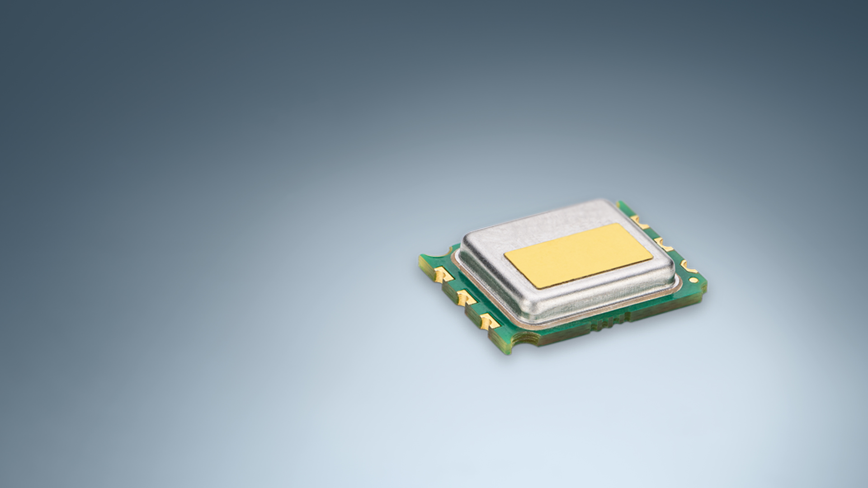
SFA40
Next generation Sensirion FormAldehyde sensor
Preliminary and confidential

Slide 2
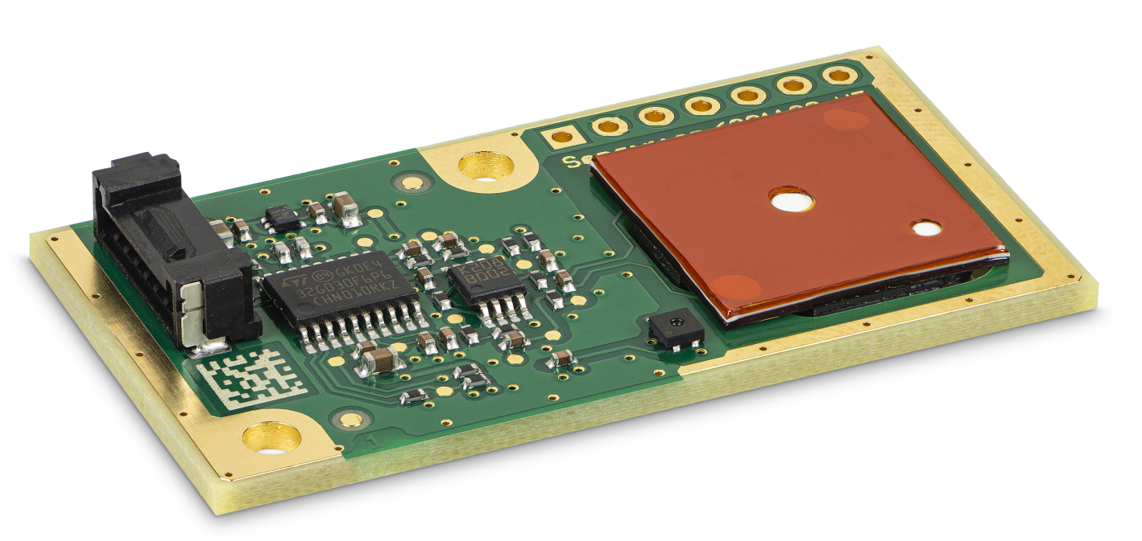
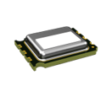
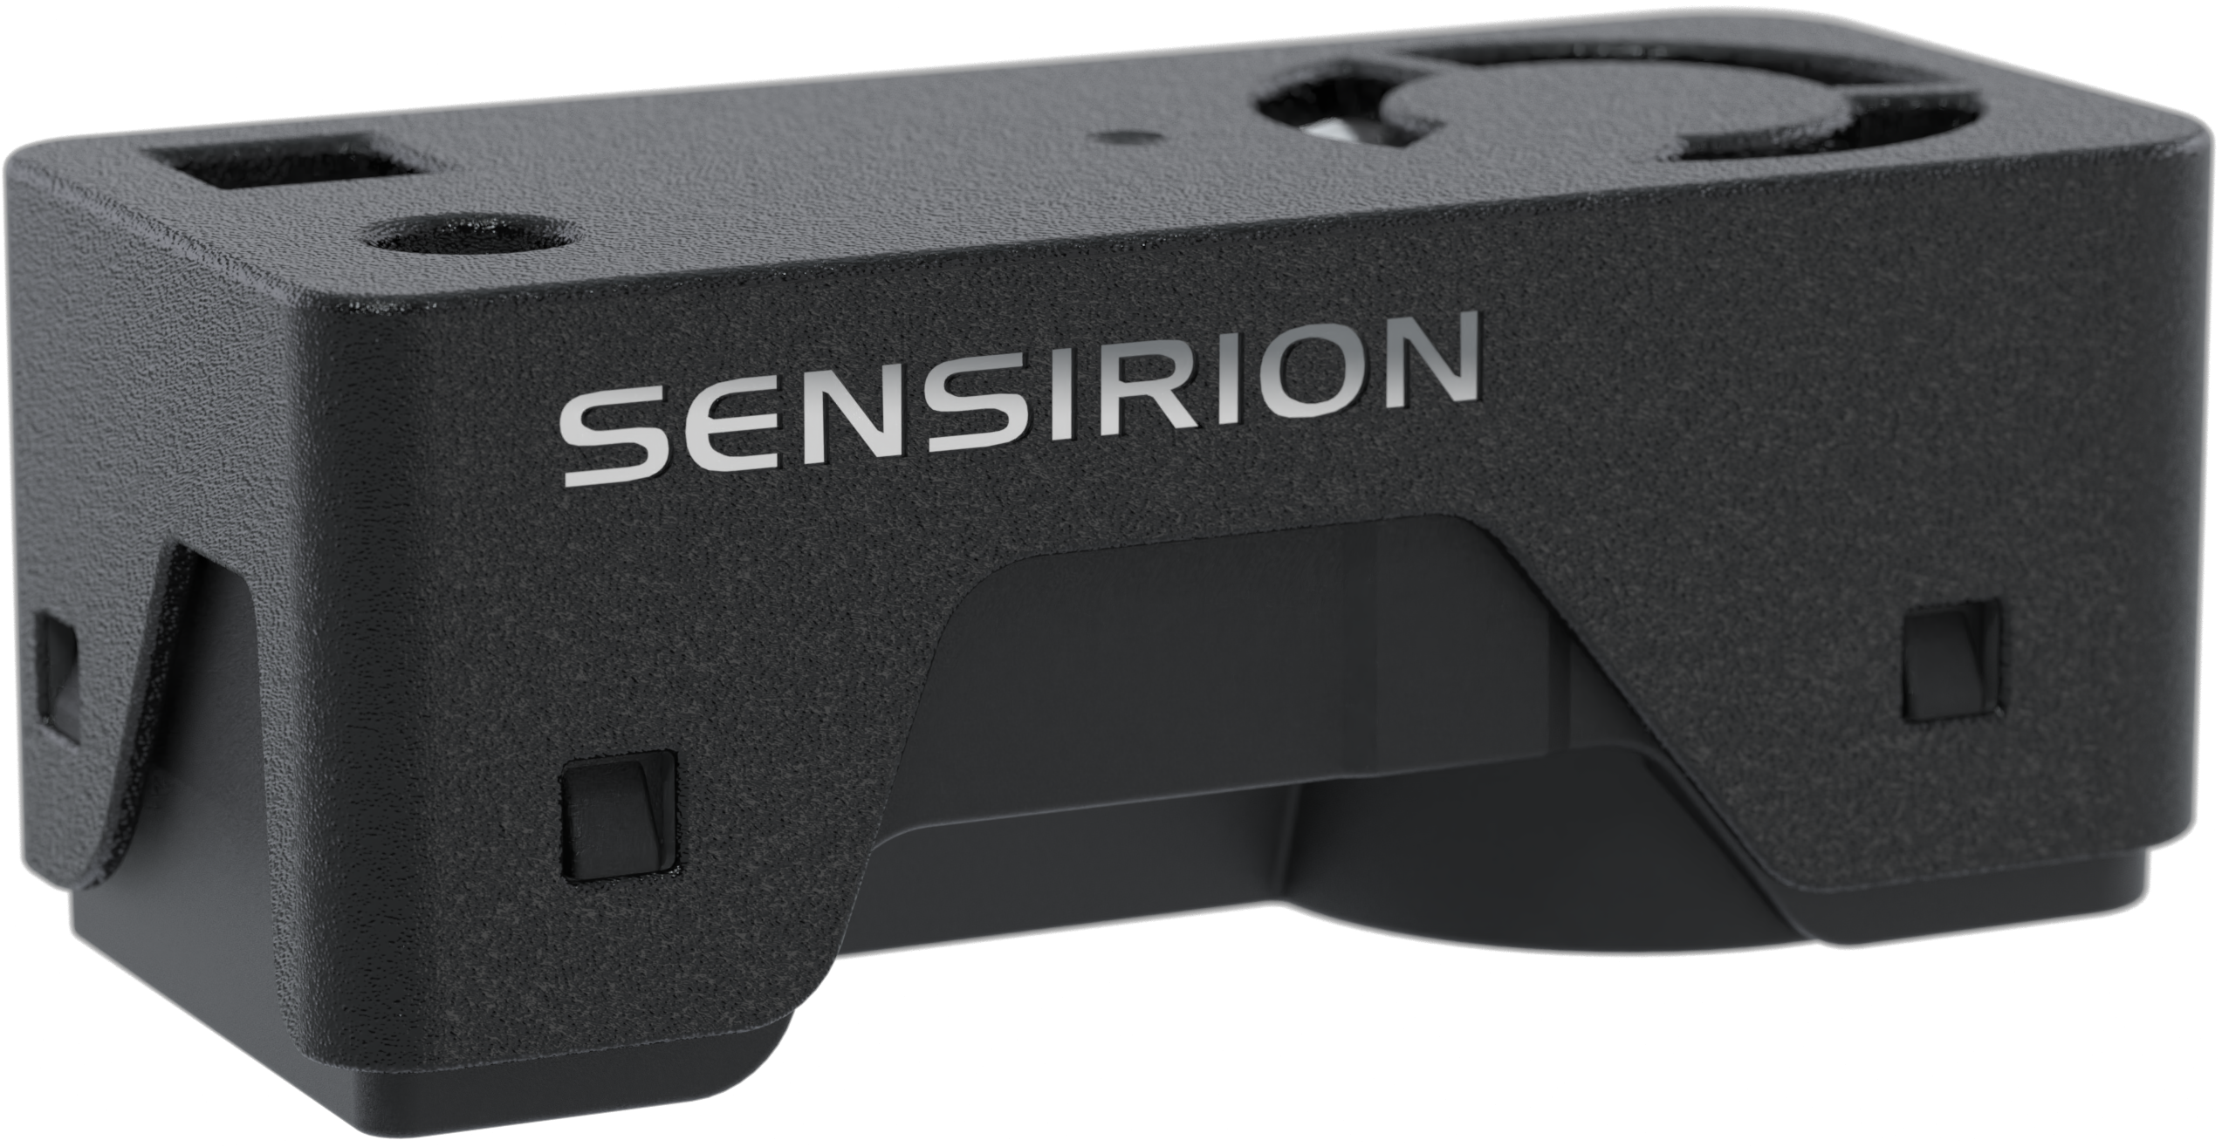
SFA40
Revolutionizing electrochemical sensing
SFA30
Designed with user in mind. Ideal for IAQ monitors, air purifiers and air conditioners.
SFA40
x8
smaller form factor than SFA30
80 µA
avg. power consumption*
<0.3%
cross-sensitivity to ethanol
Available as part of SEN68
*even lower power consumption modes are in development, expected in H1'25
SEN68
HCHO, RH, T, PM1, PM2.5, PM4, PM10, VOC, NOx
Notes:
Or «making good even better» or «minituarization through innovation» or «rethinking form factor in electrochemical sensing»

Slide 3

Focused on user experience
Making good even better
  Trusted performance
  Uniquely high selectivity to formaldehyde minimizes false positives
  On track to be certified for accuracy
  Long lifetime thanks to anti-dry technology
  Designed and made in Switzerland
  Based on success and know-how of SFA30
  Highly qualified and experienced customer support team. Sensirion sales, FAE and R&D is ready to support with sensor choice and integration.

