Slide 1
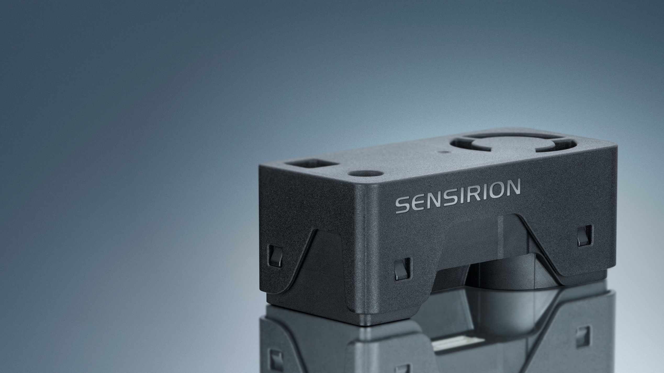
SEN6x
All-In-One Combo Solution for Air Quality Monitoring

Slide 2
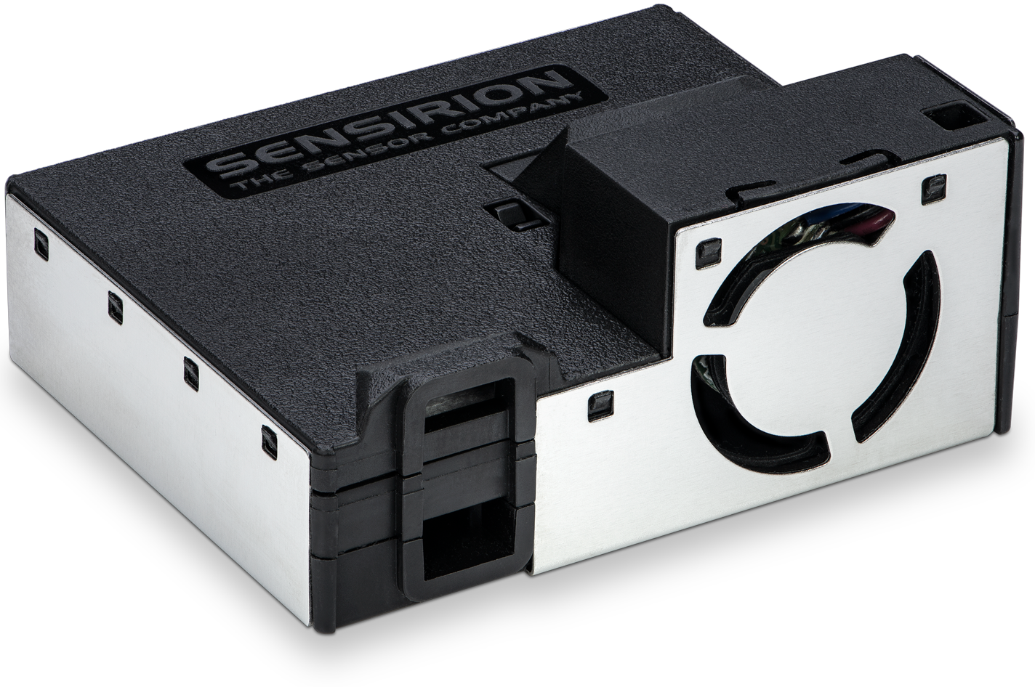
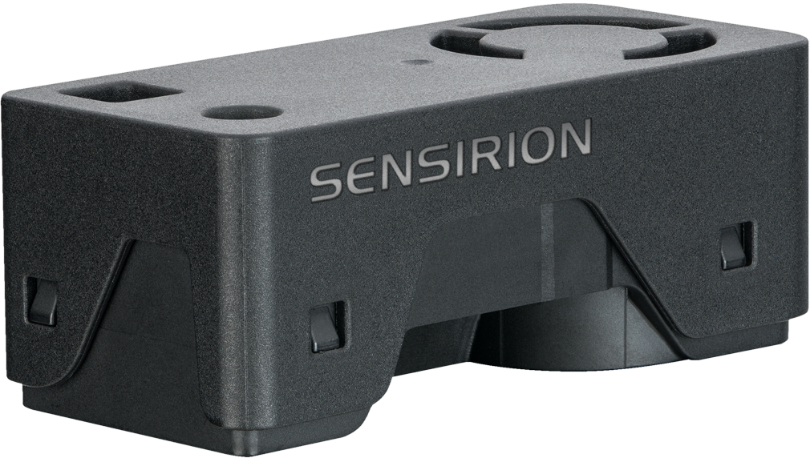
SEN6x
Simplifying Indoor Air Quality Sensing
Experience the future of air quality sensing with the compact and powerful SEN6x sensing platform. It combines multiple sensors in a never-before-seen form factor
SEN5x
2x
smaller than SEN5x
Up to 9 environmental parameters
Modular
5 Variants to choose from
SEN6x

Slide 3

SEN6x – A Modular Platform Tailored to Your Application
SEN60 – PM
SEN63C – PM, RH&T, CO₂
SEN65 – PM, RH&T, VOC & NO_{X}
SEN66 – PM, RH&T, VOC & NO_{X}, CO₂
SEN68 – PM, RH&T, VOC & NO_{X}, HCHO
Identical physical interface for all variants!
→ One Design-In
3
© Copyright Sensirion, Switzerland
Notes:
So What does the SEN6x line offer you? Your application is unique and maybe you don’t need all the parameters.
That’s the beauty of SEN6x, it is built as a modular platform. You choose which parameter matter to you in your application. We offer a total of four different models, tailored to different applications.
SEN60 is our lowest cost particulate matter sensor that we ever offered.
SEN65 adds relative humidity, temperature, VOC and NOx measurements in addition to PM, this makes it for example perfect for air purifiers
SEN66 adds CO2 to that mix, which is ideal for Indoor air quality monitors or as actionable signal in energy recovery ventilation or HVAC systems, that can use it to optimize their energy consumption while making sure that the CO2 levels stay at an optimal level
SEN68 offers PM, RH&T, VOC, NOx and Formaldehyde, this fits premium air purifiers with special filter that can decompose the Formaldehyde or indoor air quality monitors for the Asian market
And the best thing is, that all models share one physical formfactor. This means you can design it in once but offer a whole range of different tiers of products. Your requirements have changed? You want to upgrade your product with an additional sensors? No problem, just order another variant without changing your design

Slide 4
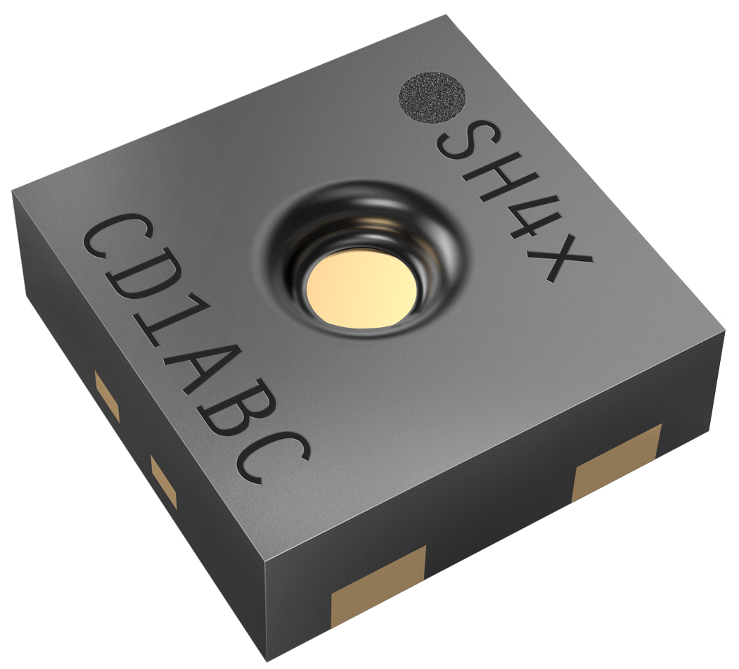
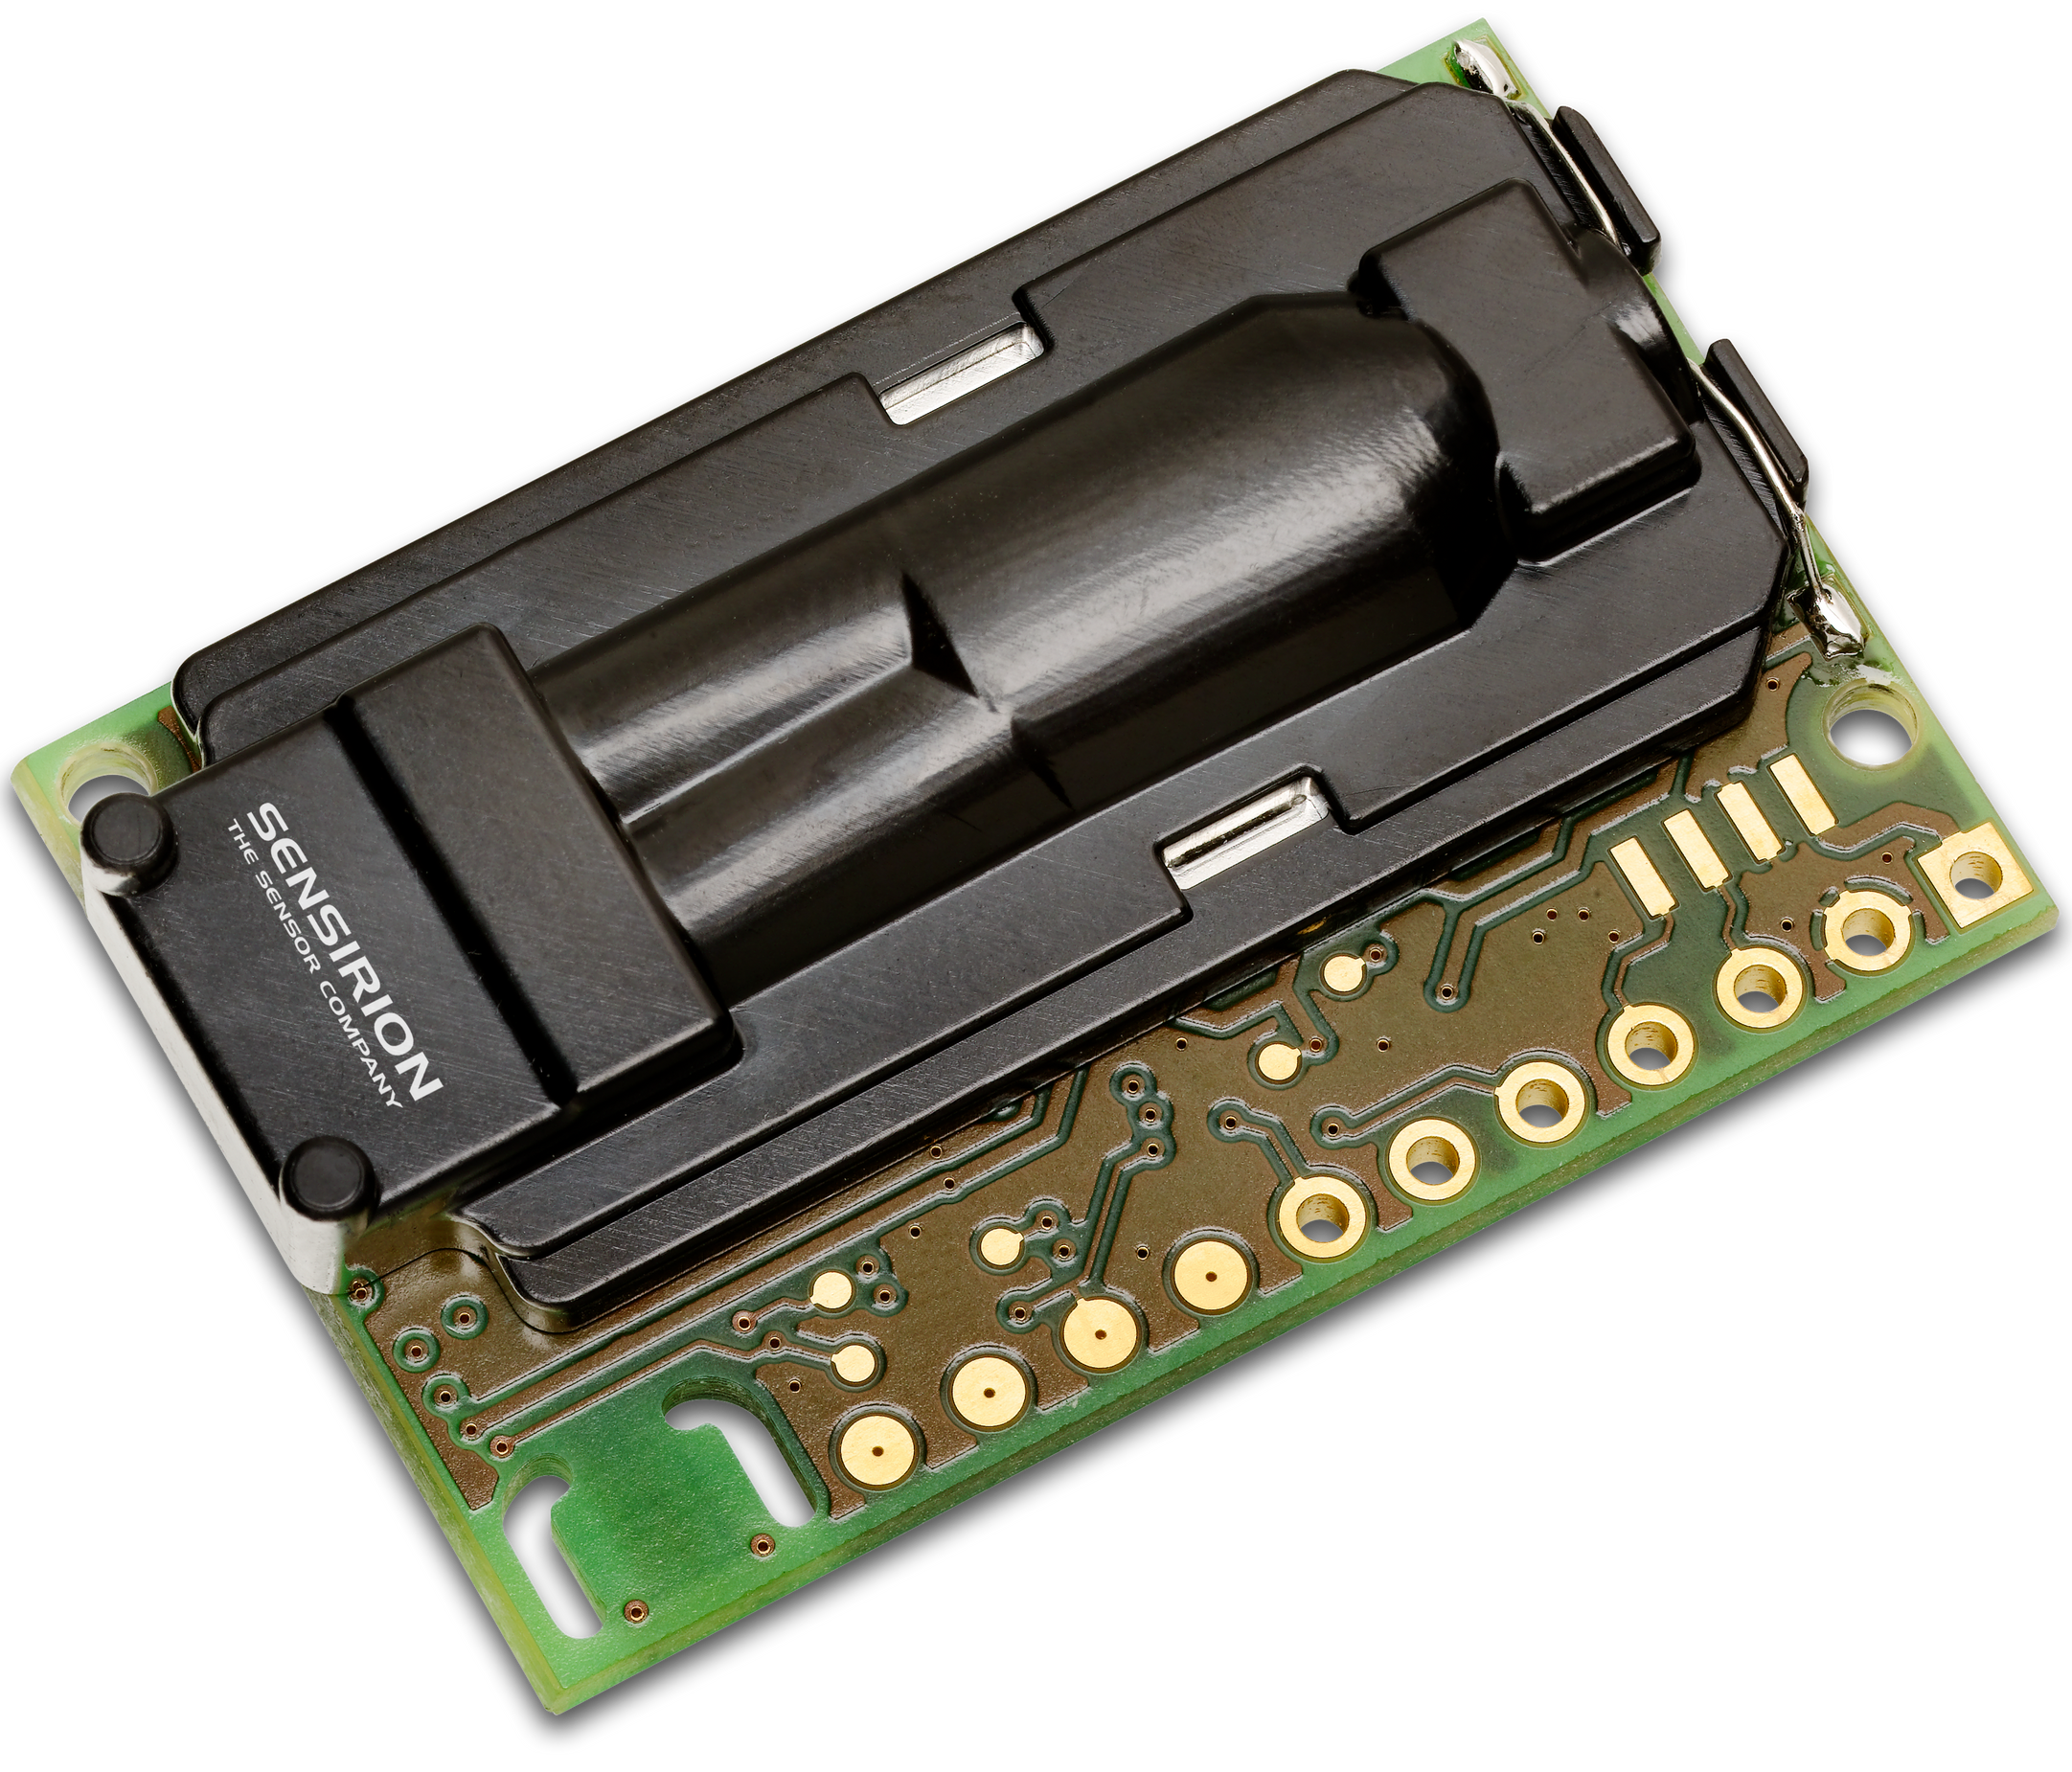
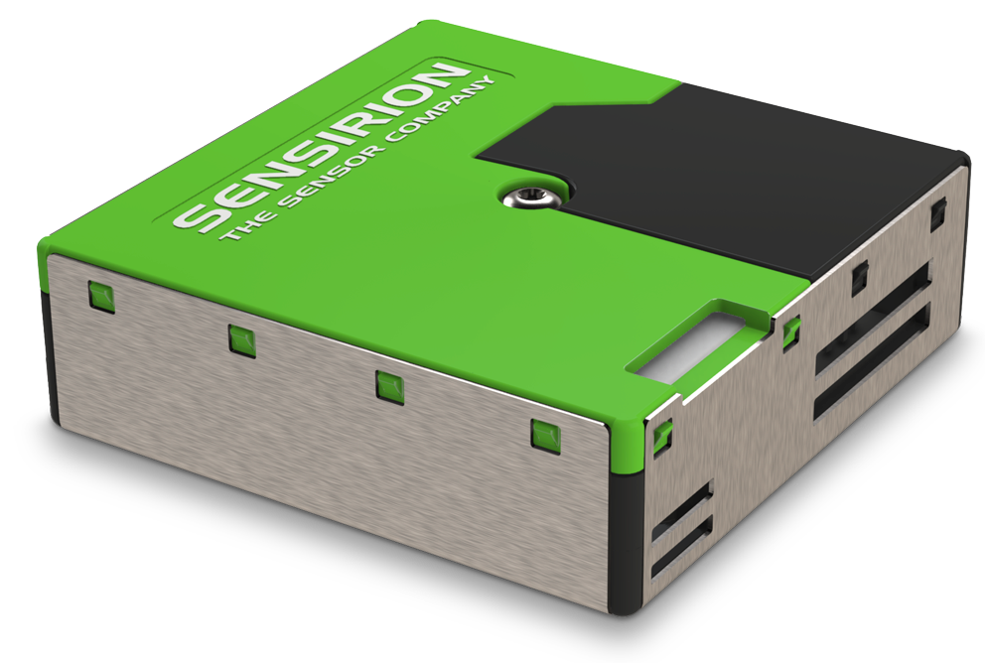
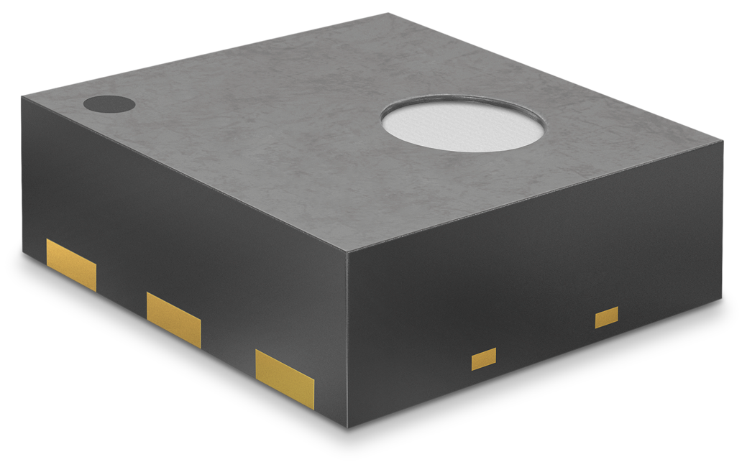
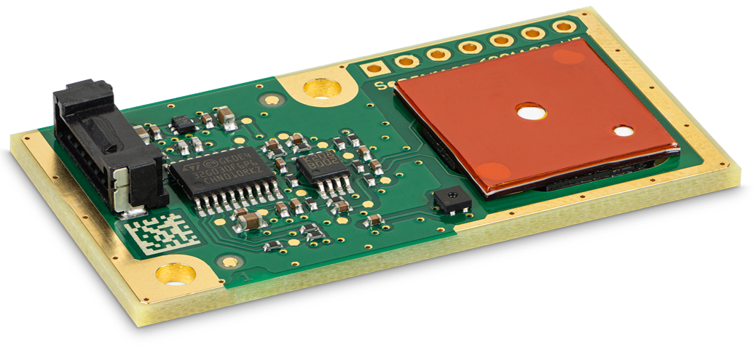
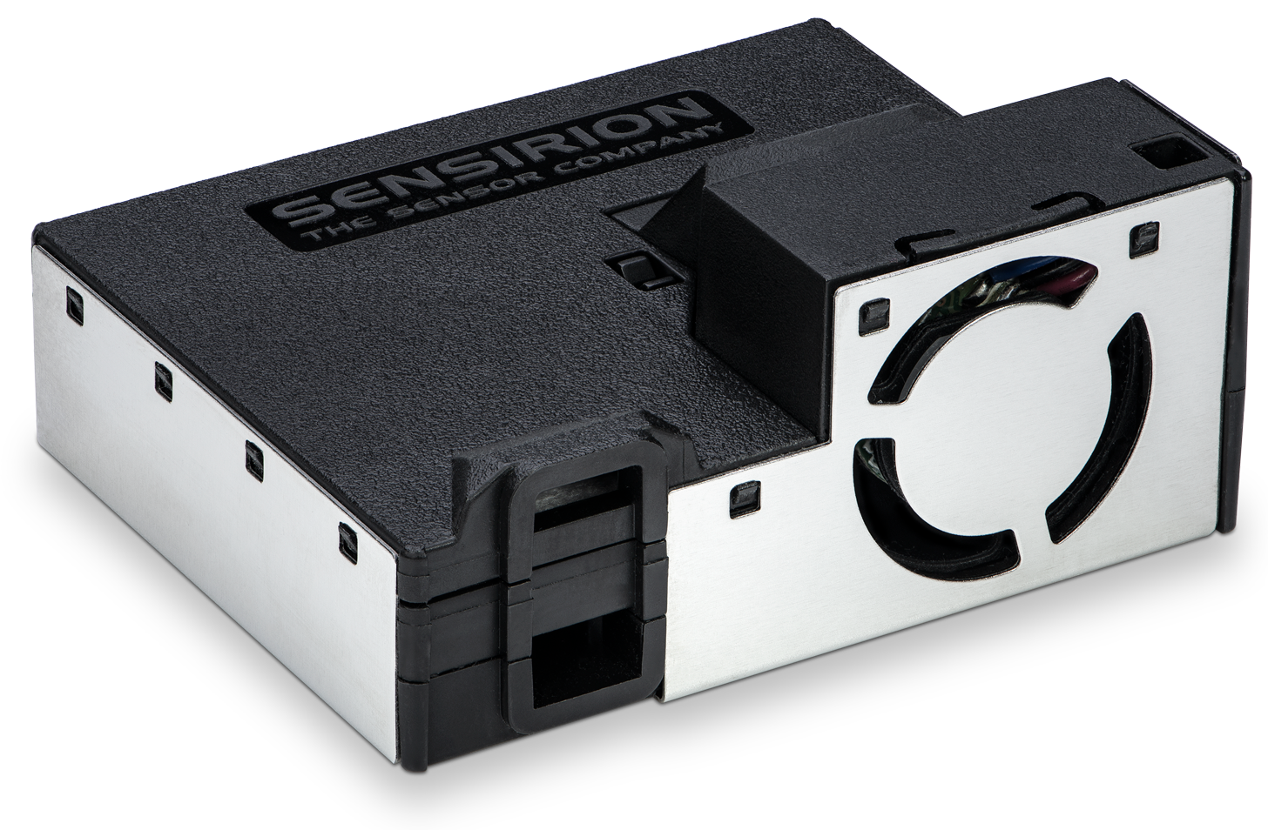
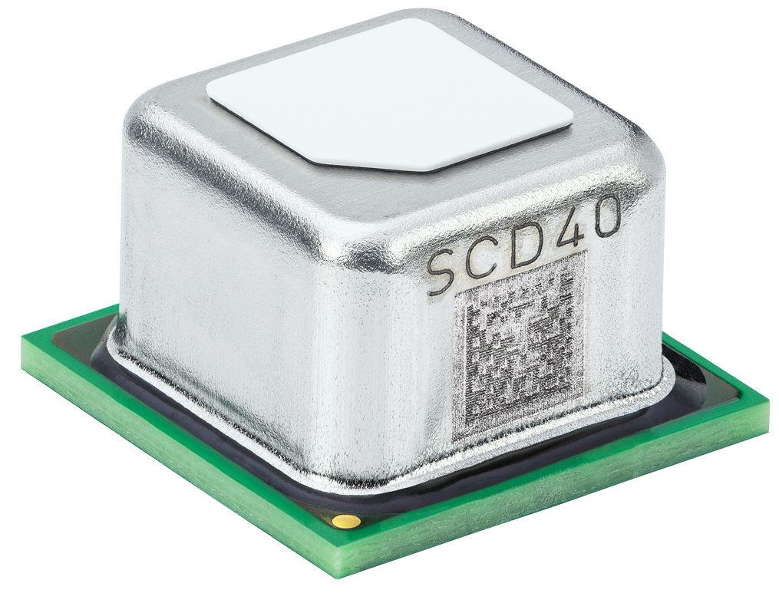
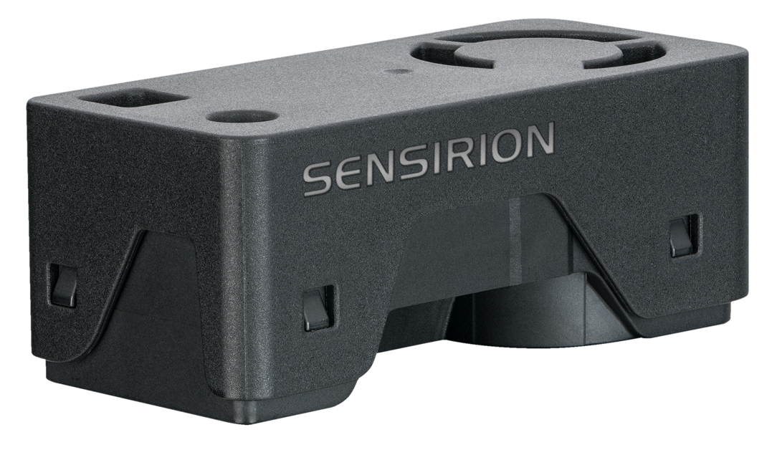
SEN6x – Simplification of Environmental Sensing
Components evolve into modules
Intrinsic advantages of SEN6x
One design-in – Many variants to choose from
Patented sheath-flow technology – Maintenance-free
All necessary algorithms integrated (e.g. temperature)
Savings during development phase and production
1 sensor to integrate – Less manhours for firmware, electronics, sensor integration and testing/quality
Less hardware, only 1 cable/connector, click fixation, simplified retainer
Fast assembly, one connection only, no soldering
No stock keeping nor handling of many discrete sensors
Price advantage of module due
to ease of integration
Integration Cost
Sensirion’s sensor generation

