Slide 1

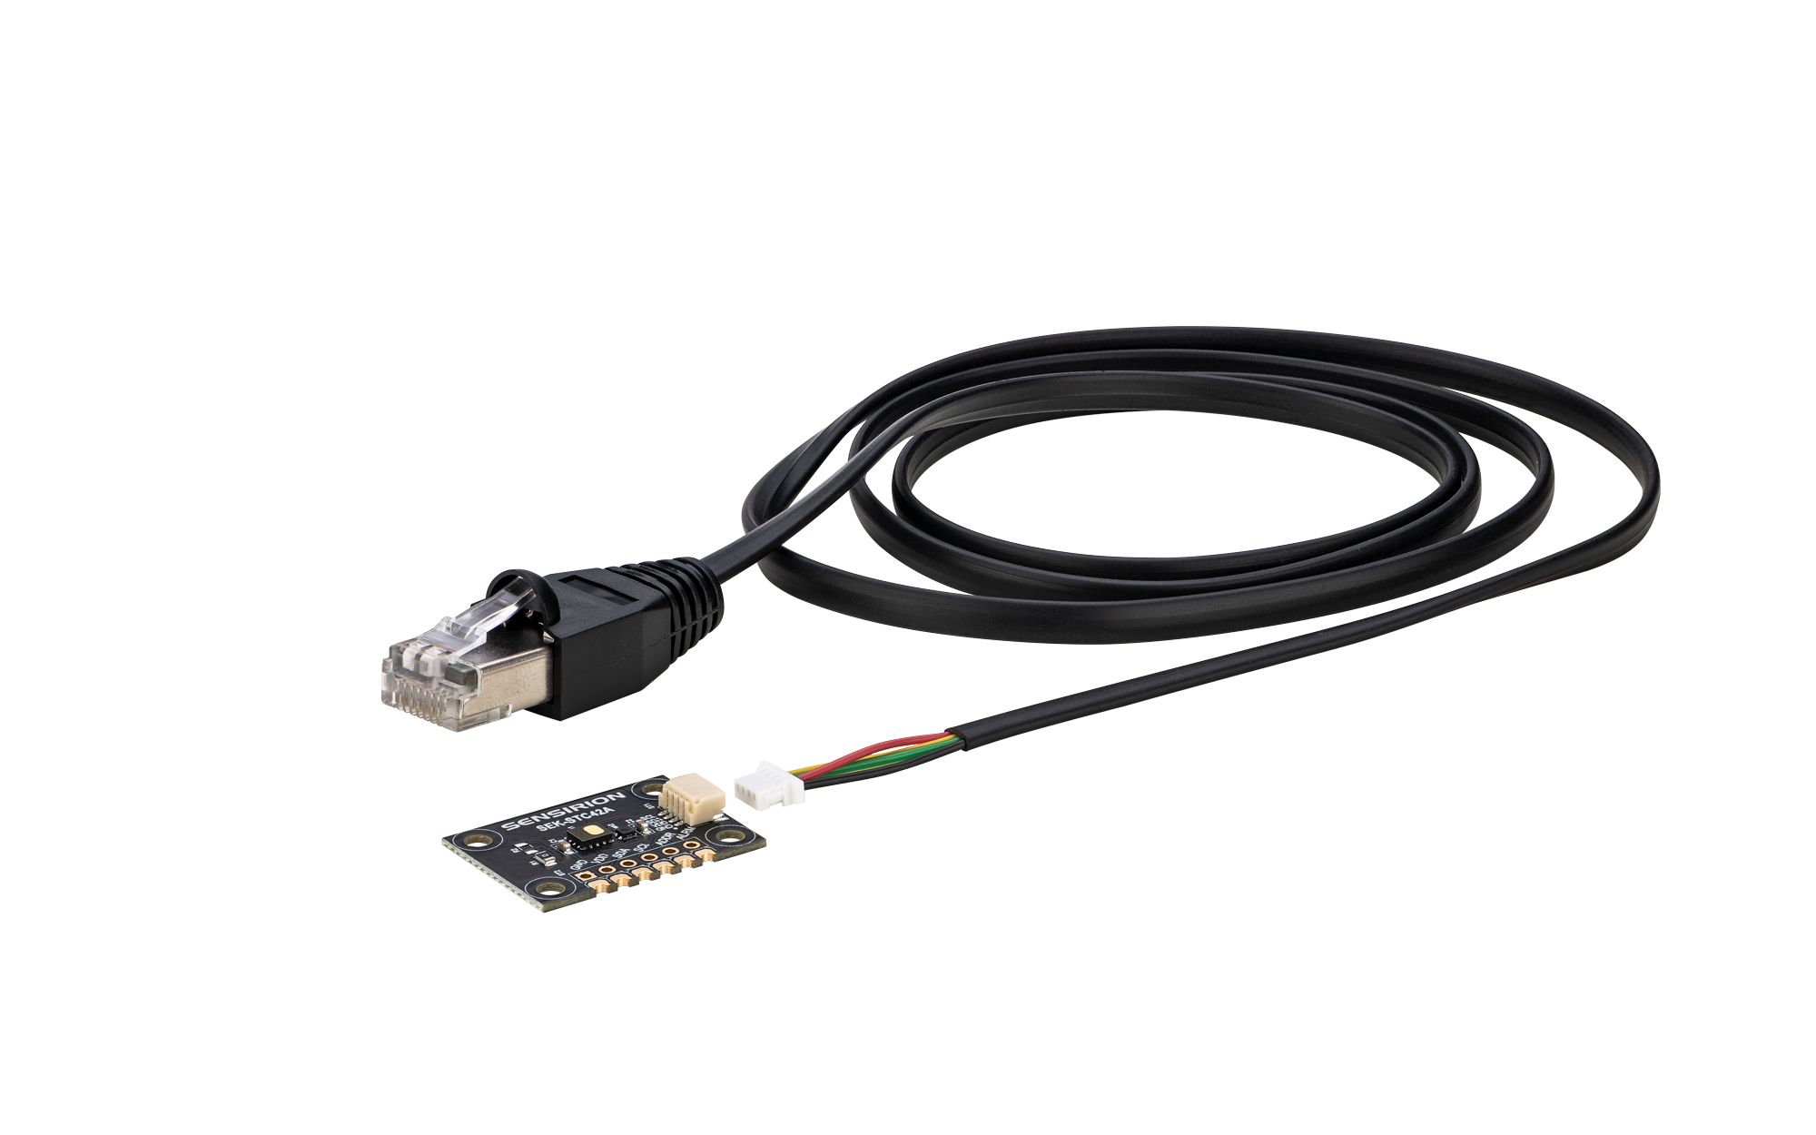

SEK-STC42A Evaluation Kit
Effective sensor evaluation.
Efficient prototyping.
Notes:
We are pleased to announce the the SEK‑STC42A Evaluation Kit - the ideal platform for exploring Sensirion’s new STC42A Hydrogen Automotive Thermal Conductivity Sensor to come. Designed for fast, effective sensor evaluation and efficient prototyping, this kit provides everything you need to accelerate development in hydrogen safety and monitoring applications.

Slide 2
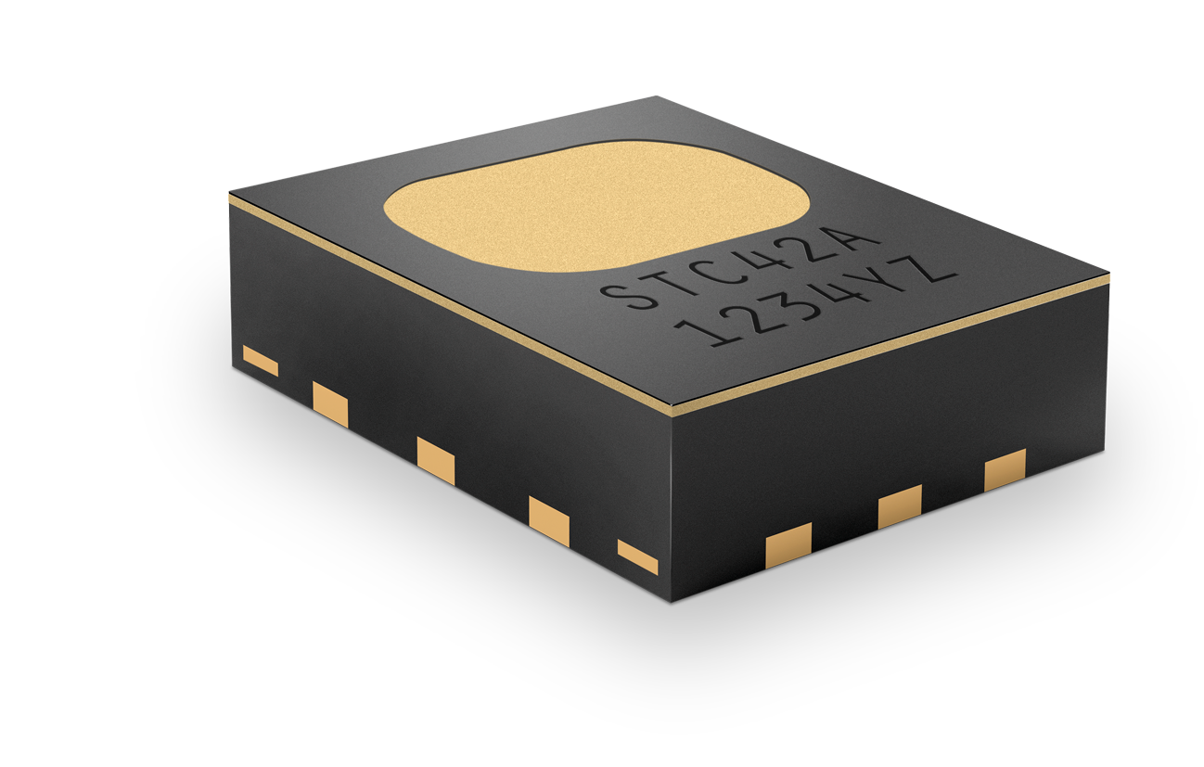

STC42A Specifications
Optimized Hydrogen Gas Sensing for Thermal Runaway Applications
Accuracy: ± (0.4vol% + 2% of reading)
H₂ range: 0 – 40vol%
Typical response time: 1s (τ63)
1mm
0.1…60s sampling interval (cont.)
On-demand (single shot)
Operation:
Supply voltage: 3.3V DC
3.5mm
3mm
Avg current consumption: <0.7mA ¹⁾
Automotive compliant: AEC-Q100 grade 2 ²⁾
¹⁾ Continuous measurement mode at 1Hz - and <7µA in low-power mode at 0.03Hz.
²⁾ Qualification standard developed by the Automotive Electronics Council (AEC) that defines stress tests and reliability requirements for integrated circuits used in automotive applications.
2
© Copyright Sensirion, Switzerland
Notes:
The STC42A is an automotive‑grade, thermal‑conductivity–based gas sensor calibrated specifically for hydrogen. With its reliable, durable, and cost‑efficient design, it is perfectly suited for critical applications such as thermal runaway detection, where automotive manufacturers are required to alert drivers at least five minutes before potential harm.
Key Specs are: …

Slide 3

Key Advantages of the STC42A Sensor
Individual sensor calibration and on chip compensation.
Excellent and proven long-term stability
Robustness to shock and vibration
SMD soldering
Digital I2C interface
PFAS-free membrane
Engineered and manufactured in Switzerland.
Notes:
Key advantages of the STC42A sensor are
Individually calibrated sensors with integrated on‑chip compensation
Excellent long‑term stability supported by field‑proven measurement technology
High robustness against shock and vibration
SMD‑mountable design for streamlined integration
Digital I²C interface for simple and direct communication
PFAS‑free membrane for reliable gas detection without environmentally harmful fluorinated compounds
Engineered and manufactured in Switzerland

Slide 4
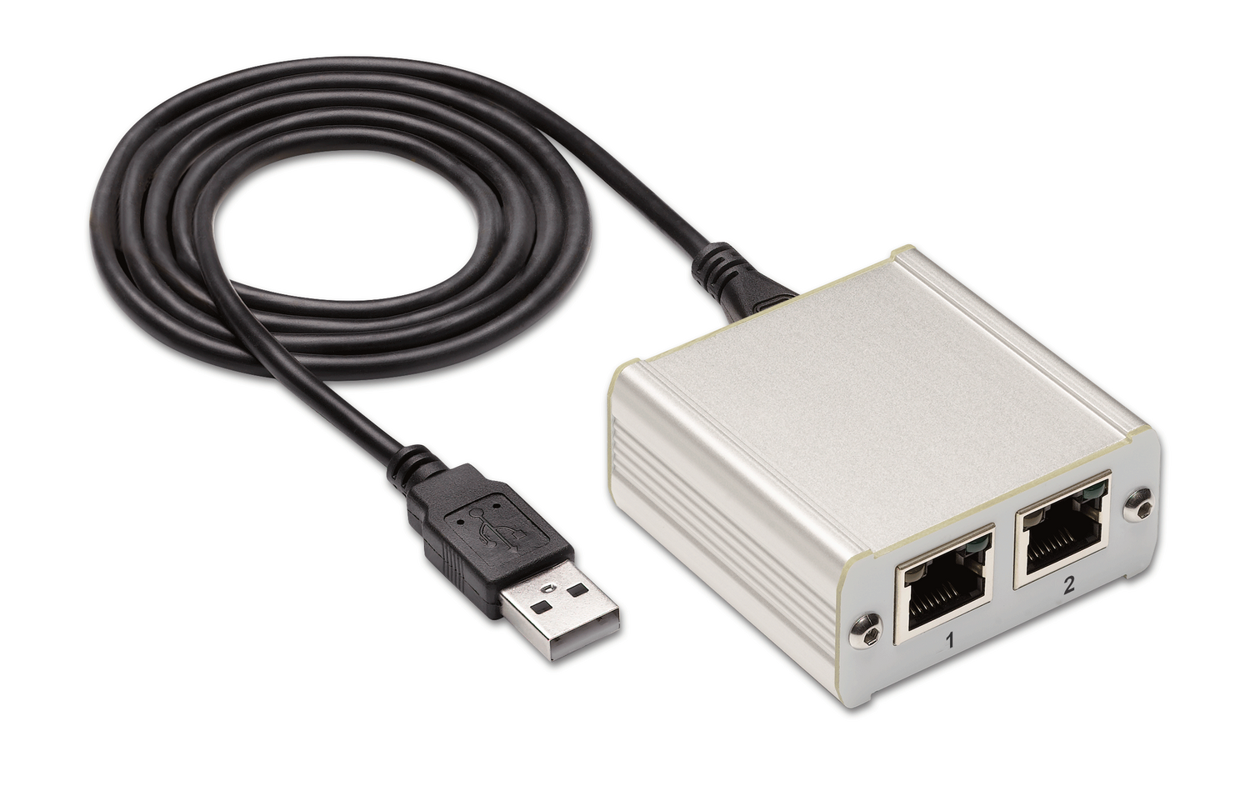

SEK-STC42A: Evaluation Kit
For Effective STC42A Sensor Evaluation and Efficient Prototyping
Adapter Cable
(included in SEK-STC42A)
Sensirion Sensor Bridge
(not included in SEK-STC42A)
SEK-STC42A
(with STC42A H₂ and
SHT41A RH/T Sensor)
Notes:
The SEK‑STC42A is available now for testing and development. Each kit includes: One STC42A hydrogen sensor and an SHT humidity and temperature sensor on a PCB board.
Full compatibility with Sensirion’s Sensor Bridge enables effortless first measurements using Sensirion’s ControlCenter software, allowing you to read sensor data instantly and intuitively.
The STC42A sensor itself will be commercially launched in Q2 of this year.
At Sensirion, we look forward to working closely with our channel partners to identify and unlock new opportunities for the STC42A in the rapidly growing field of hydrogen sensing.

