Slide 1

Q3 2025 Rep Call
Sensirion RSM / September 15, 2025

Slide 2
Agenda
Americas Channel Team Reorg
RSM Updates
Distribution NPI
Marketing Updates
Inside Sales Updates
Team Activity to Win Something

Slide 3

Channel team changes
Reorg to support >20% CAGR initiatives
Increase Demand Creation &
Close-Win %

Slide 4

Summary of Org Changes
US Channel Team Reorg for >20% CAGR Initiatives
Added 2nd Distribution Manager Role
Promoted Theresa Tesch to Distribution Mgr.
Hired Inside Sales focused on Distribution (next slide)
Created Technical Sales Manager Role
Transitioned Frank to help expand Demand Creation
Split North America into Two (2) Regions
Rick handles East
Gary handles West & Central
Notes:
Added 2nd Distribution Manager Role
Promoted Theresa Tesch to this position
Opened backfill req for Inside Sales to replace TTES
This enables Global focus + Field Engagement
Created Technical Sales Manager Role
Moved Frank D’Aliesio to this position
Drive and Support Empowerment to Reps
Focus on Field Engagement & Scaling Know-how
Split North America into Two (2) Regions
RSMs will become more Strategically focused
Rick Zanardo handles East
Gary McNelly handles West & Central

Slide 5

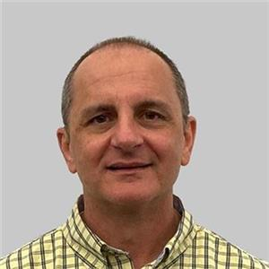
Distribution Updates
Katie Pflanz – New Inside Sales Account Manager, Distribution
Support for distribution managers and distributors
Salesforce support alongside Holger
Located in Chicagoland area
Frank D'Aliesio appointed newly created TSM role for North America
Focus on Increasing Demand Creation & Closed-Win % through:
Scaling knowledge by training Manufacturers' Representatives and Distributors
Increasing more buddy calls (after trainings)
Distributor trainings so far in 2025 (Luscombe, Mel Foster, MRB, Norris)
Think about Prioritizing trainings in Q3 and Q4 – schedule now!
Please help us prep for trainings by providing primary markets and applications for your territories
For distributor trainings, please contact the Distribution Manager and they will get Frank involved as needed

Slide 6

Wholistic Ownership
Of Distribution Relationship to drive growth:
HQ
Global
Relationship
Adding 2nd Distri Mgr enables complete ownership:
HQ Global Relationship (if HQ in Americas)
Global Performance (Americas, EMEA, APAC)
Ease of doing business
Marketing Initiatives
Aligned to Focus Products & Target Applications
Driving Campaigns & Solutions
Field Engagement
More Buddy Calls (TSM, Distri Mgrs, DKEN, RSMs)
Focused FAE Training (& other trainings)
Campaign Leads closed Loop (drive through SFDC)
Rep Distri Mgr Oppty Funnel Review (By Distri Mgr)
Field
Engagement
Marketing
Initiatives

Slide 7













Sensirion AMERICAS Distribution Partners & Team 2025
BROADLINE
Sr. Distribution Manager
Distribution Manager
(Americas Only)
HIGH-SERVICE
SPECIALTY
TX, OK, LA, AR Only
A2L Fulfillment option
Inside Sales for Distribution

Slide 8
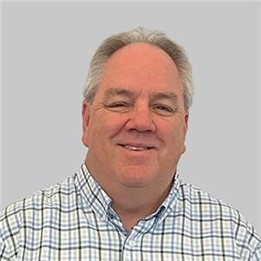

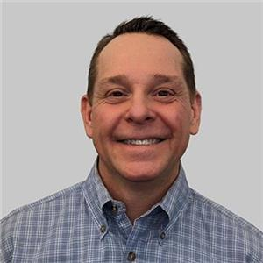







Rep Partners and Expansion Plan: 2025 - 2026
RSM: Gary McNelly
RSM: Rick Zanardo
ISAM: Nancy Brummund
ISAM: Holger Oswald
1
(Onboarded Apr 2025)
2026 Territories to Add REPS
IL / WI Rep
KS-MO-So IL Rep
2025/26 Territories to Add REPS​
2
Mid-Atlantic States
(Metro NY, NJ, E. PA, VA, DE)
Mountain States (CO, UT, WY)​
2026 South American Countries to Add REPS

Slide 9

Technical Sales Manager
TSM supports Demand Creation through
Field Engagement with Partners
Buddy Calls
Distribution FAE Training (Group or 1:1 breakfast, lunch)
Rep Training (or Support Rep in Branch trainings)
Opportunity Funnel Review (support project success)
Supports Reps, Distributors, RSMs and DSMs to:
Increase Design Win %
Grow Funnel Revenue Size
Increase Customer Count
TSM is focused on:
Revenue Growth
Scaling Sensirion know-how
Empowering Reps

Slide 10

RSM Updates

Slide 11
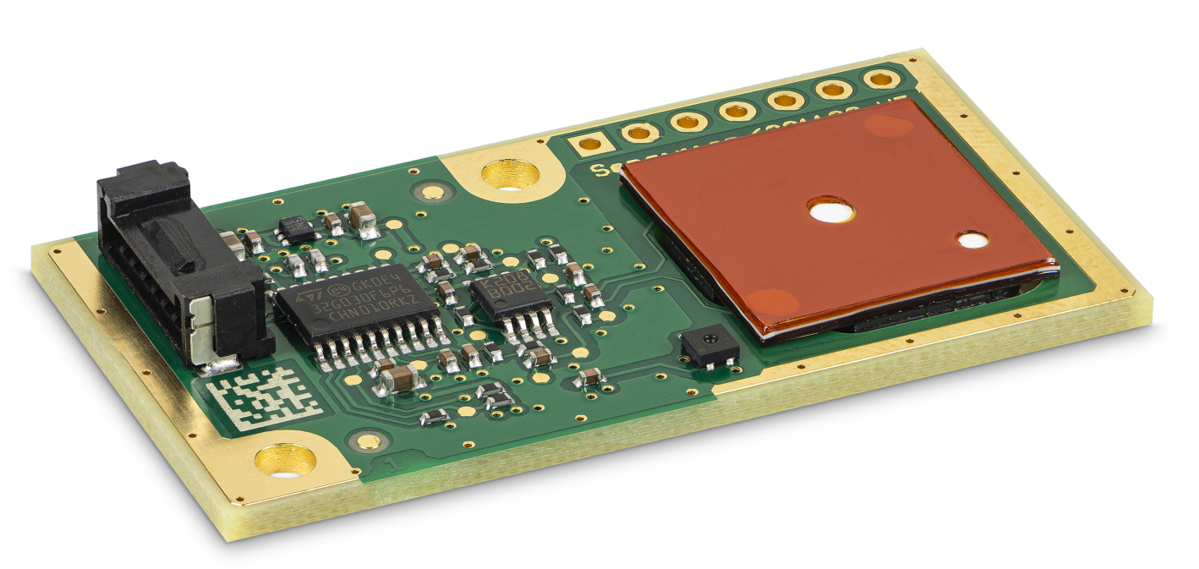
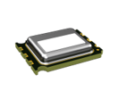
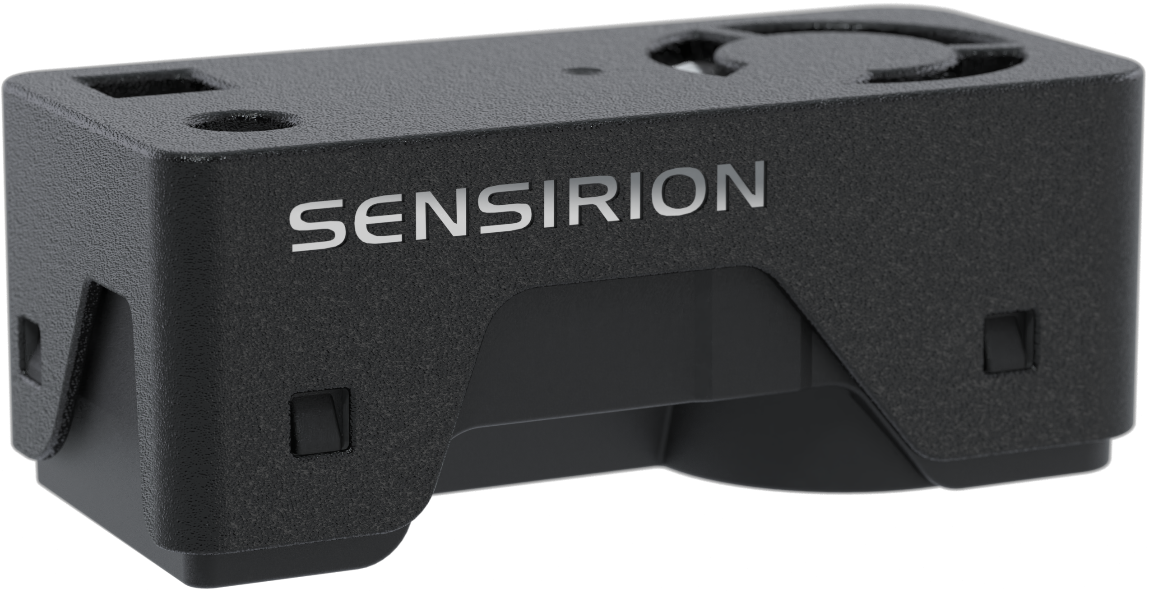
SFA40
Revolutionizing electrochemical sensing
SFA30
Ideal for IAQ monitors, air purifiers and air conditioners.
SFA40
x8
smaller form factor than SFA30
80 µA
avg. power consumption*
<0.3%
cross-sensitivity to ethanol
Available as part of SEN68
*even lower power consumption modes are in development, expected in H2'25
SEN68
HCHO, RH, T, PM1, PM2.5, PM4, PM10, VOC, NOx
Notes:
Or «making good even better» or «minituarization through innovation» or «rethinking form factor in electrochemical sensing»

Slide 12
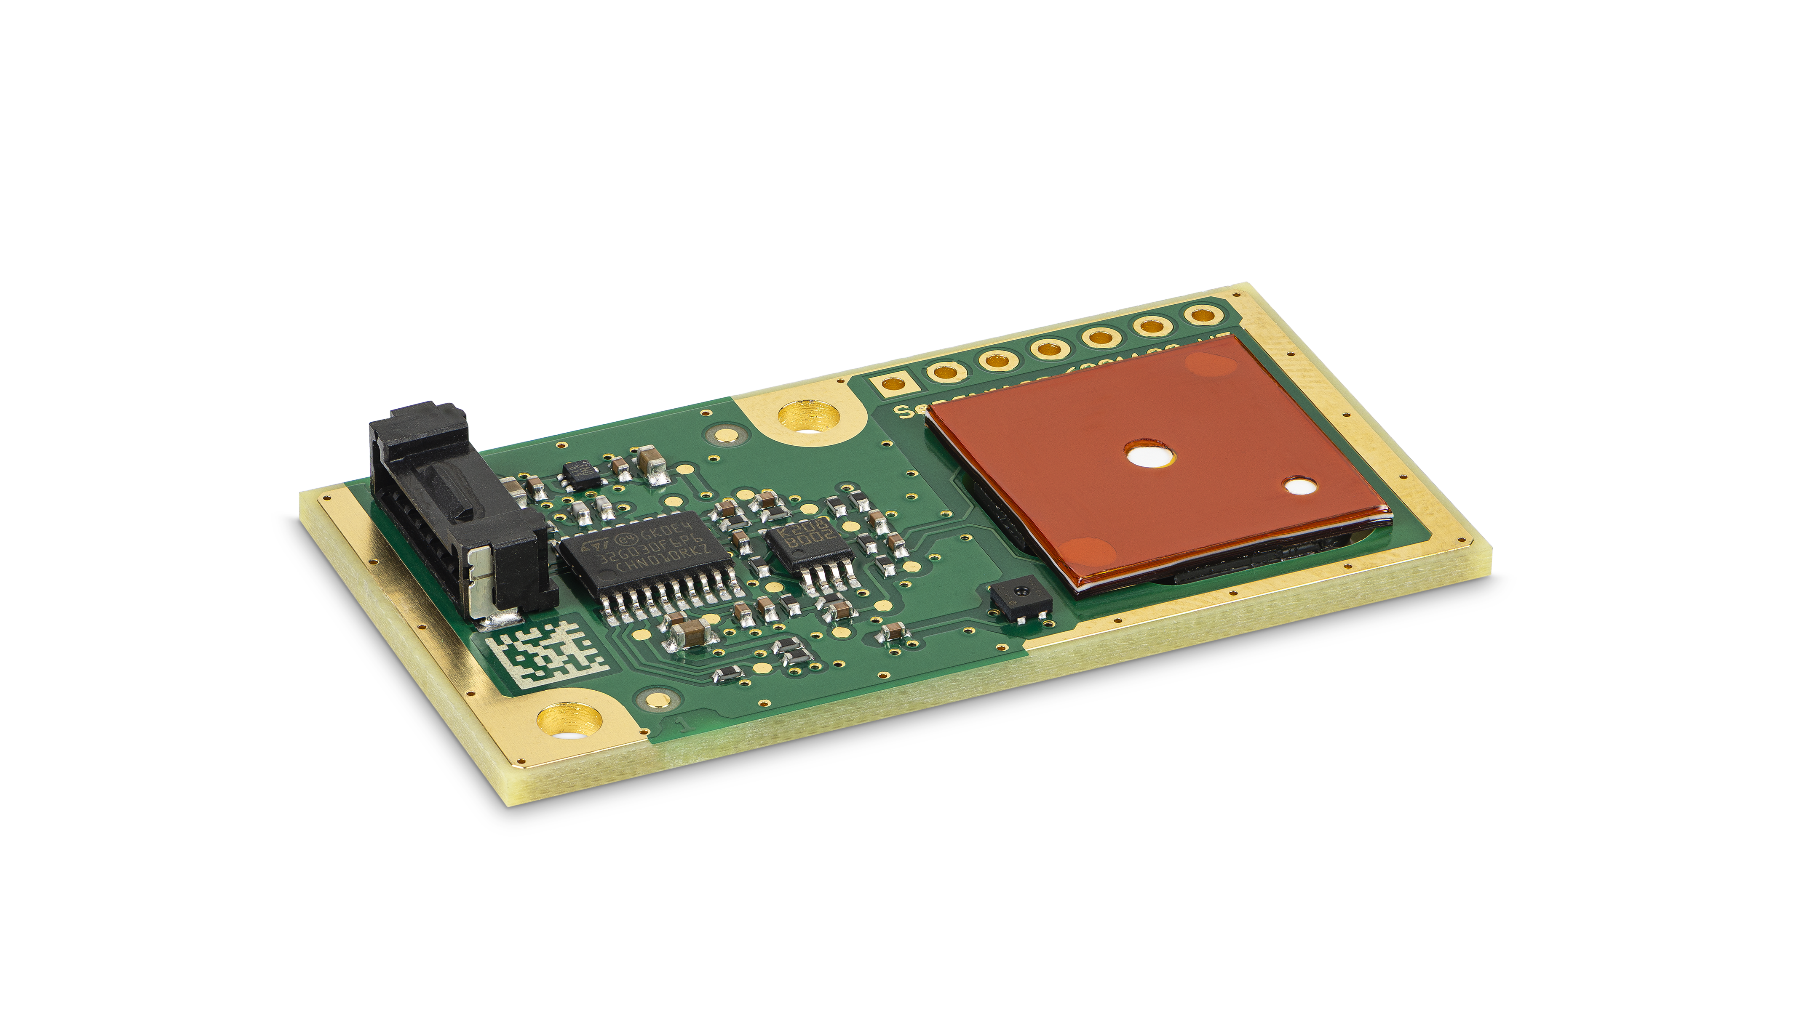
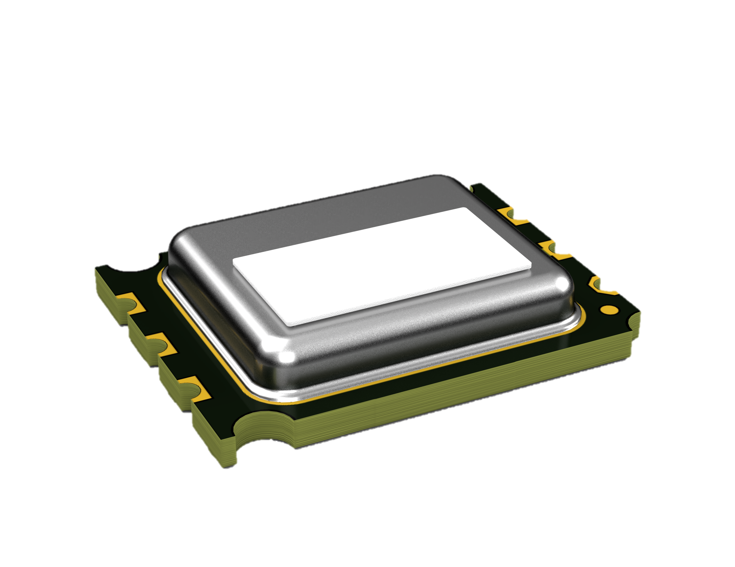
Already available in small quantities
2025
Apr
May
Jun
Jul
Aug
Sep
Oct
Nov
Dec
SFA30
SFA40
Samples
Pilot production
Volume production

Slide 13
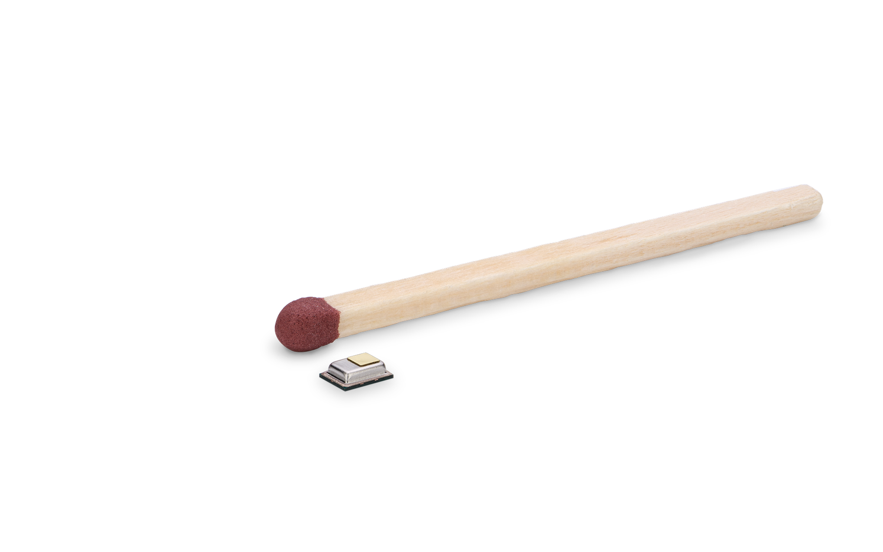
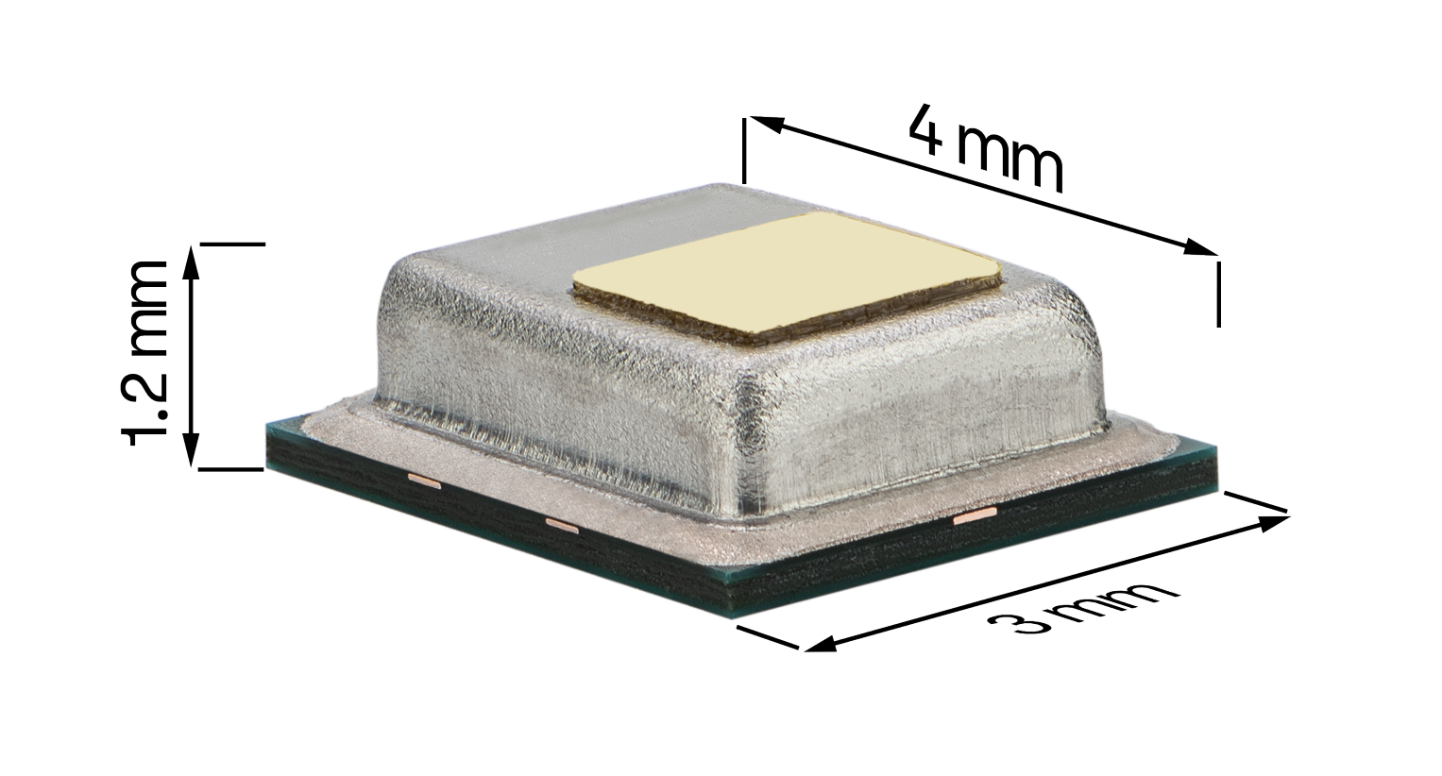
STCC4
Minimal Size.
Maximize the Potential.
Striking the right balance between performance, size, power consumption and price.
50x
smaller form factor than SCD4x
±(100ppm+10%) optimized accuracy for IAQ applications
<100 µA possibility for low power applications
Cost-efficiency
compared to optical sensors

Slide 14
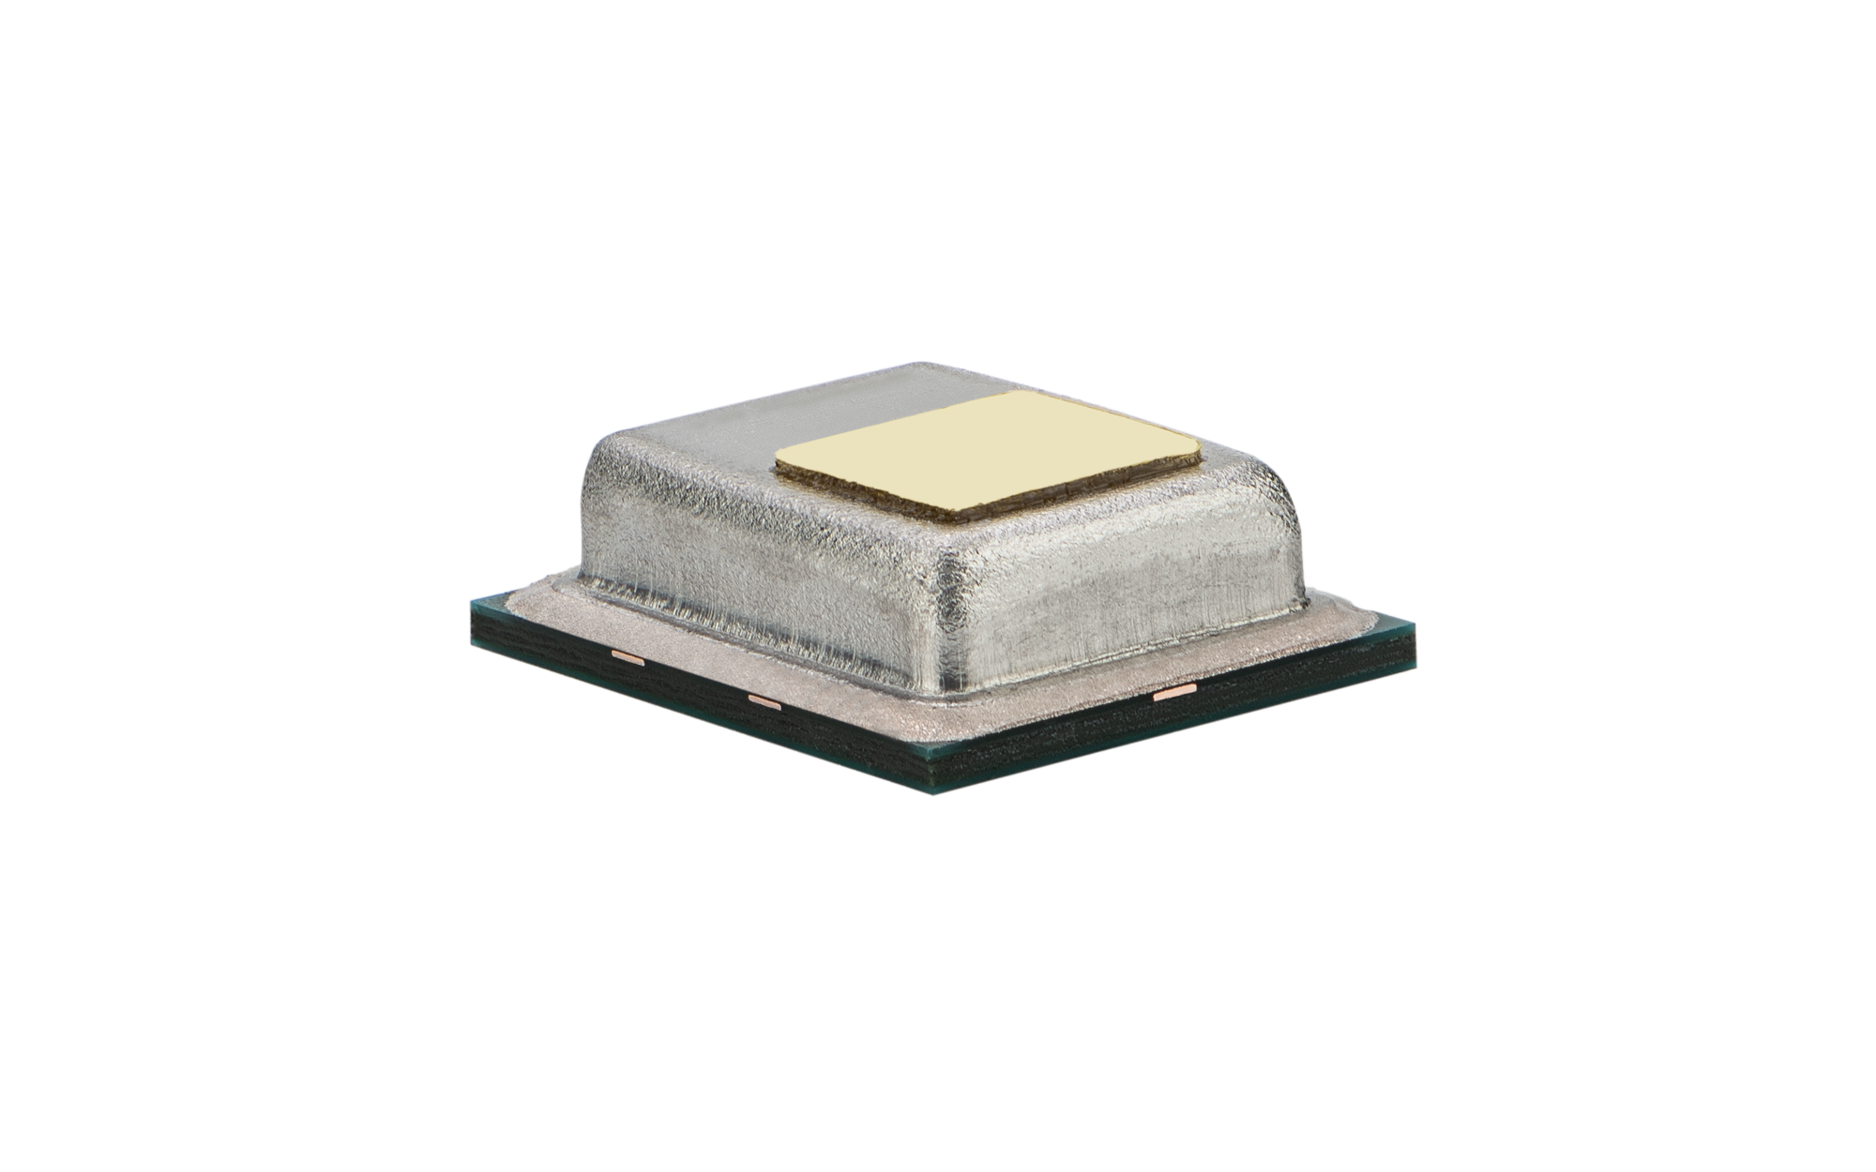
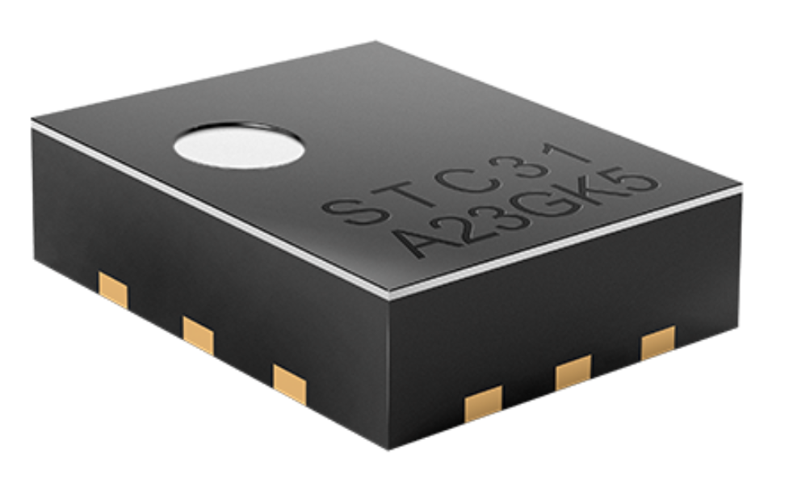
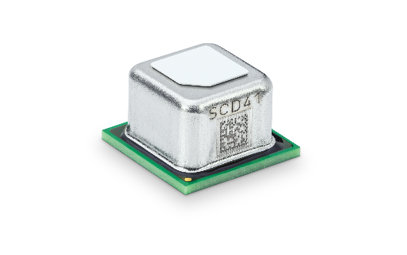










CO₂ Sensing Applications by Concentration
0.1 vol%
1 vol%
10 vol%
100 vol%
1’000 ppm
10’000 ppm
100 ppm
STC31-C
STCC4
SCD4x
SCD30
Bio-incubators & Process Control
Greenhouse Control & Monitoring
Breath Analysis
Grain Storage
Controlled Fruit & Vegetable Storage / Logistics
Demand-Controlled & Energy Recovery Ventilation
Battery Thermal Runaway Detection
Indoor Air Quality & Air Purifiers
Industrial Safety Monitors
14
© Copyright Sensirion, Switzerland

Slide 15
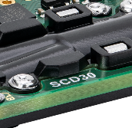


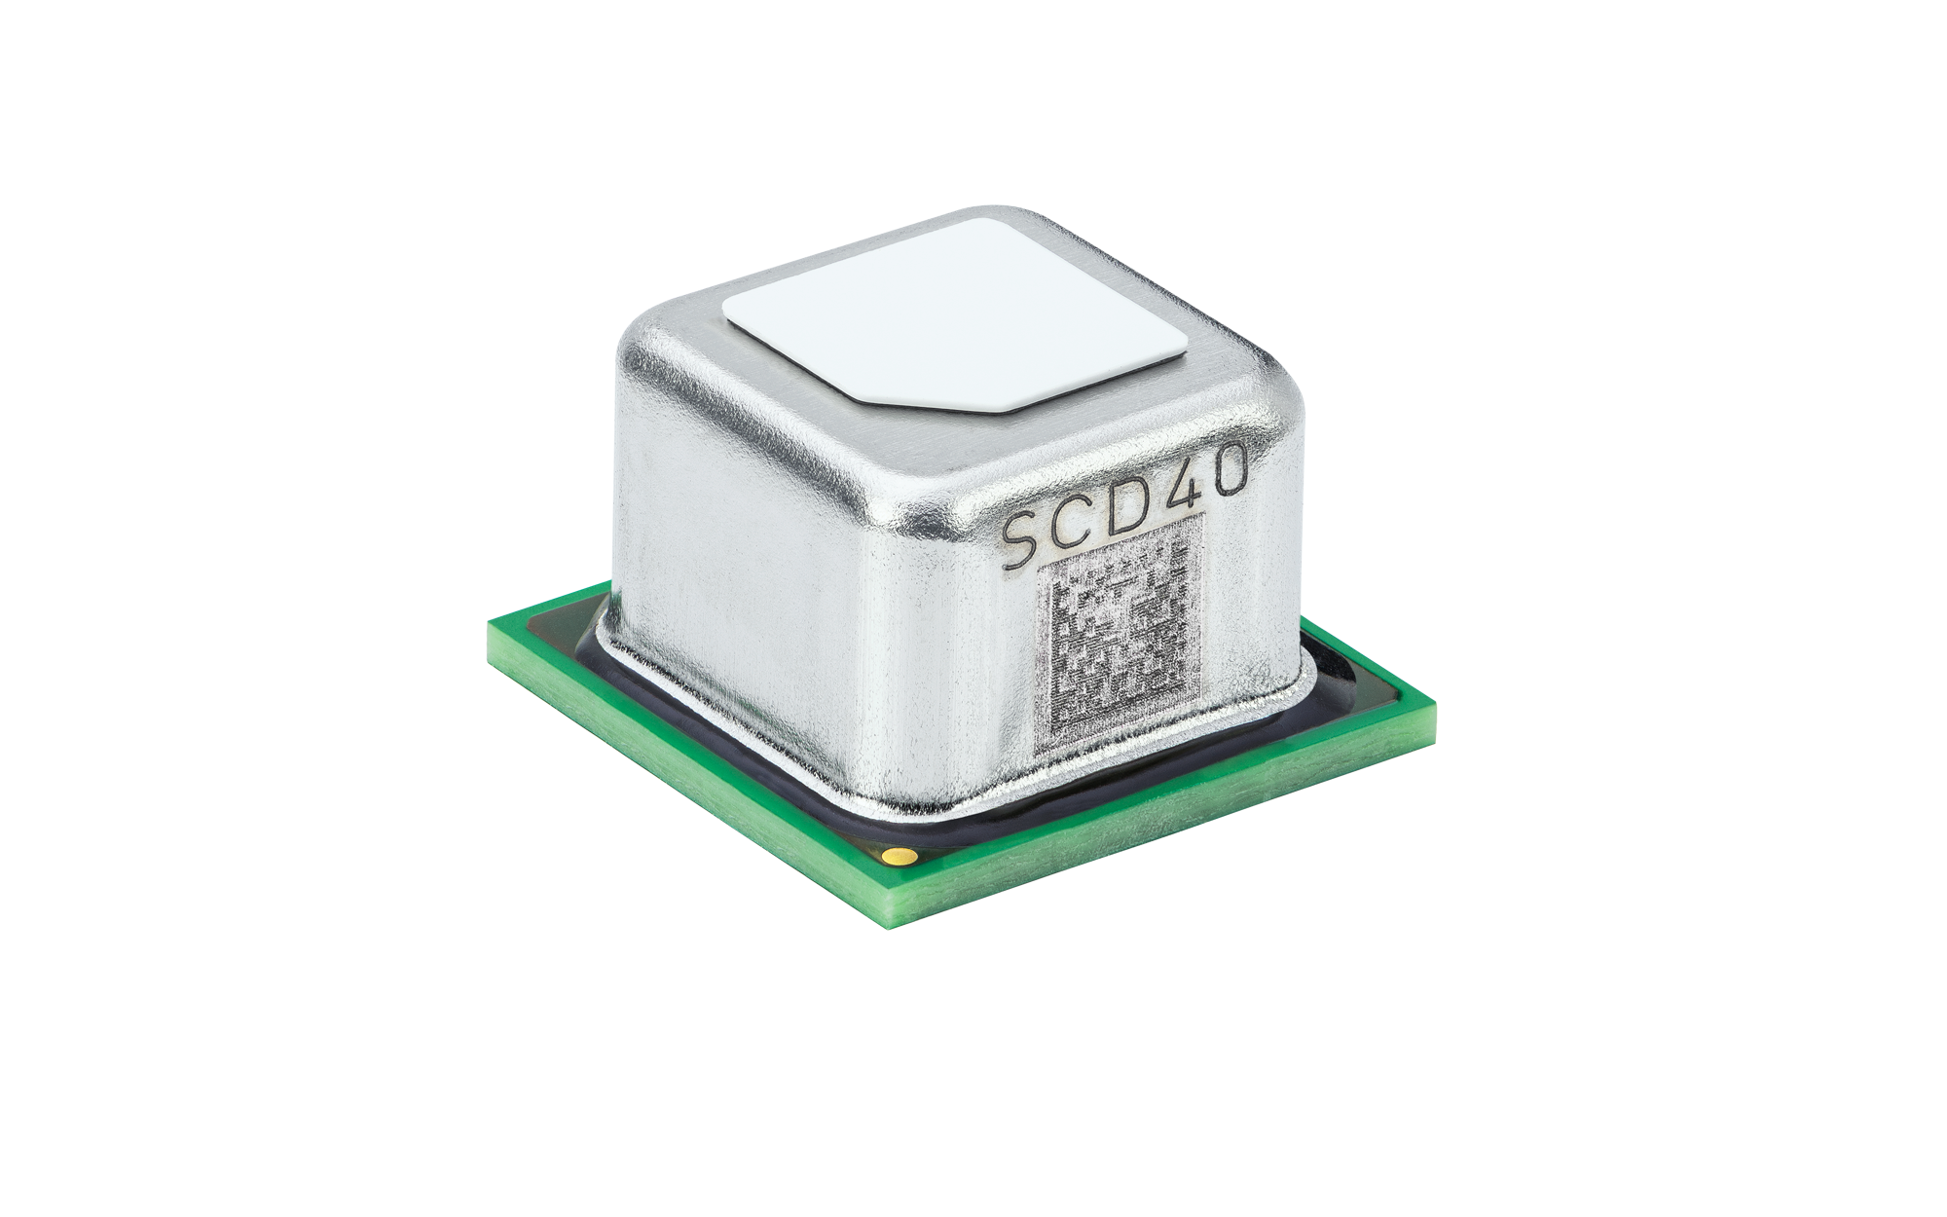
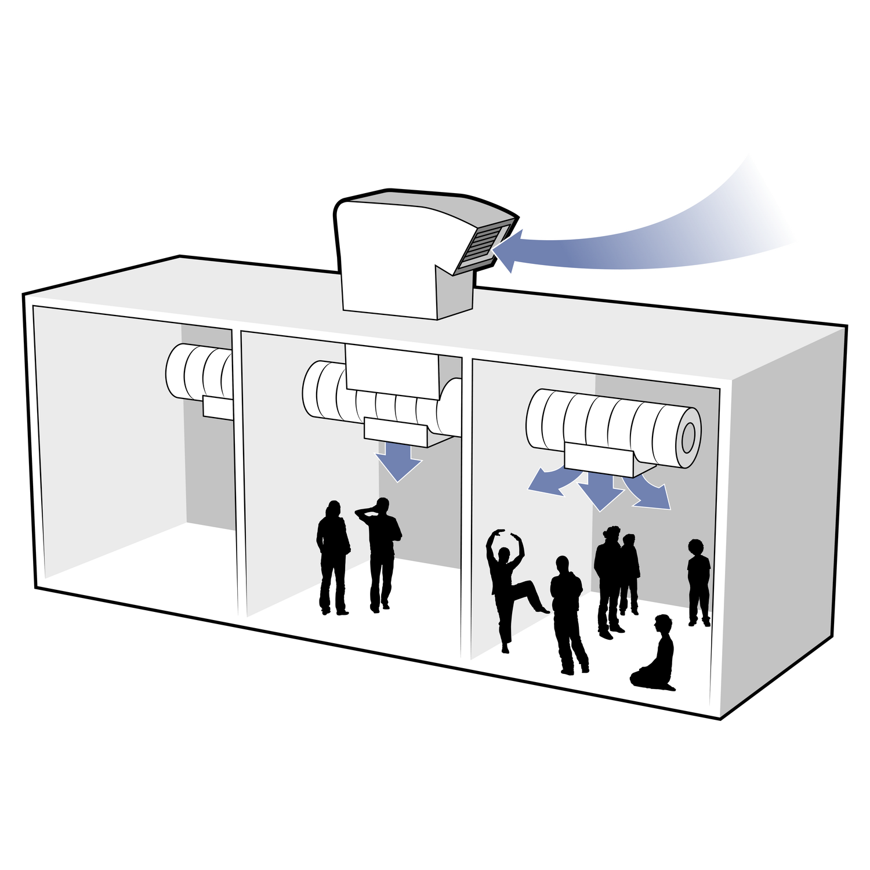

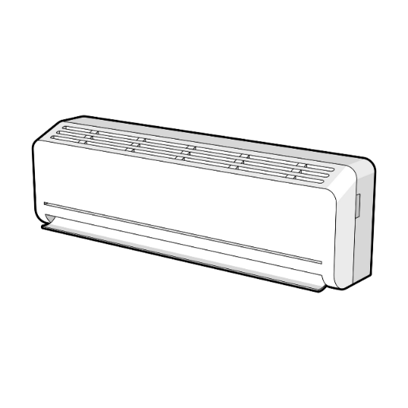
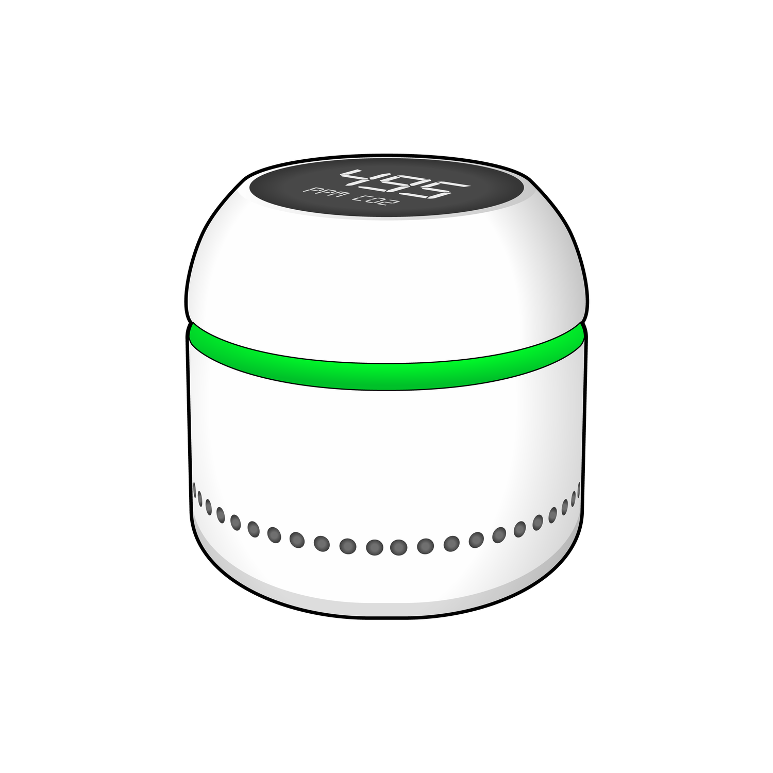
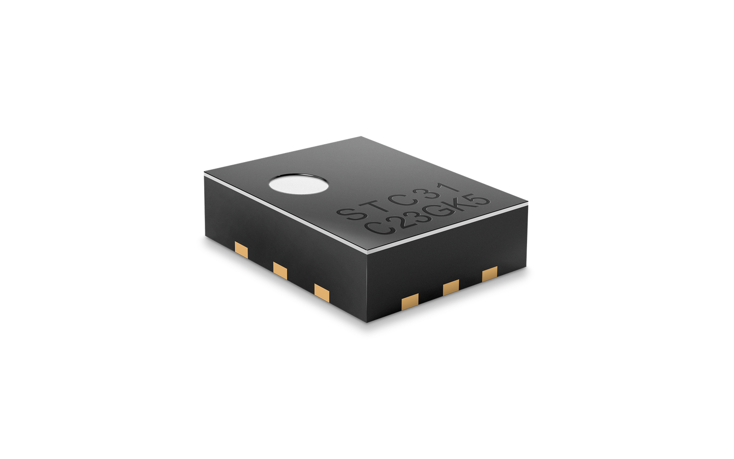
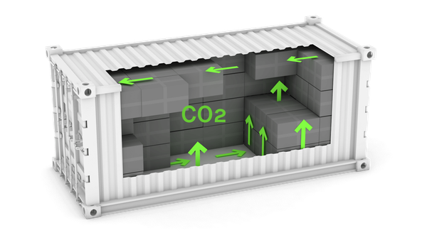
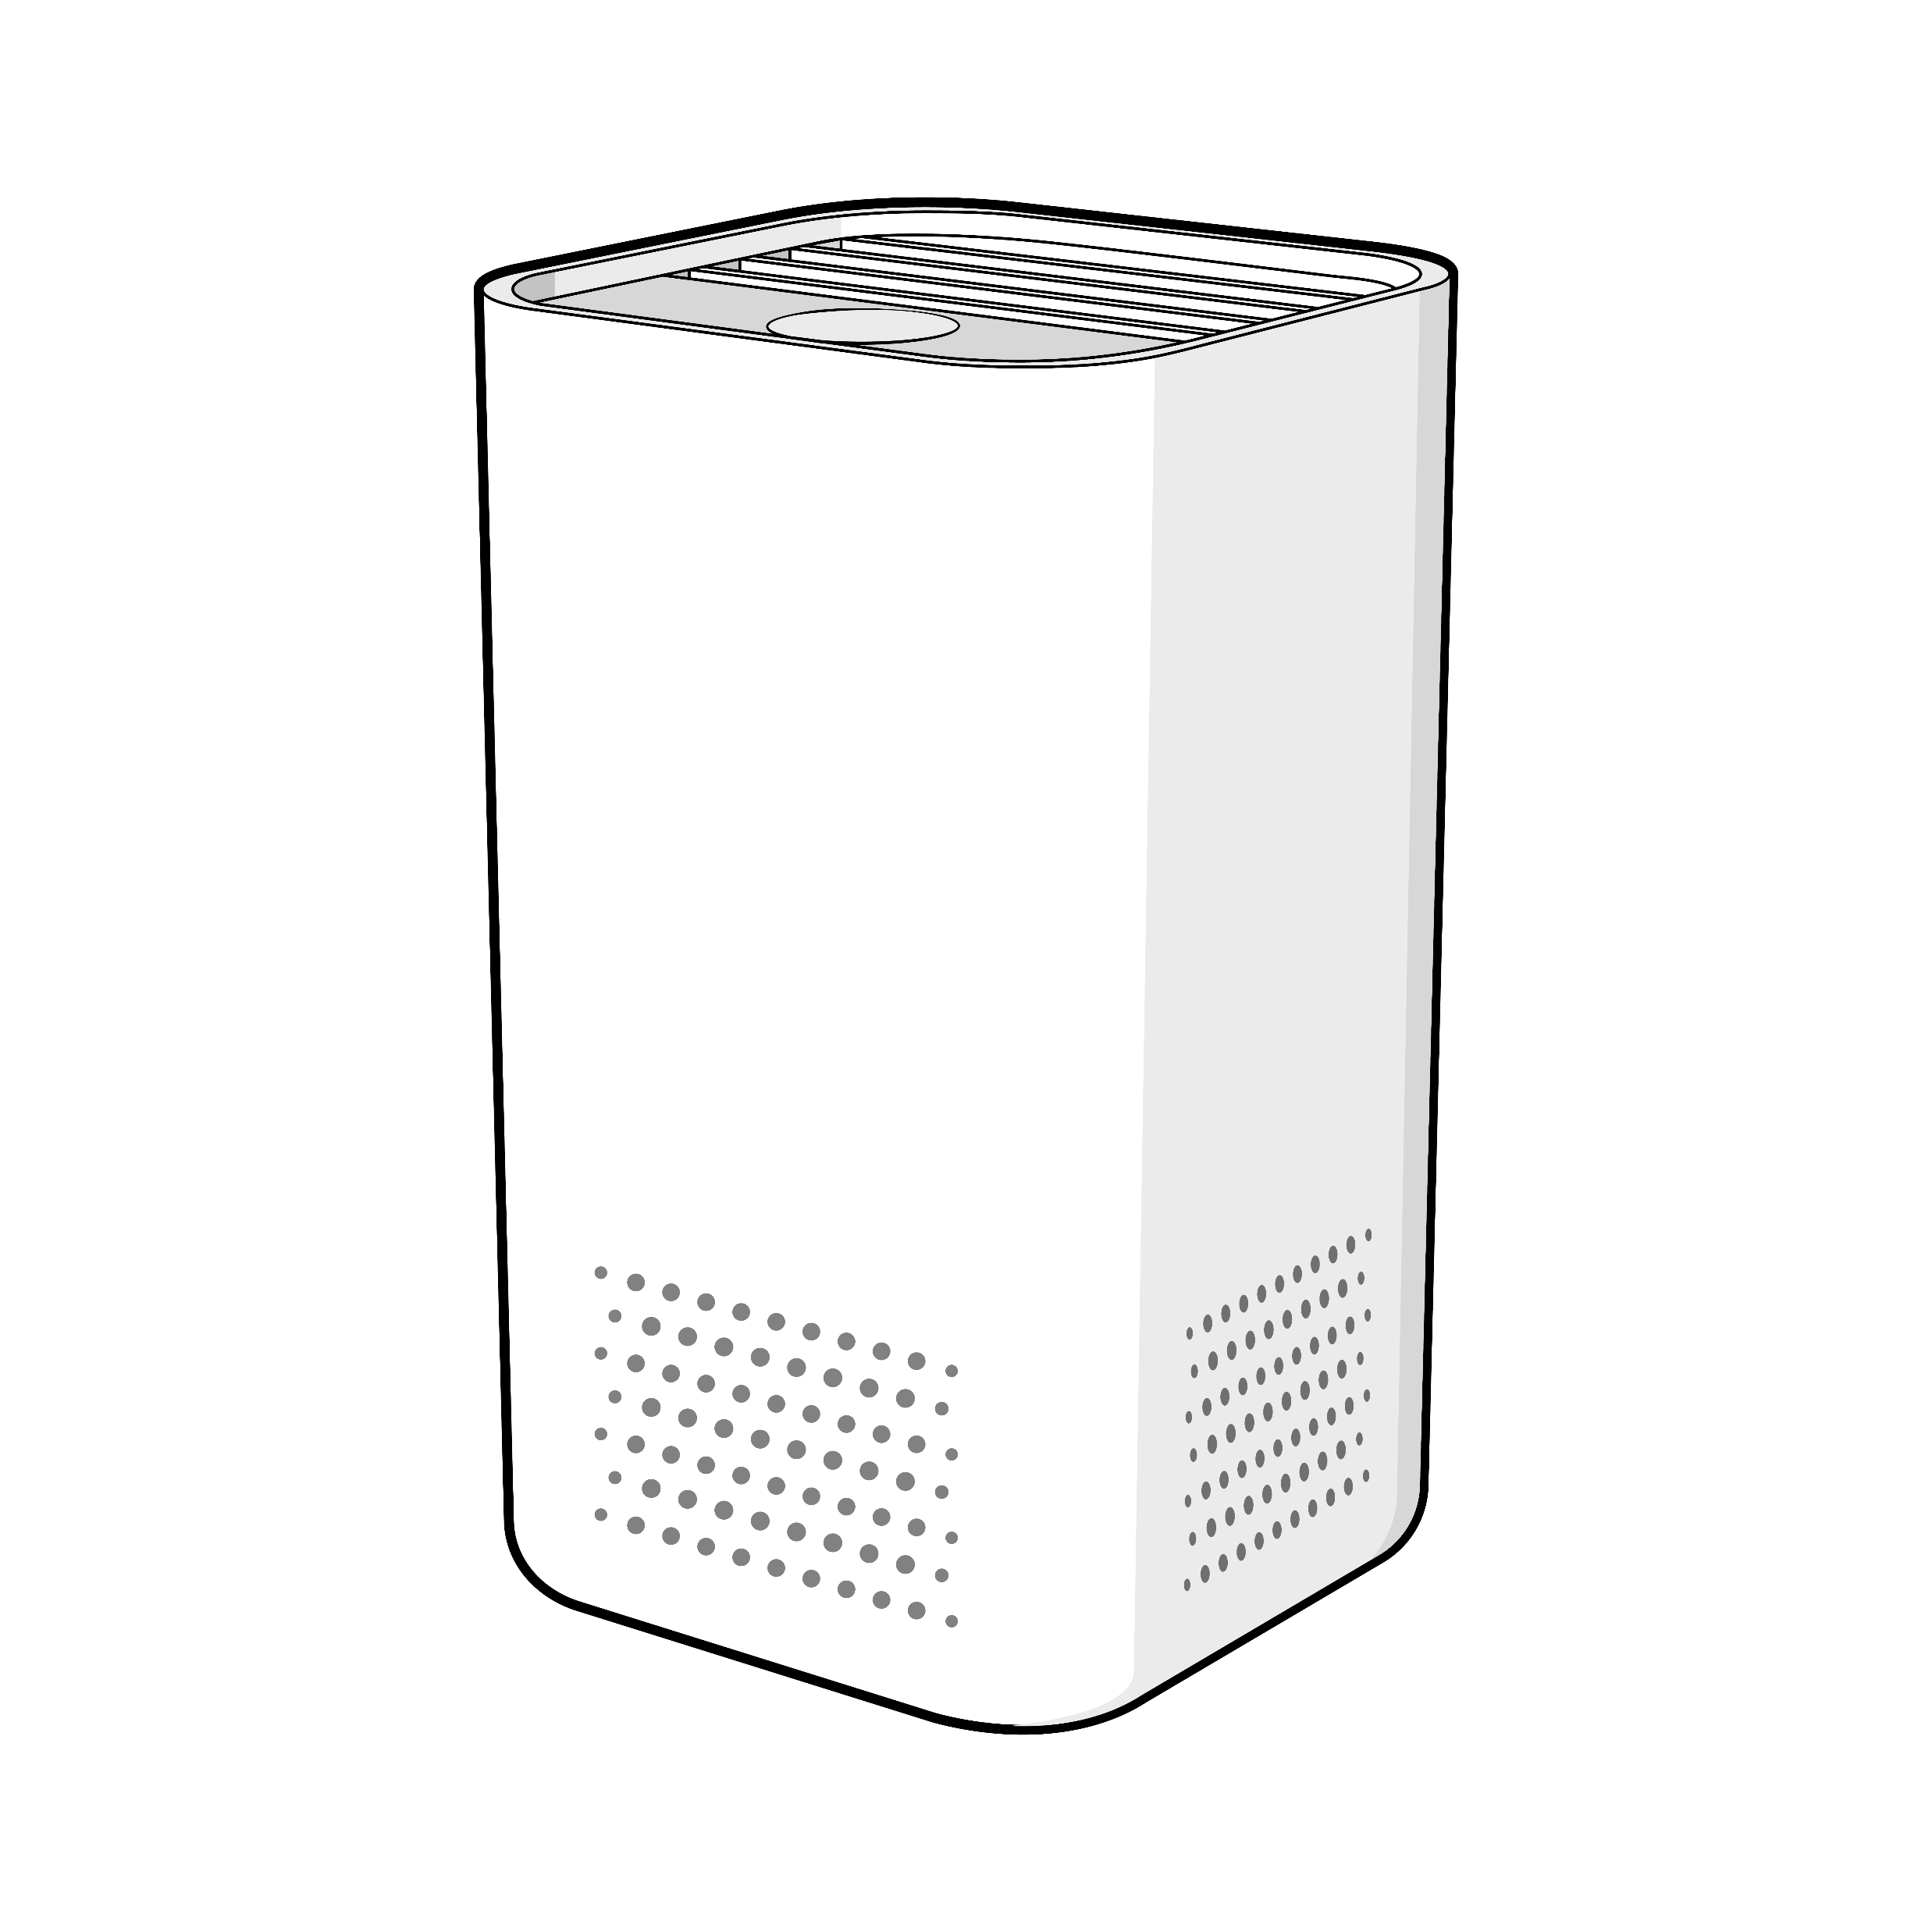
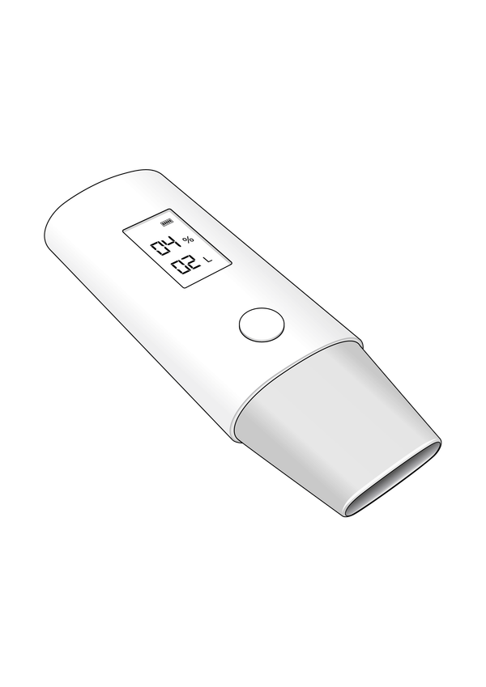
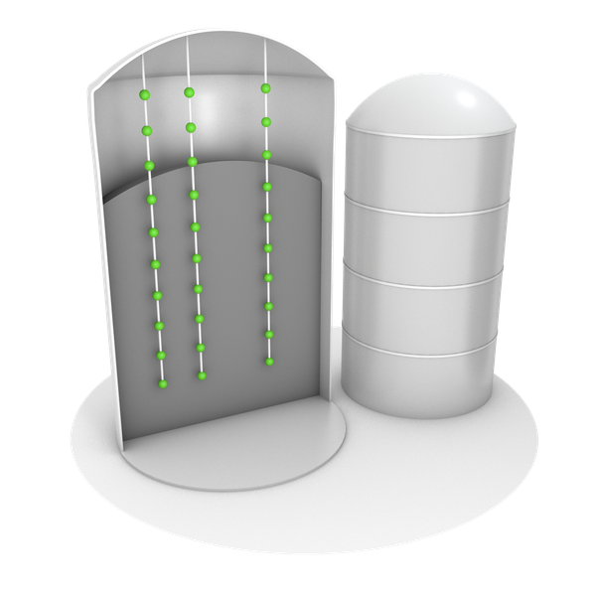
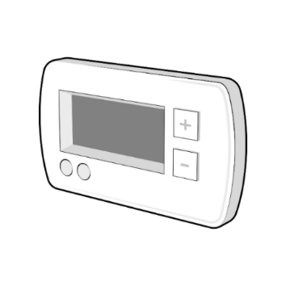
Sensirion CO₂ Sensing Portfolio
The right sensor for every application
SCD30 Best-in-class NDIR CO₂ sensor
Properties
High Accuracy
Small Size
Low Price
Low Power
Fast Response
Applications
Applications
Properties
High Accuracy*
Small Size
Low Price
Low Power
Fast Response
SCD4x Small & cost-competitive PA NDIR CO₂ sensors
DCV
DCV
IAQM
Appliances
STCC4 Low-concentration
TC CO₂ sensor
Properties
High Accuracy
Small Size
Low Price
Low Power
Fast Response
Applications
Applications
Properties
High Accuracy*
Small Size
Low Price
Low Power
Fast Response
STC31-C High-concentration
TC CO₂ sensor
CA Transport
IAQM
Appliances
Grain Storage
Breath Analysis
Thermostats
*Specification dependent on sensor variant
15
© Copyright Sensirion, Switzerland

Slide 16
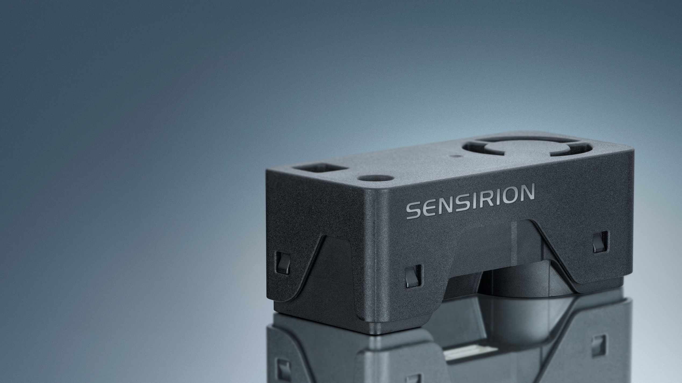
SEN6x
All-In-One Combo Solution for Air Quality Monitoring
September 2025

Slide 17


New SEN6x Releases!!!
A Modular Platform Tailored to Your Customer's Application
SEN62 – PM, RHT
SEN63C – PM, RH&T, CO₂
STCC4
SEN65 – PM, RH&T, VOC & NO_{X}
SEN66 – PM, RH&T, VOC & NO_{X}, CO₂
SEN68 – PM, RH&T, VOC & NO_{X}, HCHO
SFA40
SEN69C – PM, RH&T, VOC & NO_{X}, HCHO, CO₂
SFA40 + STCC4
Identical physical interface for all variants!
→ One Design-In
17
© Copyright Sensirion, Switzerland
Notes:
So What does the SEN6x line offer you? Your application is unique and maybe you don’t need all the parameters.
That’s the beauty of SEN6x, it is built as a modular platform. You choose which parameter matter to you in your application. We offer a total of four different models, tailored to different applications.
SEN60 is our lowest cost particulate matter sensor that we ever offered.
SEN63C is the most affordable way to get CO2 sensing in a module
SEN65 adds relative humidity, temperature, VOC and NOx measurements in addition to PM, this makes it for example perfect for air purifiers
SEN66 adds CO2 to that mix, which is ideal for Indoor air quality monitors or as actionable signal in energy recovery ventilation or HVAC systems, that can use it to optimize their energy consumption while making sure that the CO2 levels stay at an optimal level
SEN68 offers PM, RH&T, VOC, NOx and Formaldehyde, this fits premium air purifiers with special filter that can decompose the Formaldehyde or indoor air quality monitors for the Asian market
And the best thing is, that all models share one physical formfactor. This means you can design it in once but offer a whole range of different tiers of products. Your requirements have changed? You want to upgrade your product with an additional sensors? No problem, just order another variant without changing your design

Slide 18
SEN6x – Product Family
SEN62 – PM, RH&T
Our lowest cost PM sensor ever!
SEN63C –PM, RH&T, CO₂
All-in-one solution for entry level IAQ monitors
SEN65 – PM, RH&T, VOC & NO_{x}
All-in-one solution for air purifiers
SEN66 – PM, RH&T, VOC & NO_{x}, CO₂
All-in-one solution for IAQ monitors and air exchangers
SEN68 – PM, RH&T, VOC & NO_{x}, HCHO
All-in-one solution for high end air purifiers
SEN69C –PM, RH&T, VOC & NO_{x}, HCHO
All-in-one solution for high end IAQ monitors
Same physical interface for all variants!
→ One Design-In
18
© Copyright Sensirion, Switzerland
Notes:
So What does the SEN6x line offer you? Your application is unique and maybe you don’t need all the parameters.
That’s the beauty of SEN6x, it is built as a modular platform. You choose which parameter matter to you in your application. We offer a total of four different models, tailored to different applications.
SEN60 is our lowest cost particulate matter sensor that we ever offered.
SEN65 adds relative humidity, temperature, VOC and NOx measurements in addition to PM, this makes it for example perfect for air purifiers
SEN66 adds CO2 to that mix, which is ideal for Indoor air quality monitors or as actionable signal in energy recovery ventilation or HVAC systems, that can use it to optimize their energy consumption while making sure that the CO2 levels stay at an optimal level
SEN68 offers PM, RH&T, VOC, NOx and Formaldehyde, this fits premium air purifiers with special filter that can decompose the Formaldehyde or indoor air quality monitors for the Asian market
And the best thing is, that all models share one physical formfactor. This means you can design it in once but offer a whole range of different tiers of products. Your requirements have changed? You want to upgrade your product with an additional sensors? No problem, just order another variant without changing your design

Slide 19
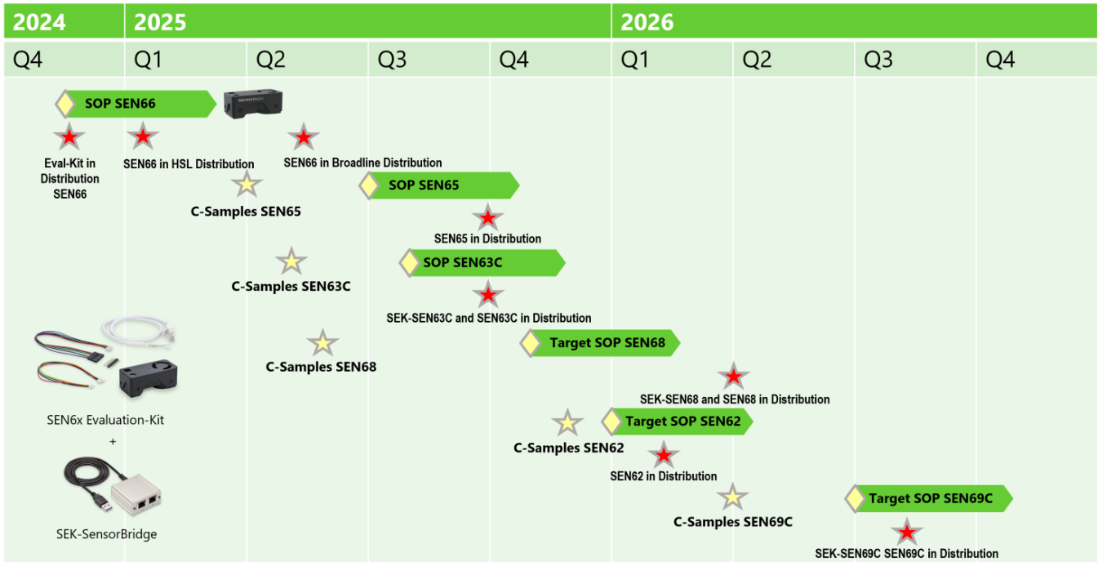
SEN6x Roadmap Summary

Slide 20

Welding
UNLOCKING SUPERIOR VALUE TO WELDERS WITH DIGITAL GAS CONTROL
Alejandro Cebria
Market Manager Process Control

Slide 21

During MIG/MAG, TIG and Plasma welding, a specific gas atmosphere is needed to displace oxygen and other particles that create defects. To achieve this, inert gases are pumped into the welding area.
Too little generates porosity, deffects and insuficient penetration. Too much gas is expensive
Notes:
Inert gases are gases with very low chemical reactivity, meaning they don't easily form compounds with other substances. Historically, these are the noble gases (Helium, Neon, Argon, Krypton, Xenon, Radon) from Group 18 of the periodic table, characterized by their complete outer electron shells. Common inert gases also include nitrogen and carbon dioxide. They are colorless, odorless, and tasteless and are used in applications requiring a non-reactive environment, such as welding, lighting, food preservation, and industrial processes.

Slide 22

CURRENT SITUATION
Pressure regulators are the norm
Limitations:
When the welder isn't running, shielding gas builds up pressure in the hose between the regulator and the torch. When you hit the trigger to start welding, that built-up pressure is released all at once, creating a "surge" of gas.
Why is it a problem?
Turbulence at the weld start: This surge disturbs the shielding gas coverage momentarily, sucking in air and leading to porosity in the weld. To try to fix this, often gas flow is increased as it may seem that there is not enough gas, but this only exacerbates the surge.
Gas waste: You end up using more shielding gas than necessary, which increases costs over time. The longer the gas hose, the greater the waste.
Inconsistent weld starts: Each start might behave a little differently, especially noticeable in precision work.

Slide 23
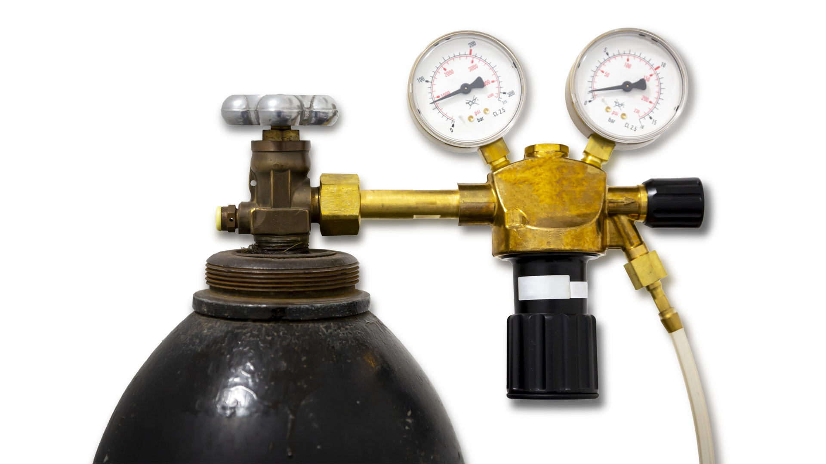
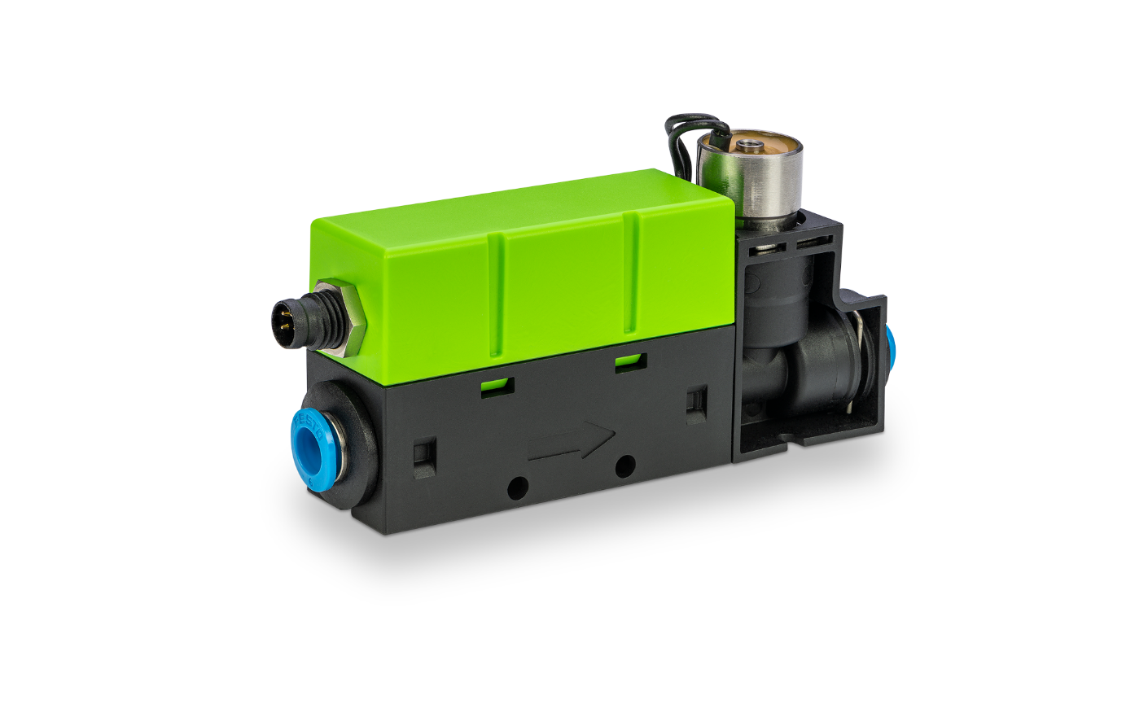
UNLOCK SUPERIOR VALUE WITH SENSIRION’S MFCS
Sensirion MFC

Slide 24
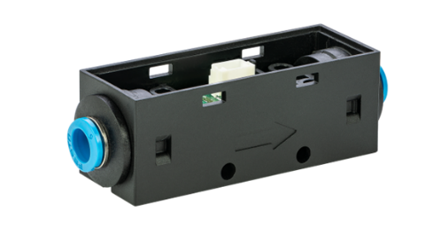
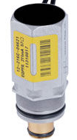
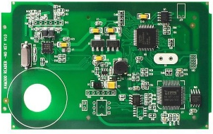
WHY SENSIRION’S MFC
Flow can also be monitored by incorporating a separate flow meter, valve and control electronics.
This is complex and expensive, it requires demanding engineering efforts and complicated gas calibrations.
Streamline the integration with Sensirion’s low cost, plug & play SFC6000
Flow meter
Valve
Sensirion MFC
Electronics

Slide 25

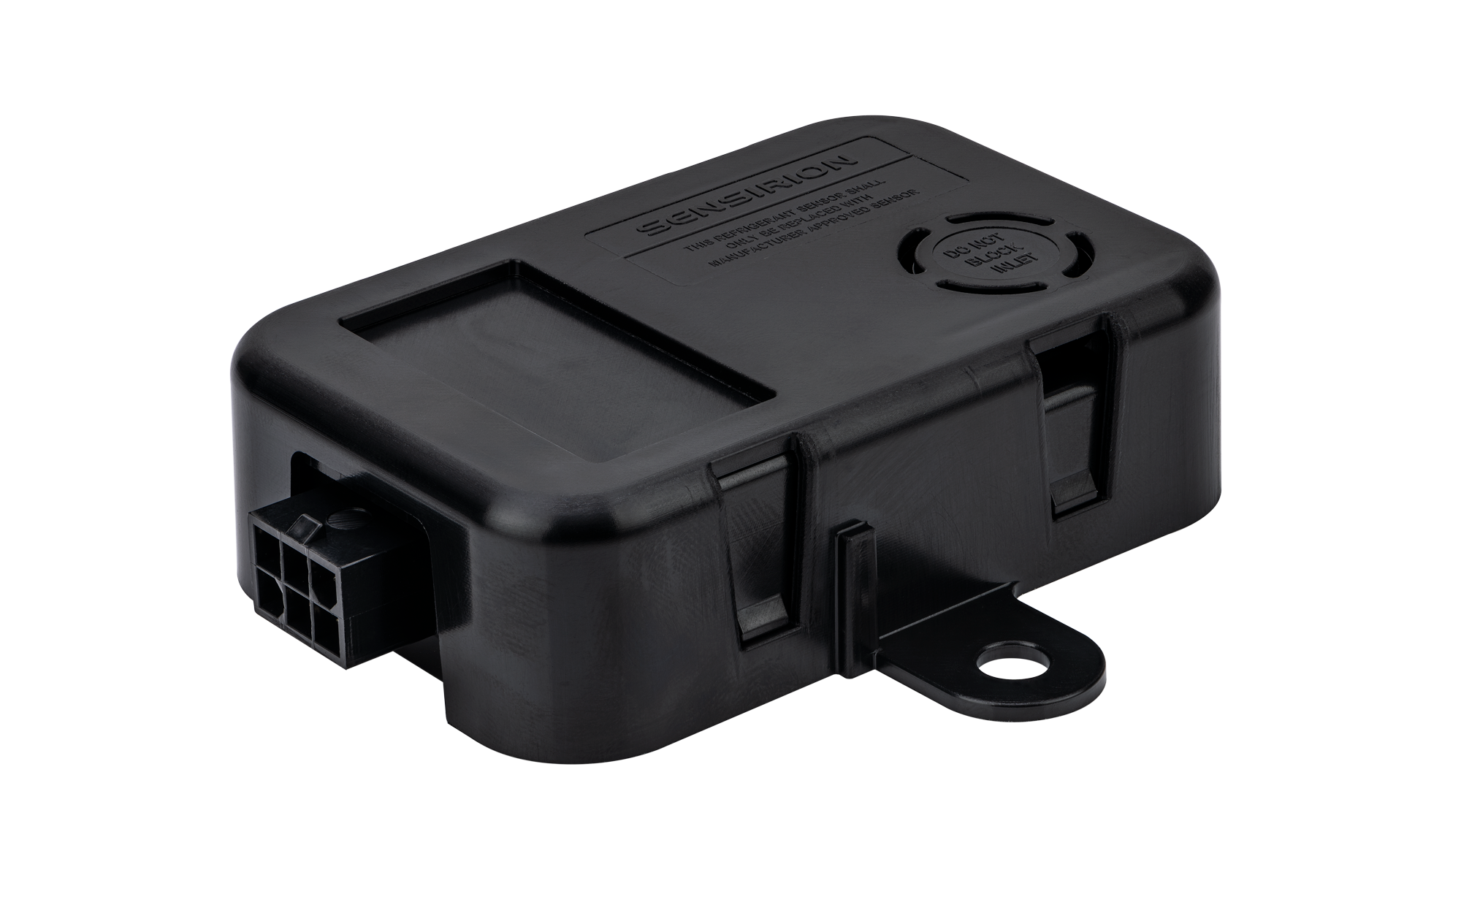
A2L Refrigerant Leak Detection Solutions
1

Slide 26

A2L Updates
A2L Update
SGD43S-M3-S5 and –S7 have been released to the broad line distributors - Arrow, Avnet, Braemac and Future. Registrations available.
One-Pagers A2L to be released (see below)
HVAC Applications –S5
Commercial Refrigeration - S7
A2L Success-Story
Success-Story: Keep Right
Success-Story: Bergstrom
Next step is to reduce the thickness and cost of the standard A2L device and switch manufacturing location to a CM facility in Mexico to get closer to our customers - Q3 2026 with UL approval. We will keep you updated and NOTE: there are no current plans to obsolete the current device coming in from Hungary.
Tariffs out of Hungary for our A2L devices are based on the EU tariff rate and NOT Switzerland.

Slide 27

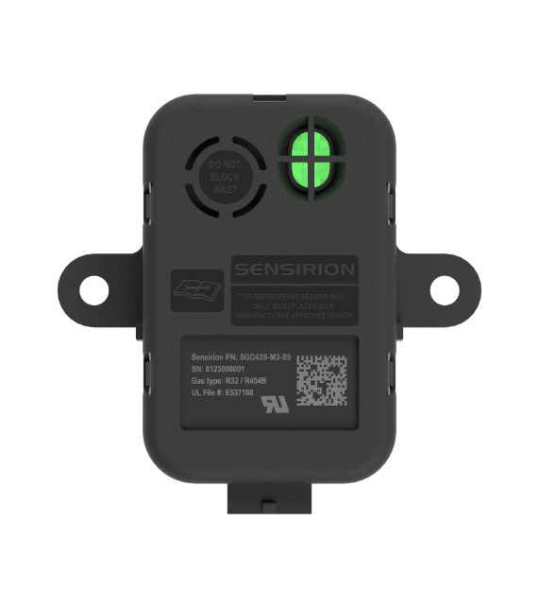

A2L Product Strategy: SGD43S-M3-Sx
UL Listing as a Refrigerant Detection System for easy compliance
SGD43S-M3-S5 HVAC Dual calibration R-32 / R-454B
For UL 60335-2-40 ed. 4.0 and ed. 4.1
Dual calibration (R-32/R-454B) approved
SGD43S-M3-S7 REFRIGERATION Triple calibration R-454A / R-454C / R-455A
For UL 60335-2-89
Triple calibration (R-454A/R-454C/R-455A) approved
BENEFITS to Customer:
Plug-n-Play full RDS Solution
OEM does not need a separate mitigation board
Eliminates need to certify sensor with a separate mitigation board
Meets all the safety and performance requirements

Slide 28

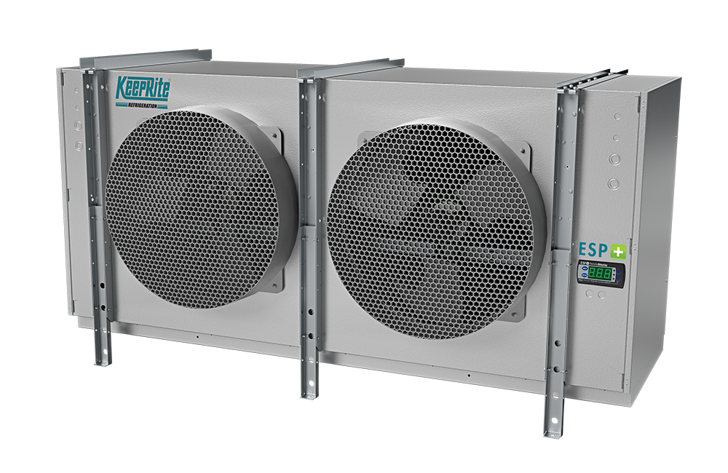
A2L Success Story KeepRite
Customer : KeepRite Refrigeration
Location: Longview TX
Rep Company: MRB
Product: SDG43S-M3-S7
EAU: 30K to 50K
5 year Value: $5M+
Value proposition: Single device for three different A2L refrigerants that is UL approved RDS solution. Ease of implementation and design with minimum additional UL system approvals.
Other factors: Rep support and follow up on lead and help generate interest and need. Liked software interface for Annex MM position testing.

Slide 29

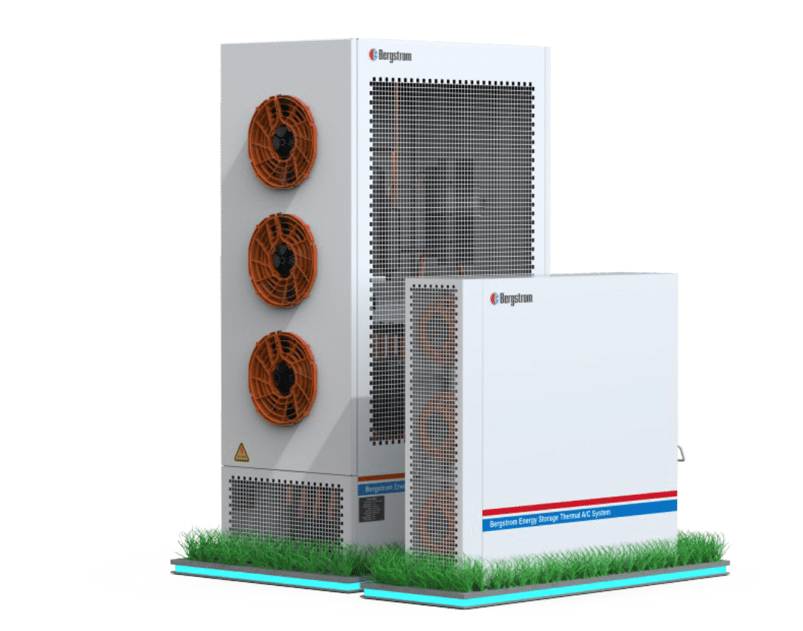
A2L Success Story Bergstrom
Customer : Bergstrom
Location: Rockford, IL
Product: SDG43S-M3-S7
EAU: 15K
5 year Value: $2.5M+
Value proposition: Single device for three different A2L refrigerants that is UL approved RDS solution. Ease of implementation and design with minimum additional UL system approvals.
Other factors: Lead follow from AHR trade show, samples and software testing environment.

Slide 30

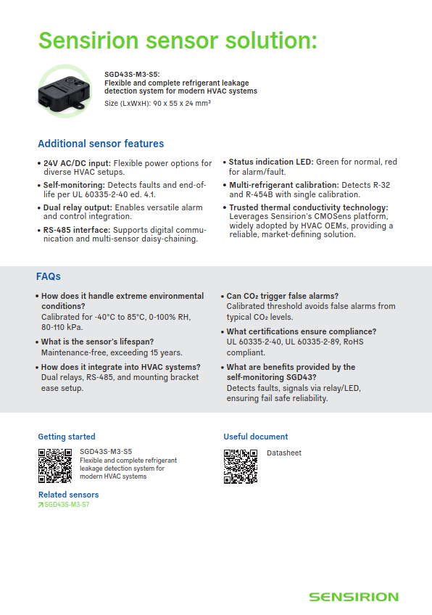
One Pager for HVAC – R32 & R454-B

Slide 31

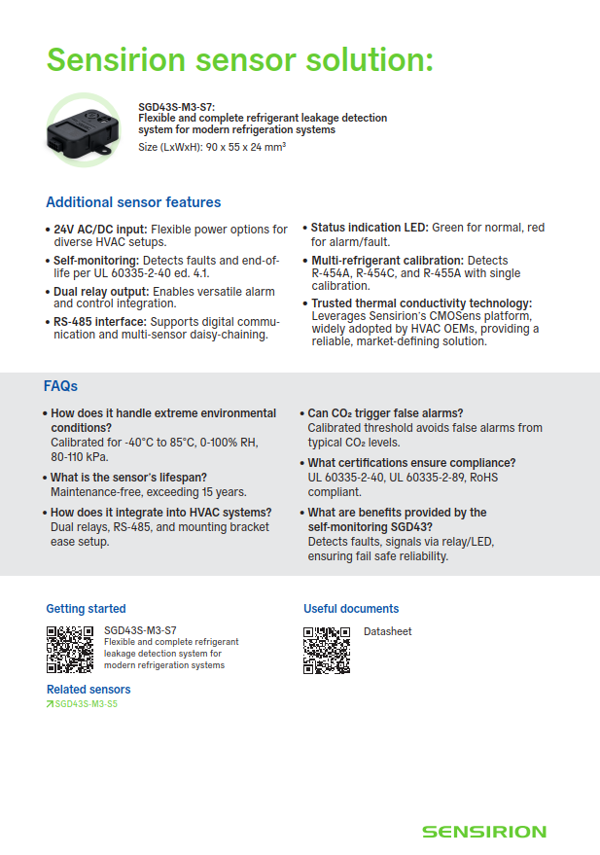
One Pager for Refrigeration – R-454A, R-454C & R-455A

Slide 32
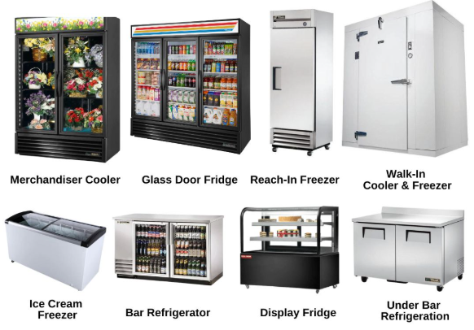
Call to Action
A2L or A3 Commercial Refrigeration
Call to Action:
Investigate Refrigeration OEMs
Mouser and Digikey first time buys.
Questions to Ask:
Are you required to comply to UL 60335-2-89?
Do you use A2L or A3 (Propane) for your refrigerant?
Would you like a full RDS (Refrigerant Detection System) that is already UL Listed?

Slide 33
Distribution updates

Slide 34
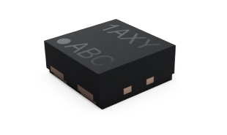
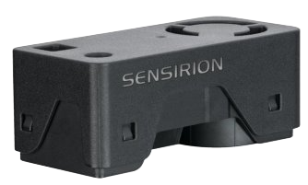
Upcoming NPIs
NPI: STS41A mid of September
NPI: SEN65, SEN63C and SEK-SEN63X end of September

Slide 35
Marketing updates

Slide 36
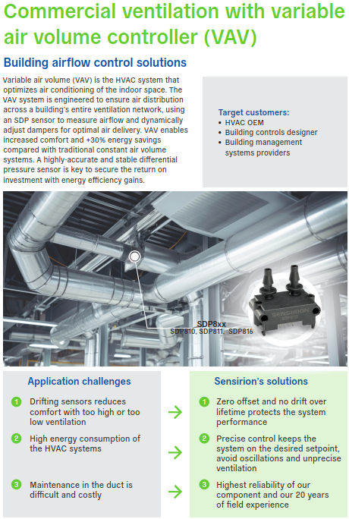
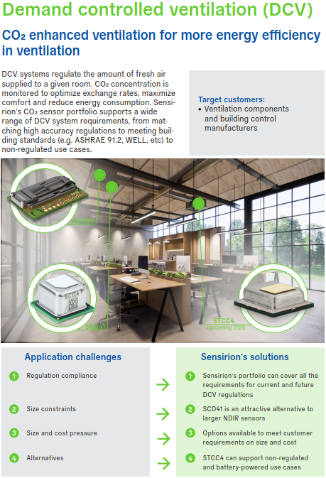
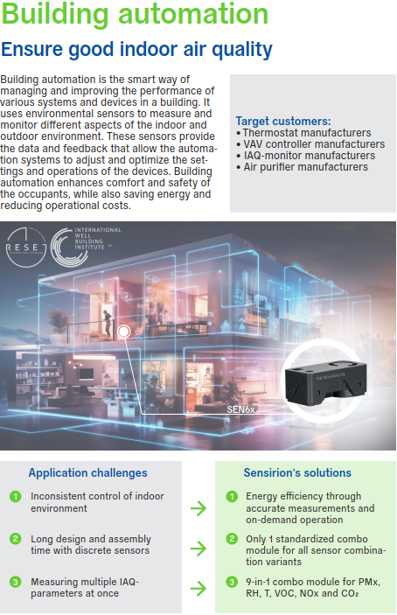
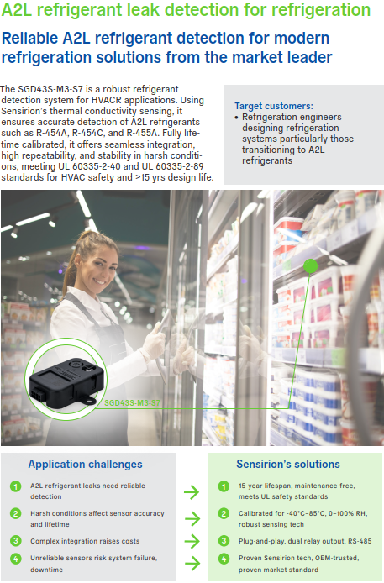

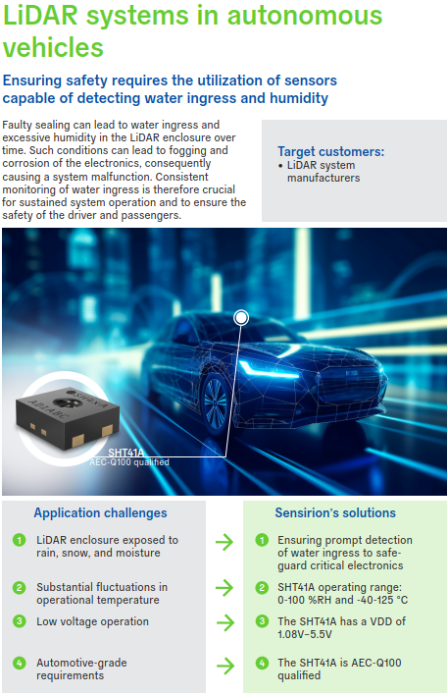
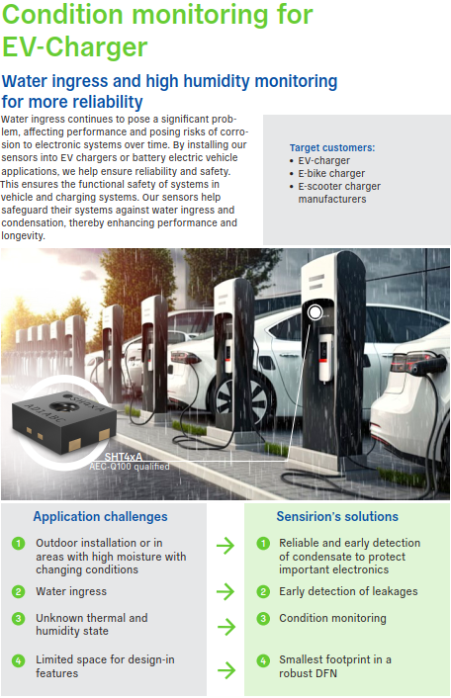
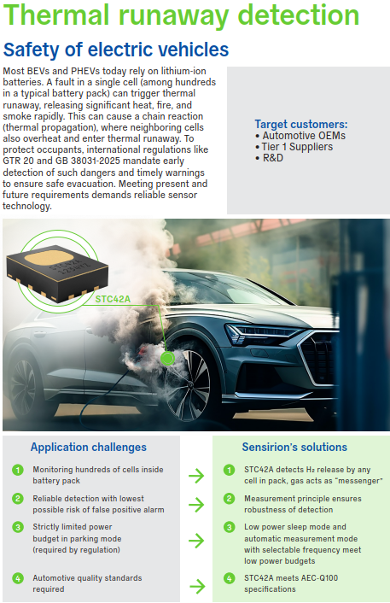
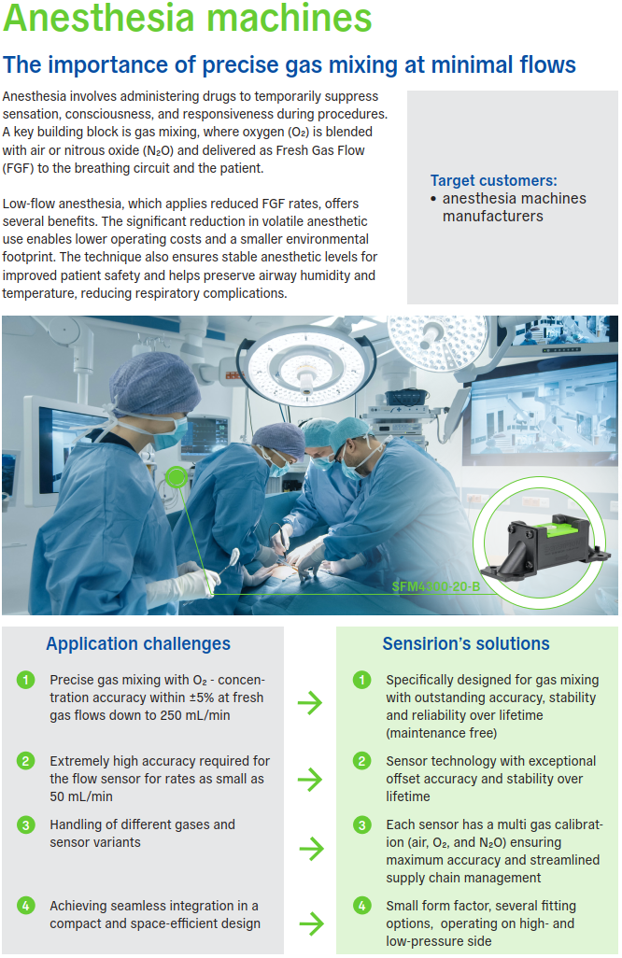
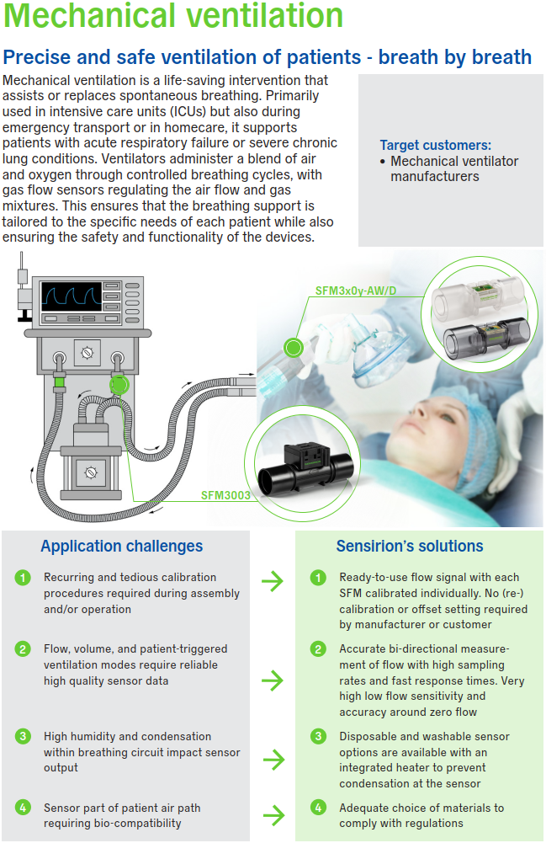
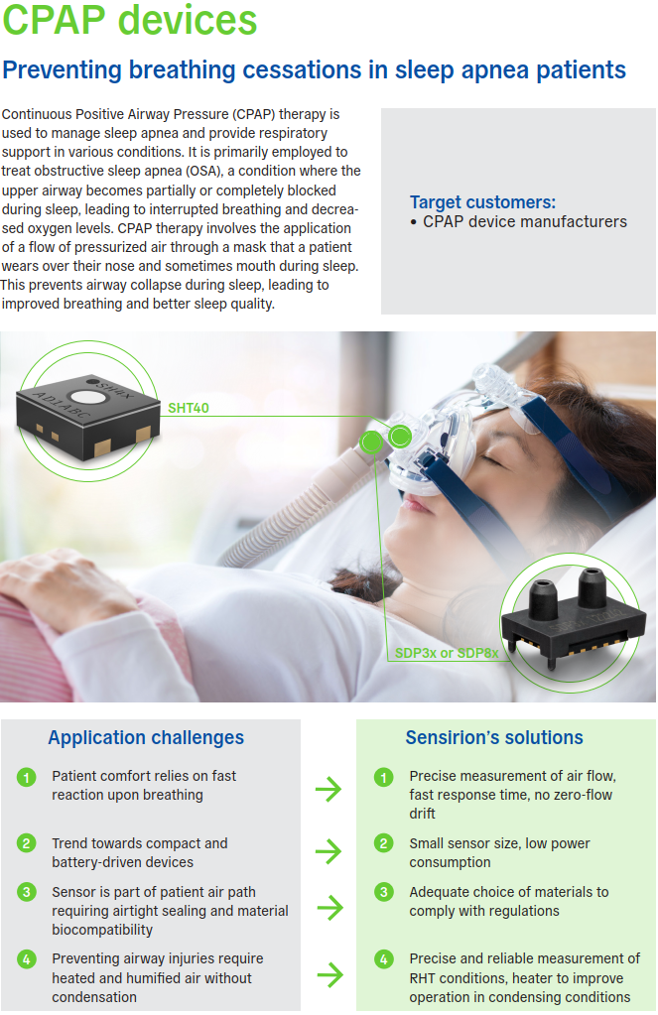

One-pager overview
HVAC
MOBILITY
Commercial ventilation with variable
air volume controller (VAV)
Building automation SEN6x
A2L refrigerant leak detection for refrigeration
Condition monitoring for EV-Charger
Demand controlled ventilation (DCV)
A2L refrigerant leak detection for
HVAC
LiDAR systems
MEDICAL
Thermal runaway detection
Anesthesia machines
Mechanical ventilation
Smart inhaler
CPAP

Slide 37











One-pager overview
INDUSTRIAL
Gas control in Arc welding
Thin film deposition
Pump control liquid flow
Inert gas purging in process
industries
HPLC
Gas chromatography
FOUP
Chemical dosing and dispensing
BESS STC42A
BESS SEN66
BESS SGP40

Slide 38







One-pager overview
MCE
Smoke detectors
Humidity control for fridges
Vape detection
Air purifiers
IAQ monitors
Smart thermostats
Cold chain monitoring for pharmaceuticals

Slide 39

Partner's Portal
Reminders
New Product Introductions
Newsletters
One-pager downloads
Trainings

Slide 40
Inside sales updates

Slide 41
Salesforce Cleanup Project
Merging duplicate rep accounts
Merging duplicate rep contacts
Updating contacts to inactive
Updating Sales rep as the contact in accounts and opportunities

Slide 42

FAE support
Reminder: Please utilize the FAE support for technical inquiry use: info.us@sensiron.com !!! Subject line: Customer Name – Part Number – Application
Please CC: Sensirion RSM & Inside Sales
Please add the Application. This ensures the fastest FAE response.

Slide 43
quiz

Slide 44

And now … win something :) j TOP 3 participants will win an Amazon Gift Card
We play with Kahoot …..​
How to join​
Scan QR Code​ with your cell phone
Or
www.kahoot.com and enter pin​
Login: first name & last name​

