Slide 1

STCC4 CO₂ Sensor
Minimal Size.
Maximize the Potential.
Notes:
We are pleased to announce Sensirion’s latest CO2 sensor, the STCC4. Sensirion minimized the sensor features. Our partners and customers can maximize the market potential.

Slide 2
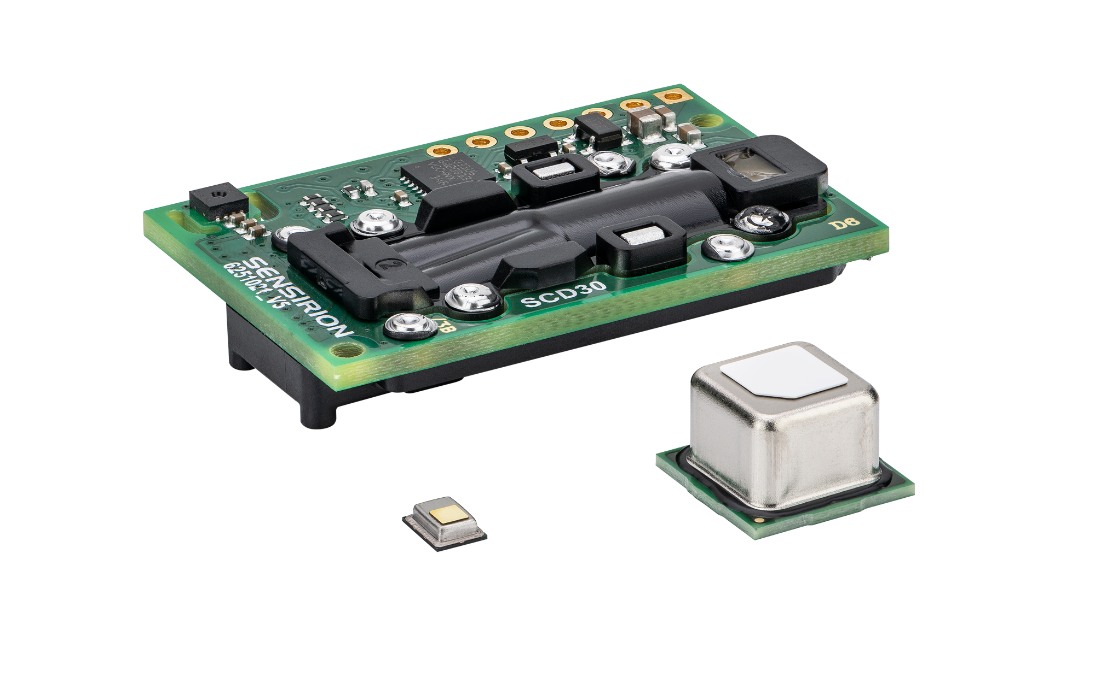
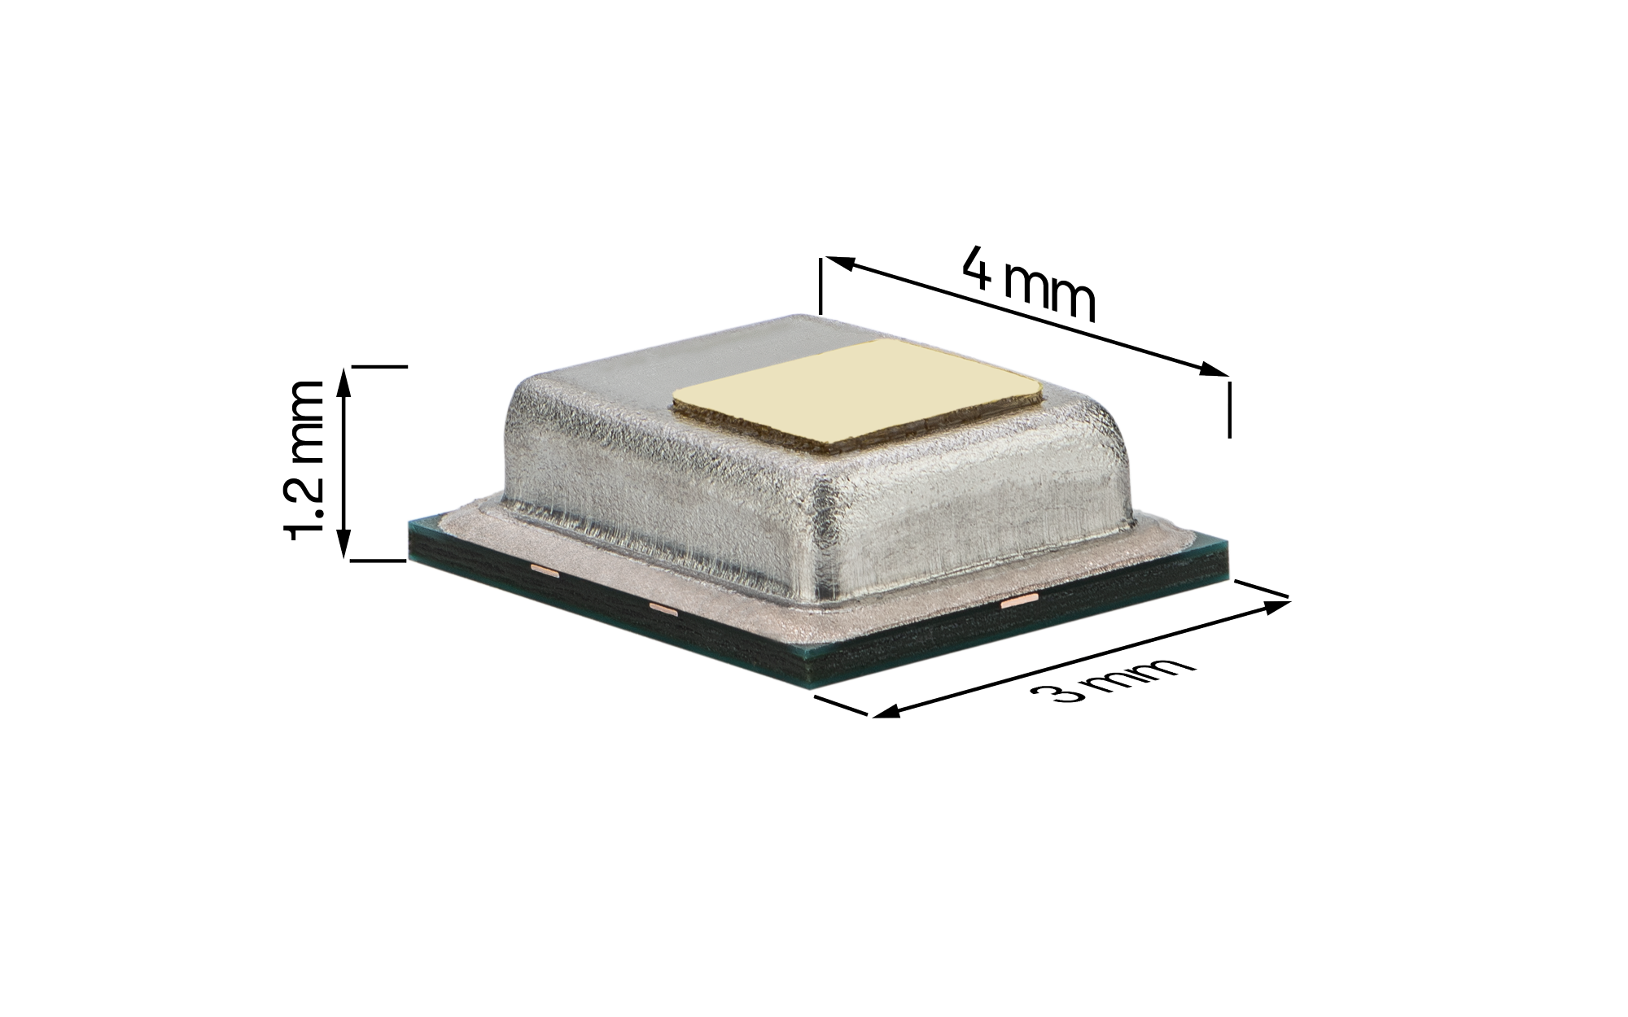
STCC4
Minimal Size.
Maximize the Potential.
SCD30
Striking the right balance between performance, size, power consumption and price. Optimized for indoor air quality applications in monitors, appliances and thermostats.
~50x
smaller form factor than SCD4x
±(100ppm+10%) optimized accuracy for IAQ applications
<100 µA possibility for low power applications
SCD4x
STCC4
Cost-efficiency
compared to optical sensors
Notes:
The STCC4 CO2 sensor strikes the right balance between performance, size, power consumption and price.
Based on the thermal conductivity sensing principle, this sensor has four critical features:
A small form factor on the order of 50 times smaller than SCD4x
A better cost efficiency compared to optical sensors
Low power feasibility with current consumption below 1 mA in continuous operation
And sufficient accuracy for general air quality monitoring with a specification of +-(100 ppm + 10%).
We believe this sensor is a great match for indoor air quality applications such as monitors, appliances and thermostats, but also opens up new applications that were previously hindered by size and cost limitations.

Slide 3

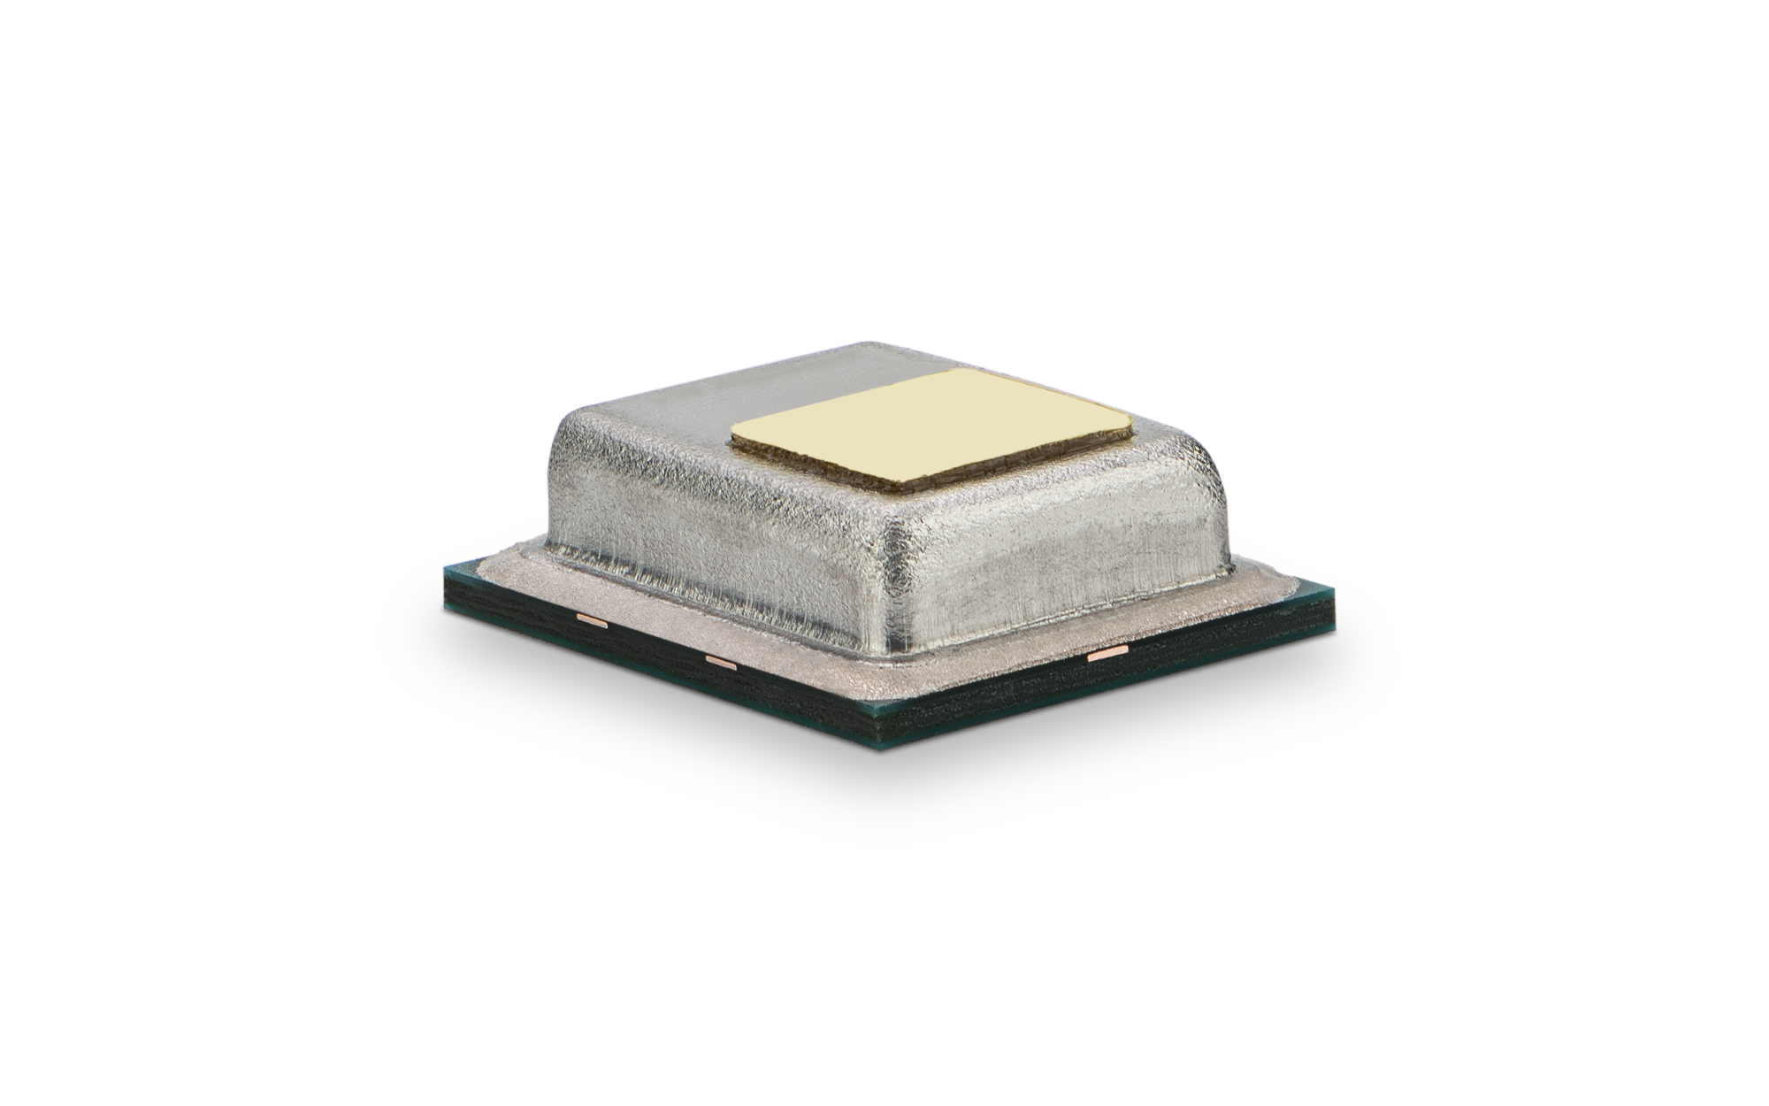
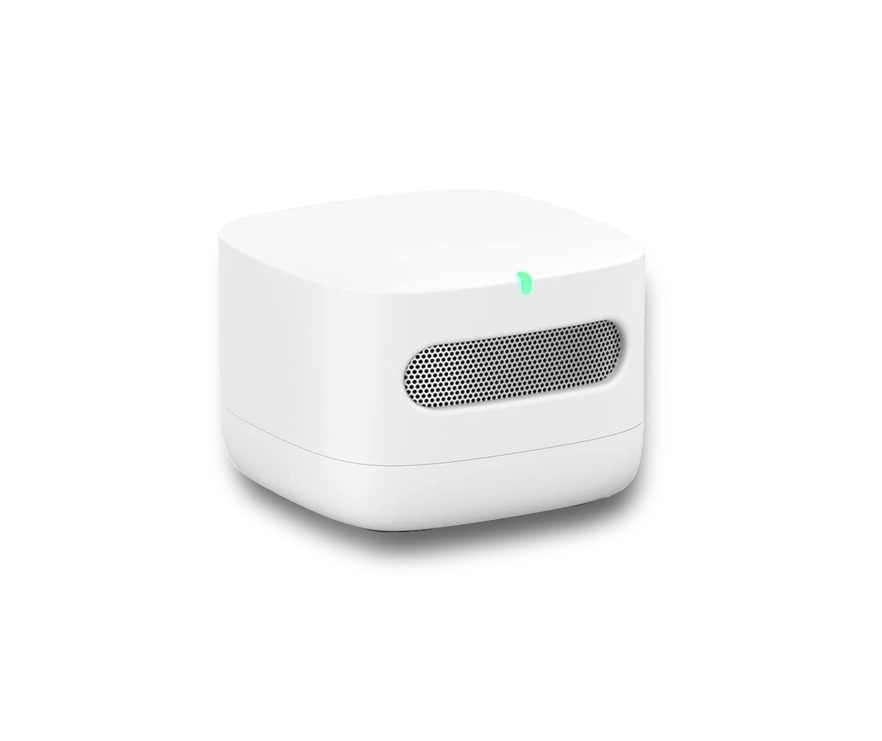
STCC4
We minimized the features.
You maximize the potential.
Engineered and manufactured in Switzerland
Two operation modes to meet different power budgets
Dedicated I²C controller interface for SHT4x RHT compensation
SMD assembly and tape & reel packaging enable high-volume applications
Digital I²C interface for straight-forward sensor communication
Notes:
Other features of STCC4 which add to the value proposition are:
Swiss engineering and manufacturing
Two operation modes to enable different power budgets
Dedicated I2C controller interface to easily compensate RHT from SHT4x
SMD assembly and tape & reel packaging to enable high-volume applications
And a digital I2C interface for straight-forward sensor communication

Slide 4
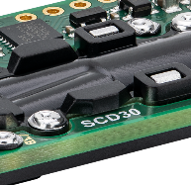
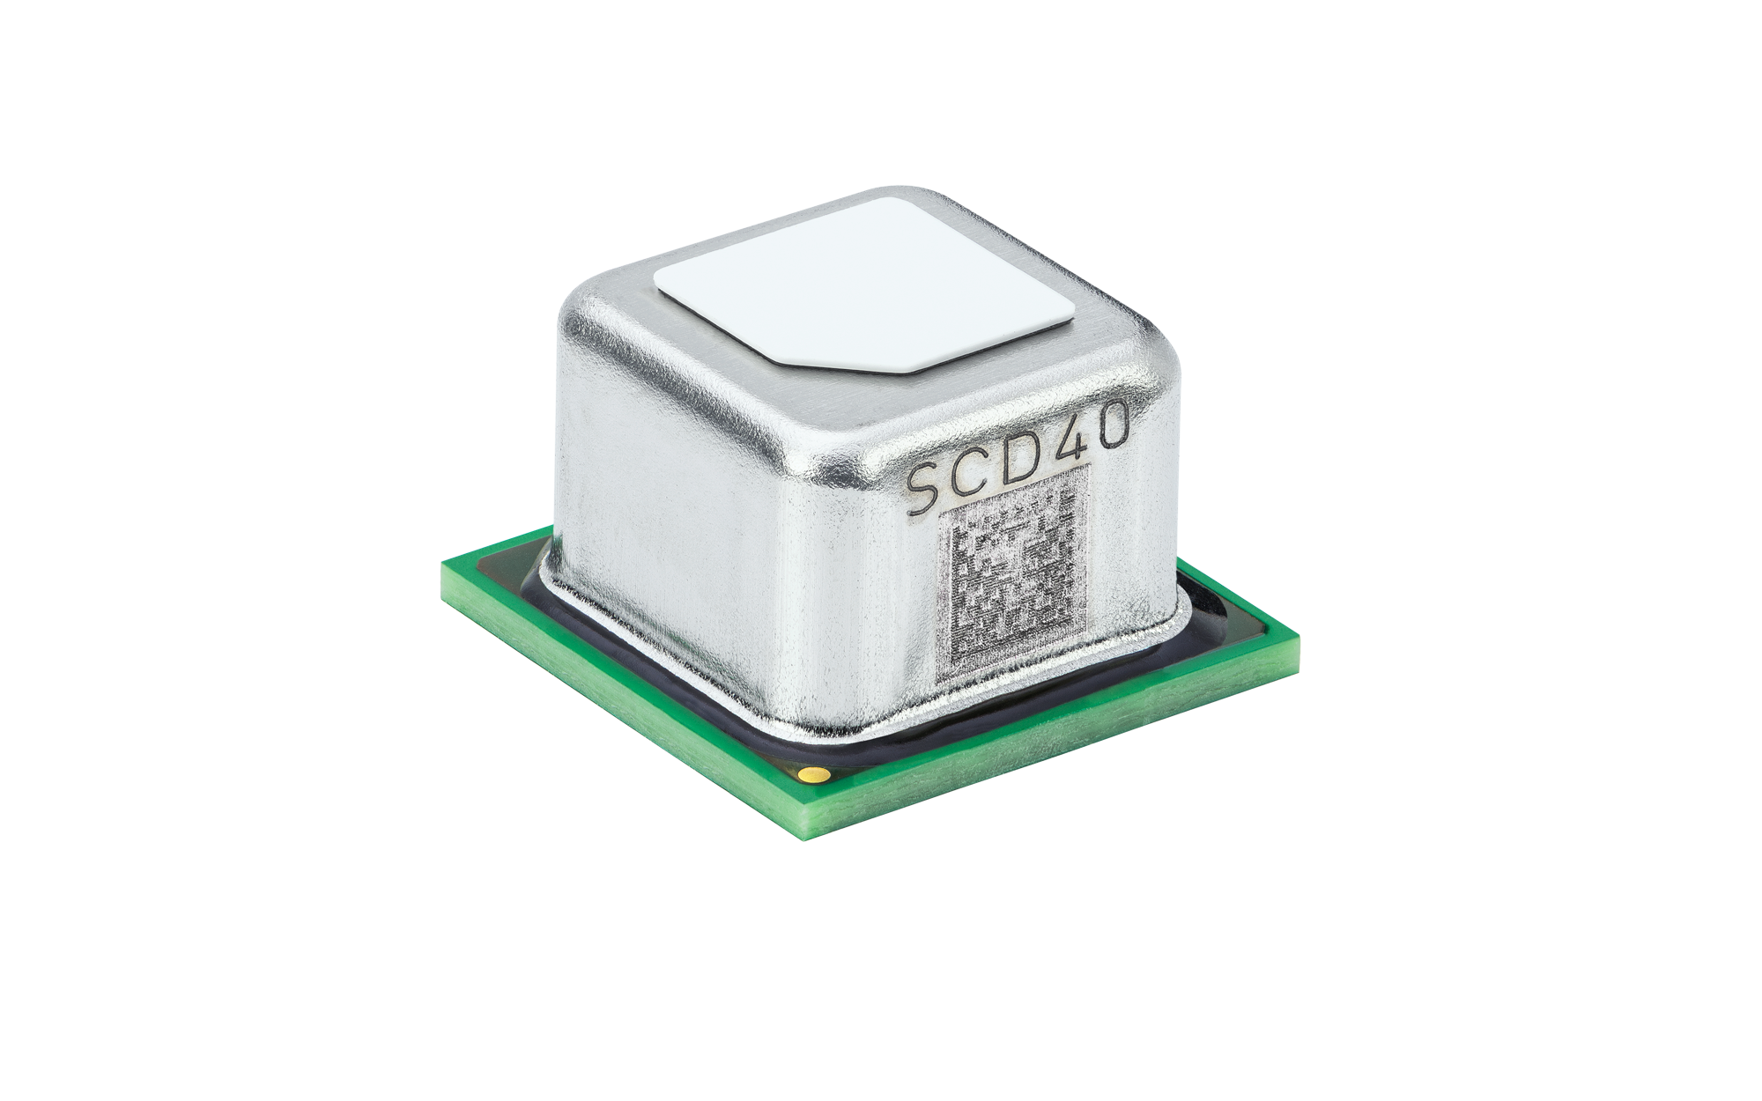
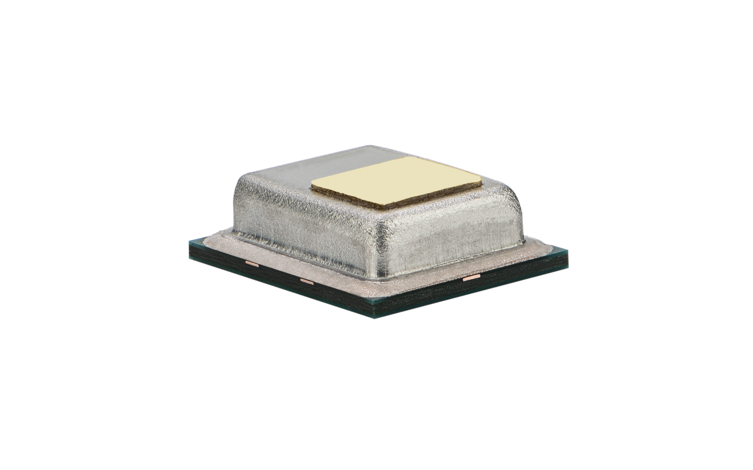
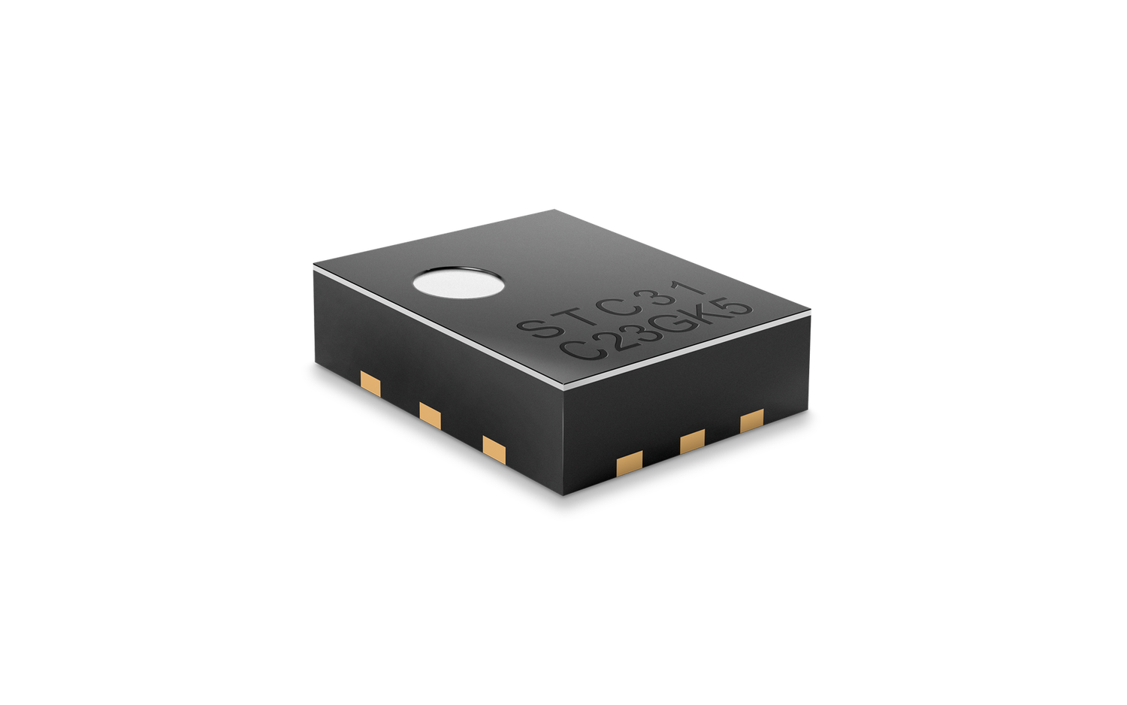
Sensirion CO₂ Sensing Portfolio
The right sensor for every application
SCD30 Transmissive dual channel NDIR sensor with best-in-class accuracy for the most demanding applications: ±(30 ppm + 3%)
SCD4x
World’s smallest optical CO₂ sensor based on photoacoustic NDIR. Capable of fulfilling accuracy specifications for several IAQ standards (RESET, WELL, California Title 24). Three variants available to meet a range of use cases and operation modes.
STCC4
Unmatched form factor and low cost paired with optimized accuracy for general air quality monitoring: ±(100 ppm + 10%)
STC31-C
Smallest CO₂ sensor for high concentration applications in consumer and medical breath measurement as well as produce transportation, storage and industrial applications.
4
© Copyright Sensirion, Switzerland
Notes:
The introduction of STCC4 to the Sensirion CO2 sensing portfolio further enables applications where CO2 sensing can bring value.
The most demanding and regulated applications in CO2 monitoring can be met by SCD30, which has best-in-class accuracy.
SCD4x meets several IAQ standards while having a small footprint and competitive price. Two variants are available to meet a variety of use cases.
For the most size- and cost-sensitive customers that want a CO2 feature, the STCC4 is the right choice.
For high volume CO2 concentration applications, the STC31-C offers and small and fast solution.
No matter what our customers need, Sensirion has a solution.
We at Sensirion look forward to finding opportunities for STCC4 in CO2 sensing with our channel partners.

