Slide 1


SGD43S-M3-Sx
A2L Refrigerant Detection System
Notes:
We are pleased to announce Sensirion’s latest A2L refrigerant detection system, the SGD43S-M3-Sx.

Slide 2
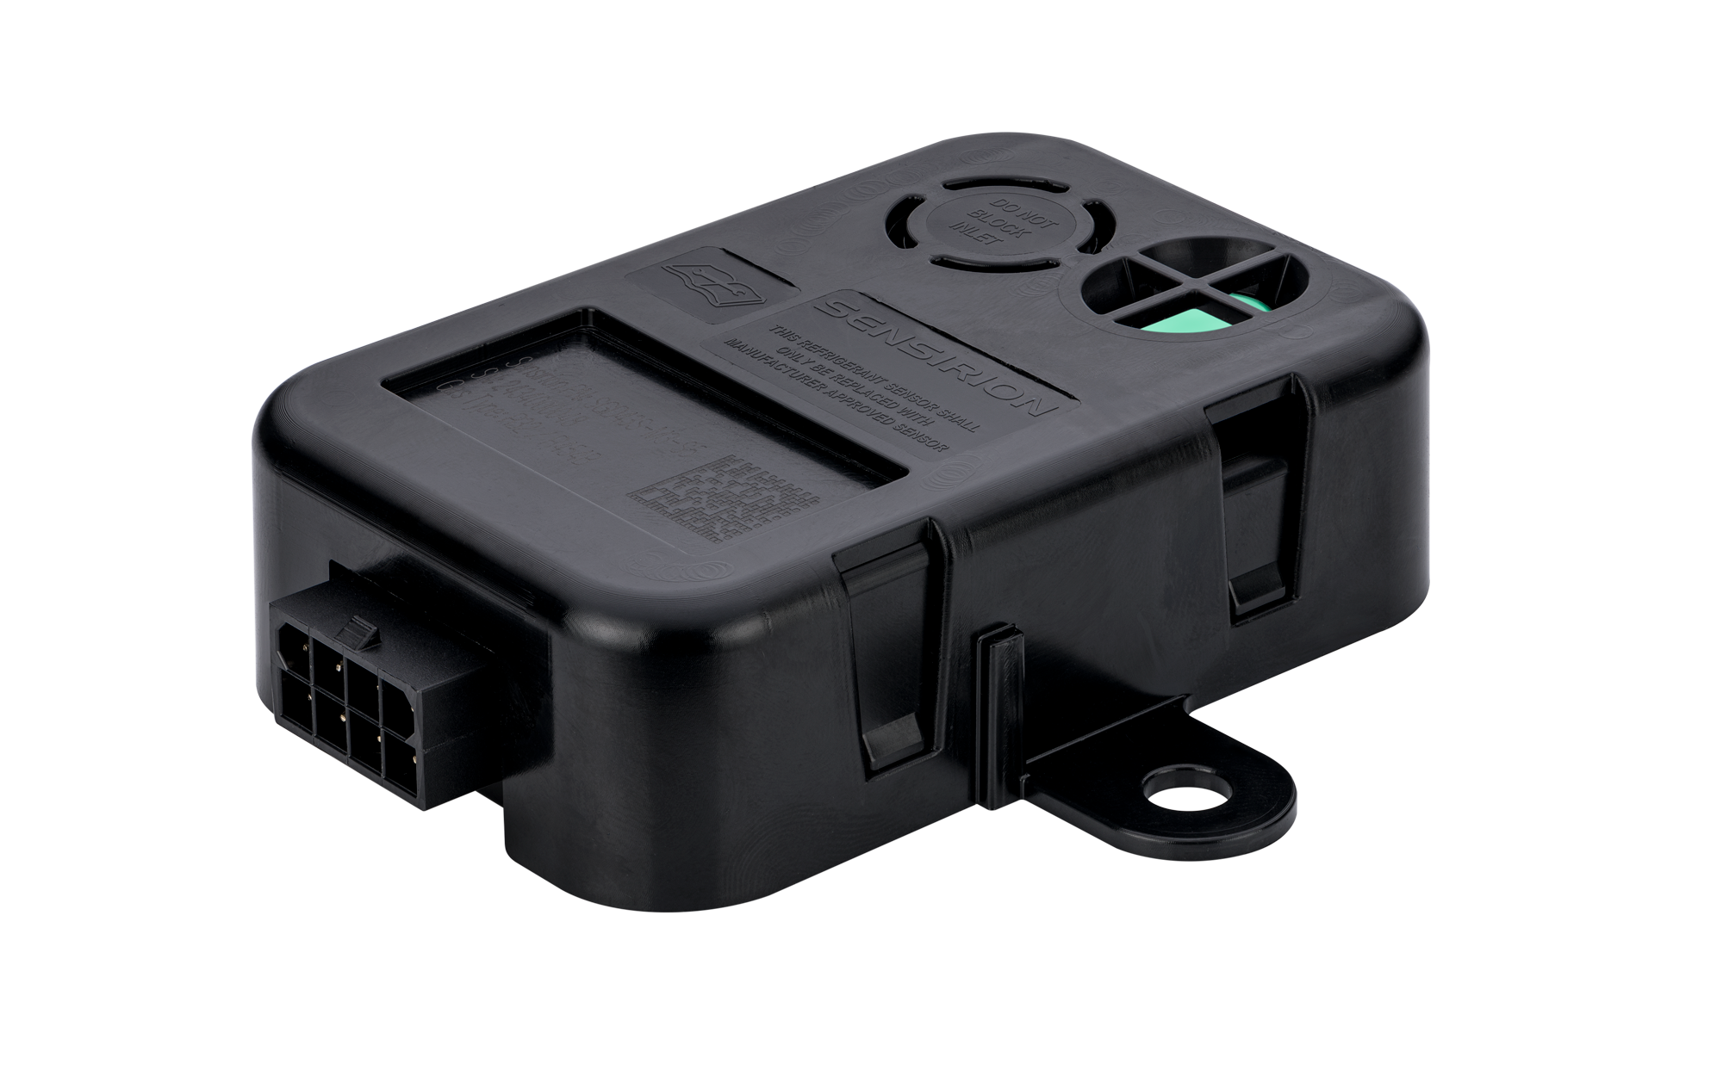

SGD43S-M3-Sx
A2L Refrigerant Detection System
Introducing SGD43S – a cutting-edge refrigerant detection system for modern HVACR systems. Engineered for accurate and reliable identification of A2L refrigerant leaks, it enhances safety and compliance with emerging regulations.
24 V
AC/DC
± 2.5 % LFL
accuracy
UL recognized
15 years lifetime
Notes:
Introducing the SGD43S - Introducing SGD43S – a cutting-edge refrigerant detection system for modern HVACR systems. Engineered for accurate and reliable identification of A2L refrigerant leaks, it enhances safety and compliance with emerging regulations.

Slide 3
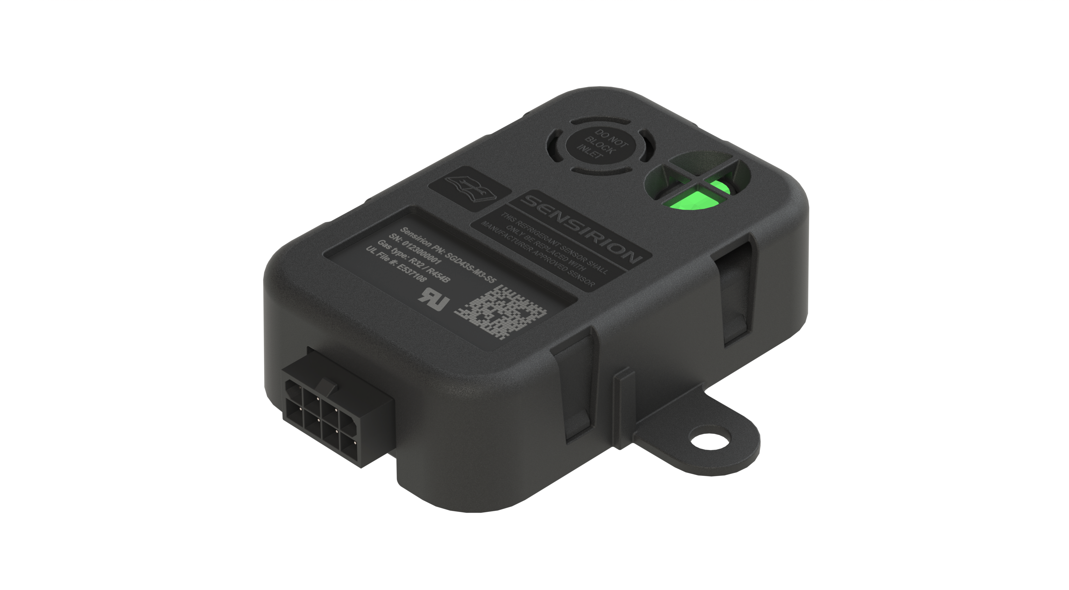

SGD43S-M3-Sx
Features
Anti-condensation heaters
Avoid mold growth and corrosion
Gas inlet
Membrane protected
IP54 protection case
UV stabilized & sealed
Status LED
Helps in troubleshooting
Laser marking tracking
QR-code & serial number
Mounting bracket
Simple fixation
8 pin sealable connector
Prepared for IP54 rated plug
RS-485 interface
Digital communication to the device
Dual relay output
Actuating the mitigation
Notes:
The product features a gas

Slide 4
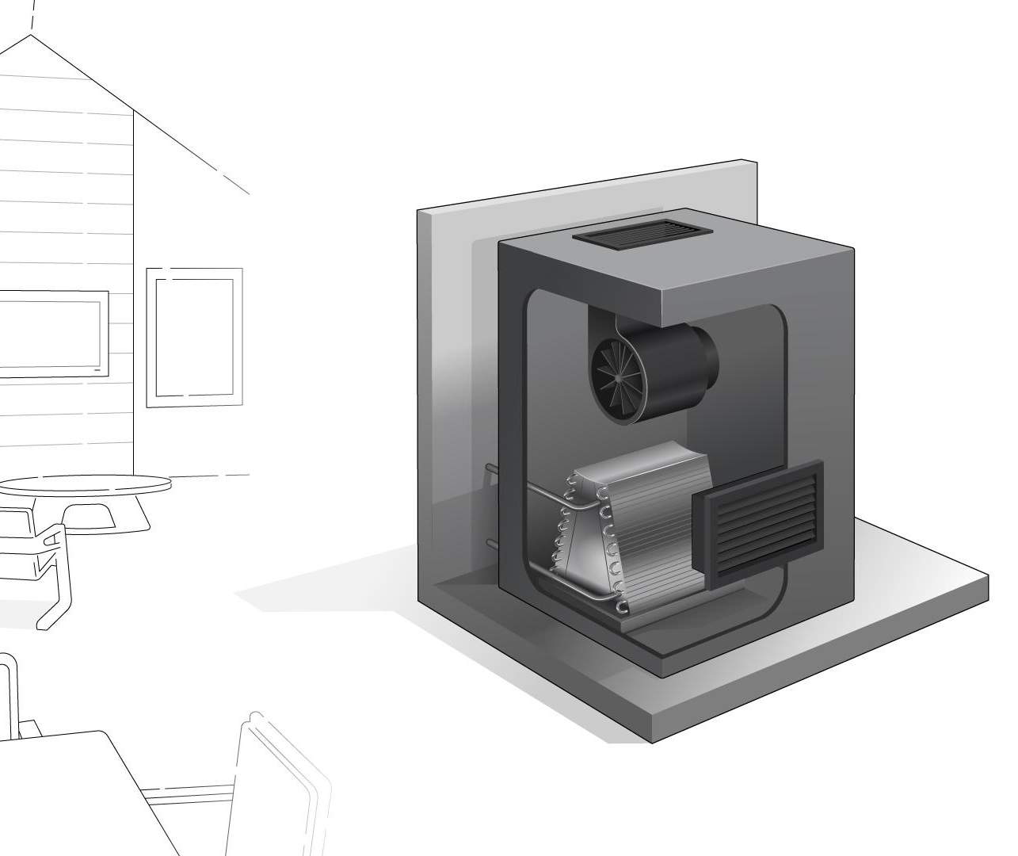

SGD43S-M3-Sx
Tailored for every HVACR application
SGD43S-M3-S5 – HVAC applications
SGD43S-M3-S5 – Calibrated for R-32, R-454B
SGD43S-M3-S7 – Refrigeration applications
SGD43S-M3-S5 – Calibrated for R-454A, R-454C, R-455A
Notes:
The SGD43S comes into two variants, tailored for your application
We at Sensirion, look forward to finding opportunities for the SGD43S with our channel partners

