Slide 1
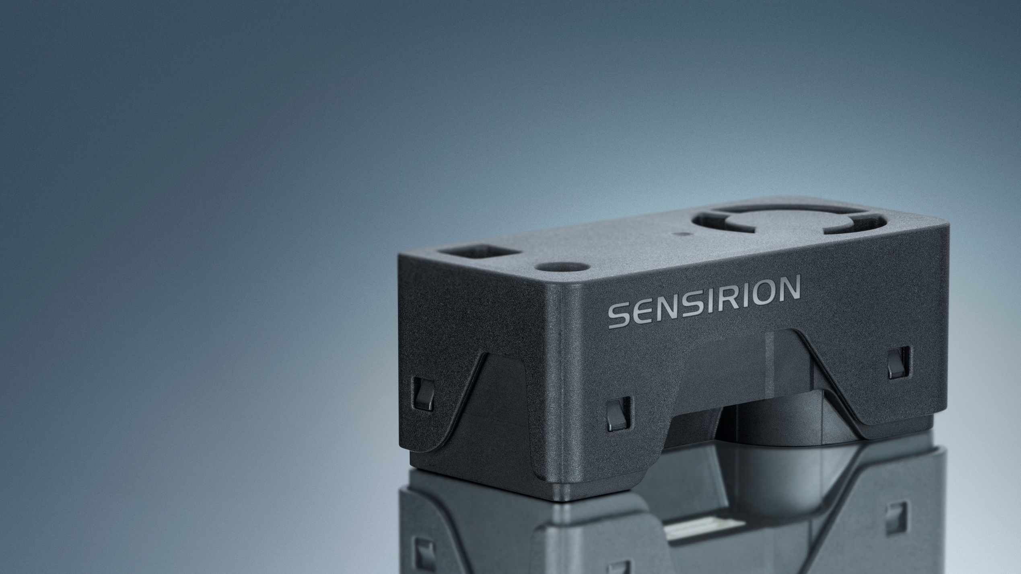

SEN6x
All-In-One Combo Solution for Air Quality Monitoring
Notes:
Imagine being able to measure all key indoor air quality parameters—particulate matter, humidity, temperature, VOCs, NOx, CO₂, and even formaldehyde—with a single, compact, future‑proof sensor platform.
That’s exactly what Sensirion delivers with the SEN6x family, our next‑generation environmental sensing platform.

Slide 2

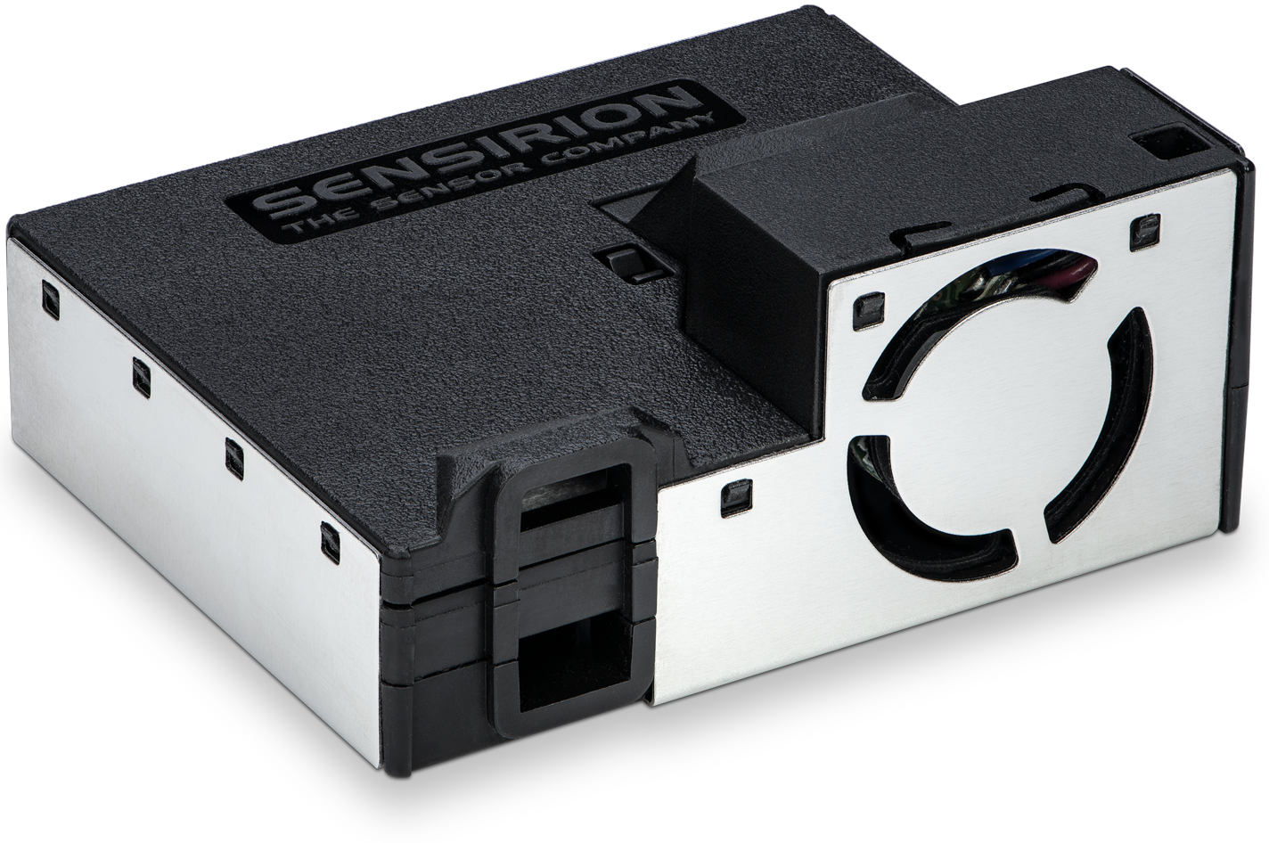
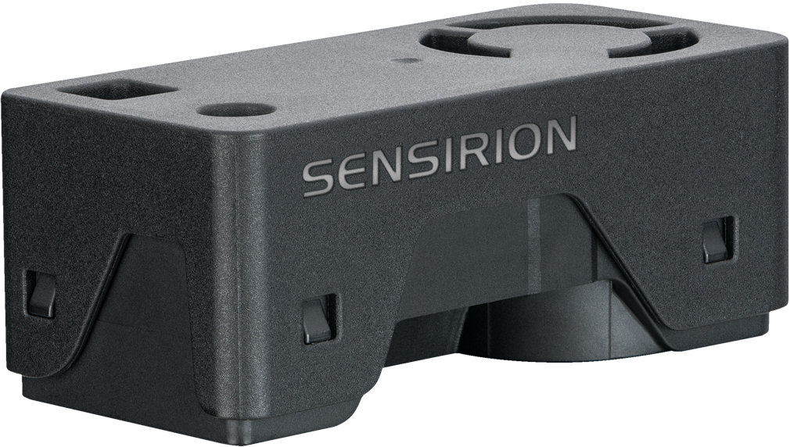
SEN6x
Simplifying Indoor Air Quality Sensing
Experience the future of air quality sensing with the compact and powerful SEN6x sensing platform. It combines multiple sensors in a never-before-seen form factor
SEN5x
2x
smaller than SEN5x
Up to 10 environmental parameters
Modular
6 Variants to choose from
SEN6x

Slide 3

Modular by Design
A sensor platform that adapts to your product – not the other way around
 | SEN62 | SEN63C | SEN65 | SEN66 | SEN68 | SEN69C
Particulate Matter PM₁ PM_{2.5} PM₄ PM₁₀ | ✔ | ✔ | ✔ | ✔ | ✔ | ✔
Relative Humidity and Temperature | ✔ | ✔ | ✔ | ✔ | ✔ | ✔
Volatile Organic Compounds and Nitrogen Oxides VOC & NO_{x} |  |  | ✔ | ✔ | ✔ | ✔
Carbon Dioxide CO₂ |  | ✔ |  | ✔ |  | ✔
Formaldehyde HCHO |  |  |  |  | ✔ | ✔
PM
T
VOC
RH
NO_{x}
HCHO
CO₂
Identical physical interface for all variants!
→ One Design-In
3
© Copyright Sensirion, Switzerland
Notes:
So What does the SEN6x line offer you? Your application is unique and maybe you don’t need all the parameters.
That’s the beauty of SEN6x, a sensor platform that adapts to your product – not the other way around
SEN62 is our lowest cost particulate matter, temperature and humidity sensor that we ever offered.
SEN63C is the most affordable way to get CO2 sensing in a module
SEN65 adds relative humidity, temperature, VOC and NOx measurements in addition to PM, this makes it for example perfect for air purifiers
SEN66 adds CO2 to that mix, which is ideal for Indoor air quality monitors or as actionable signal in energy recovery ventilation or HVAC systems, that can use it to optimize their energy consumption while making sure that the CO2 levels stay at an optimal level
SEN68 offers PM, RH&T, VOC, NOx and Formaldehyde, this fits premium air purifiers with special filter that can decompose the Formaldehyde or indoor air quality monitors for the Asian market
SEN69C the all in one solution
And the best thing is, that all models share one physical formfactor. This means you can design it in once but offer a whole range of different tiers of products. Your requirements have changed? You want to upgrade your product with an additional sensors? No problem, just order another variant without changing your design

Slide 4

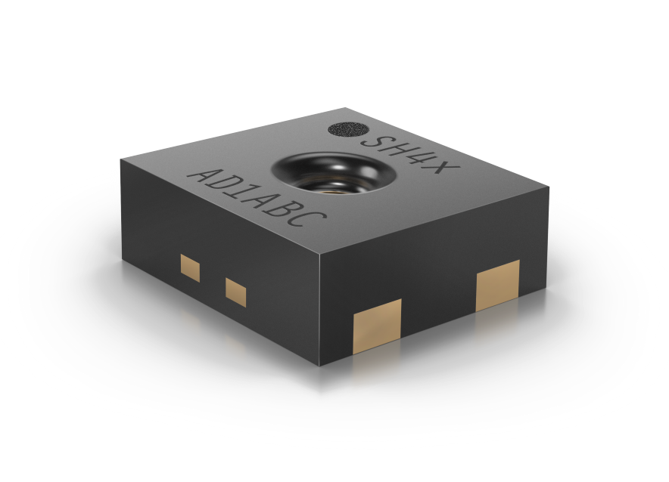
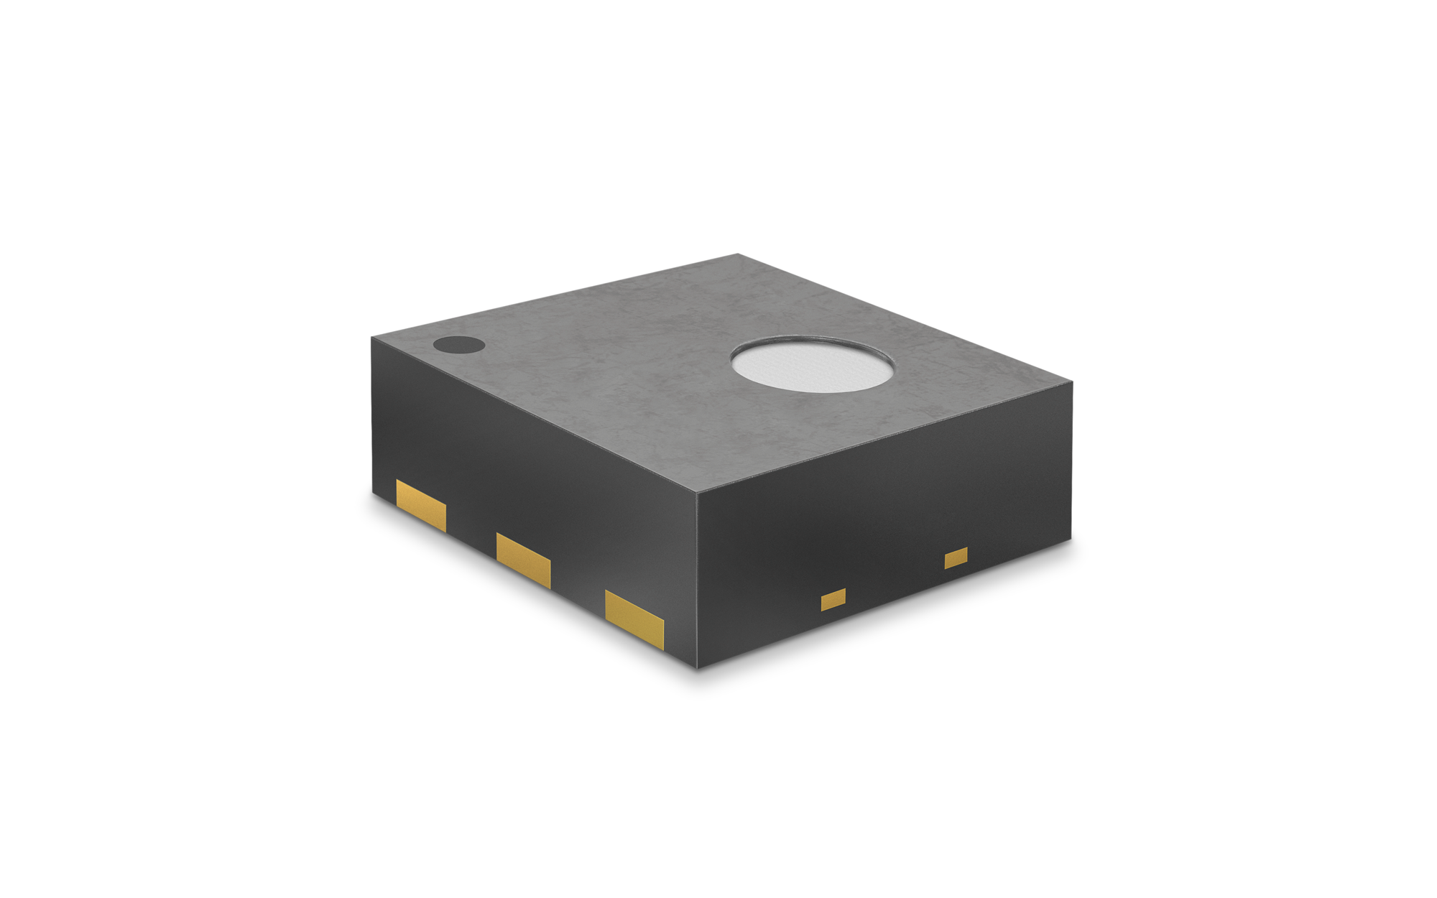
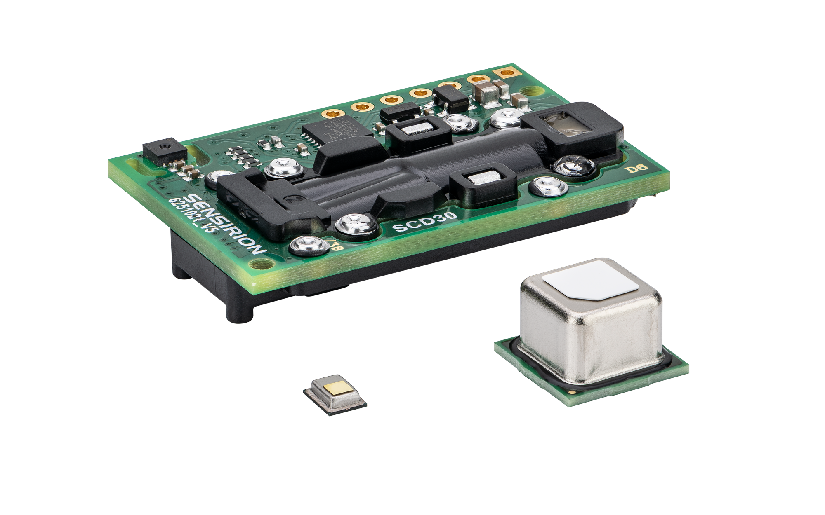
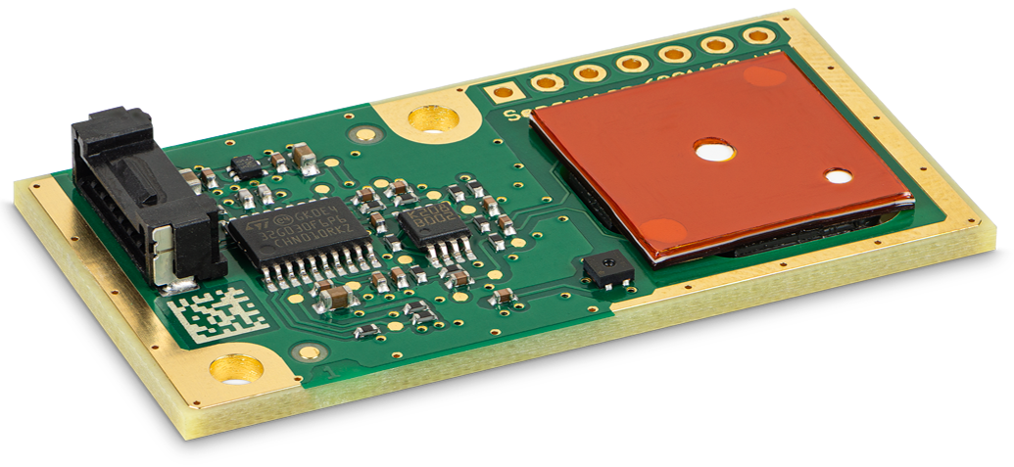
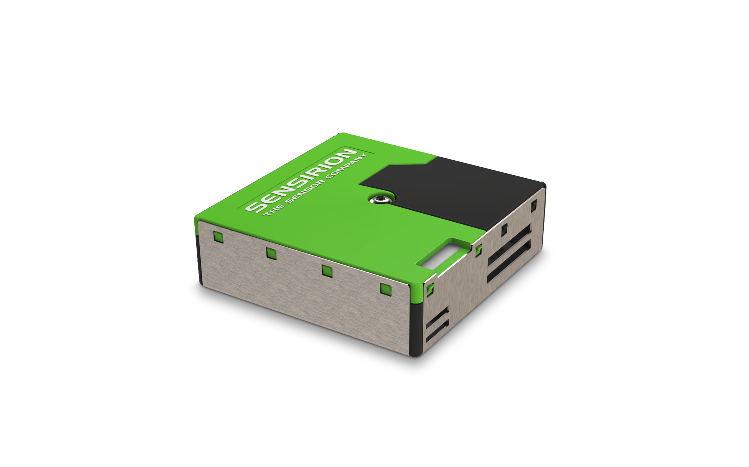
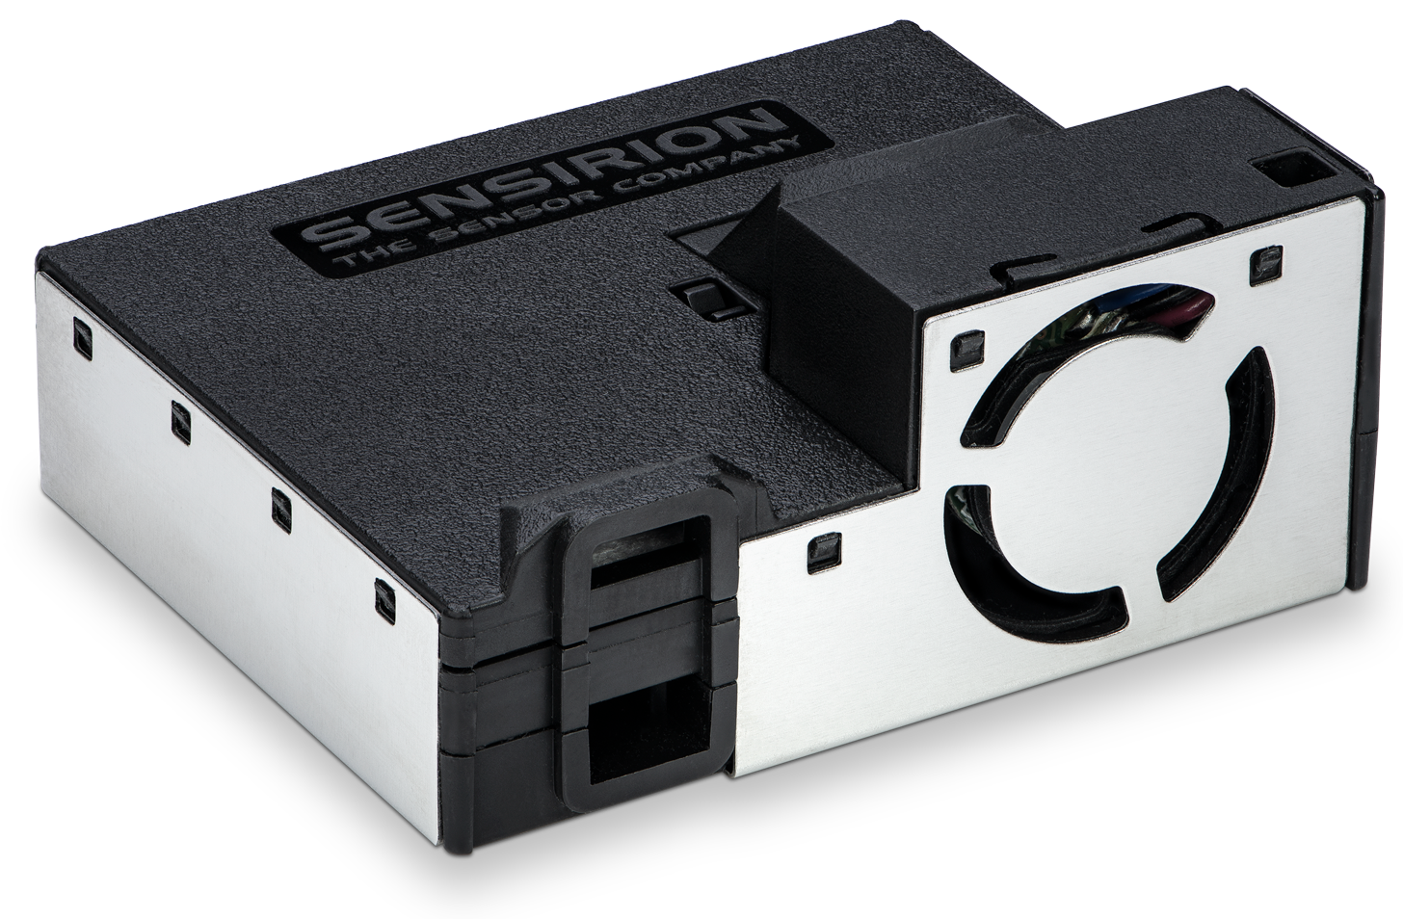
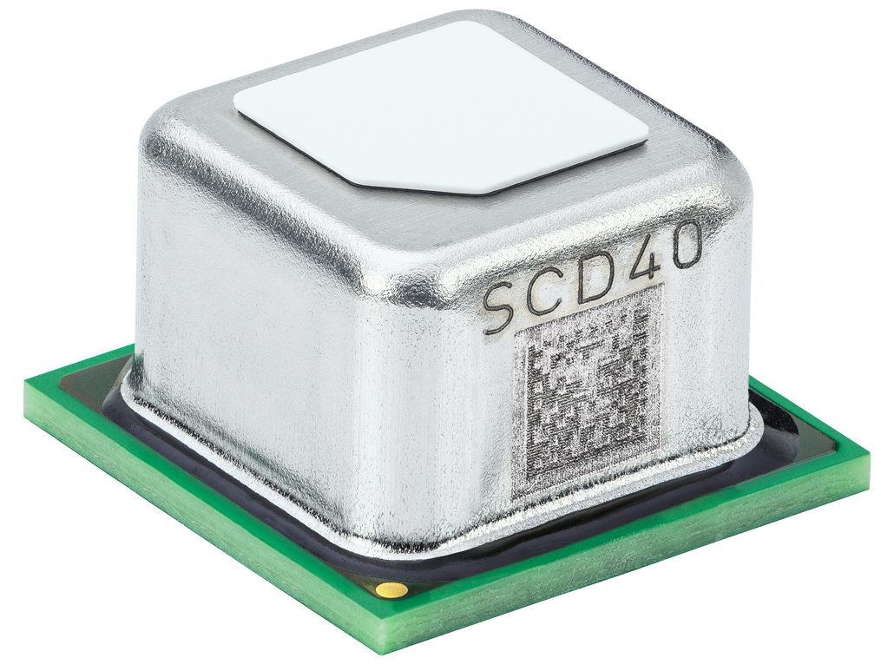
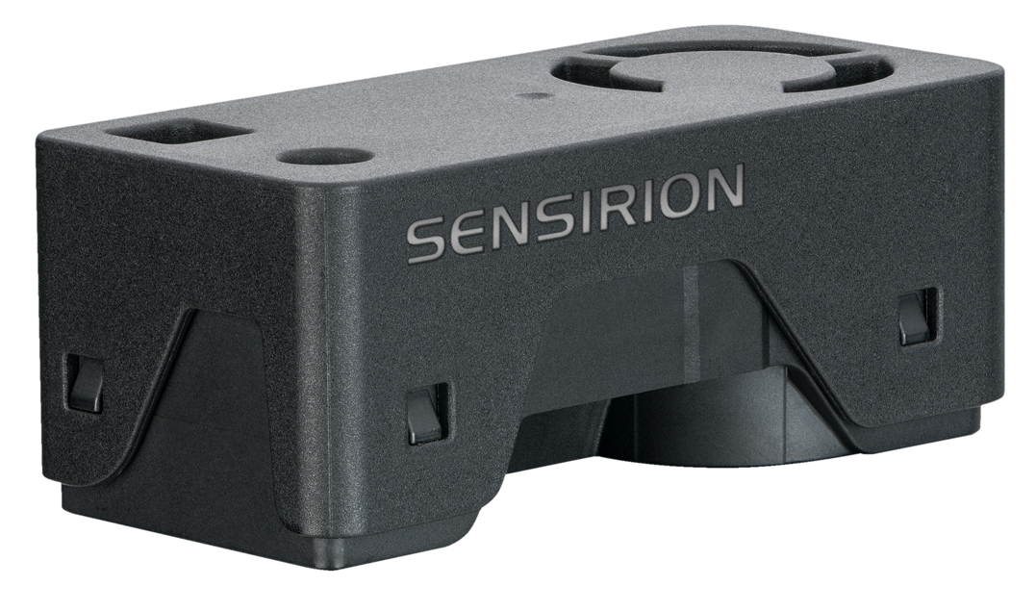
As Competitive as it Can Get
Shorten Time-To-Market with Plug & Play SEN Modules
10 parameters covering all contaminants contributing to 99% of total harm caused
Save on Cables, Resources, Design-in
Record time-to-market
Integration Cost
1 compact form factor
1 communication interface
Integrated algorithms
Installation without tools
Sensor generation
Maintenance free and long lifetime
thanks to patented sheath-flow technology
Price advantage of module due to ease of integration

