Slide 1
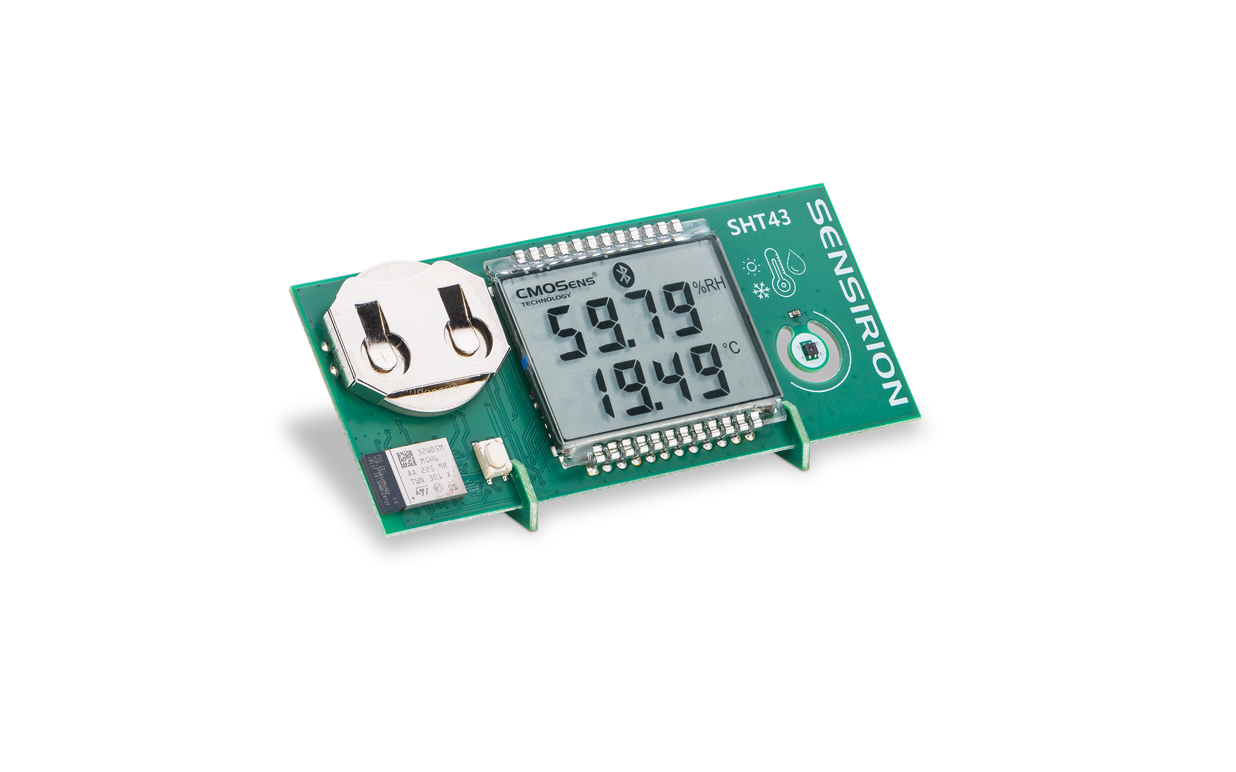
SHT43 DemoBoard
Demonstrator for our SHT43 Humidity and Temperature Sensors

Slide 2
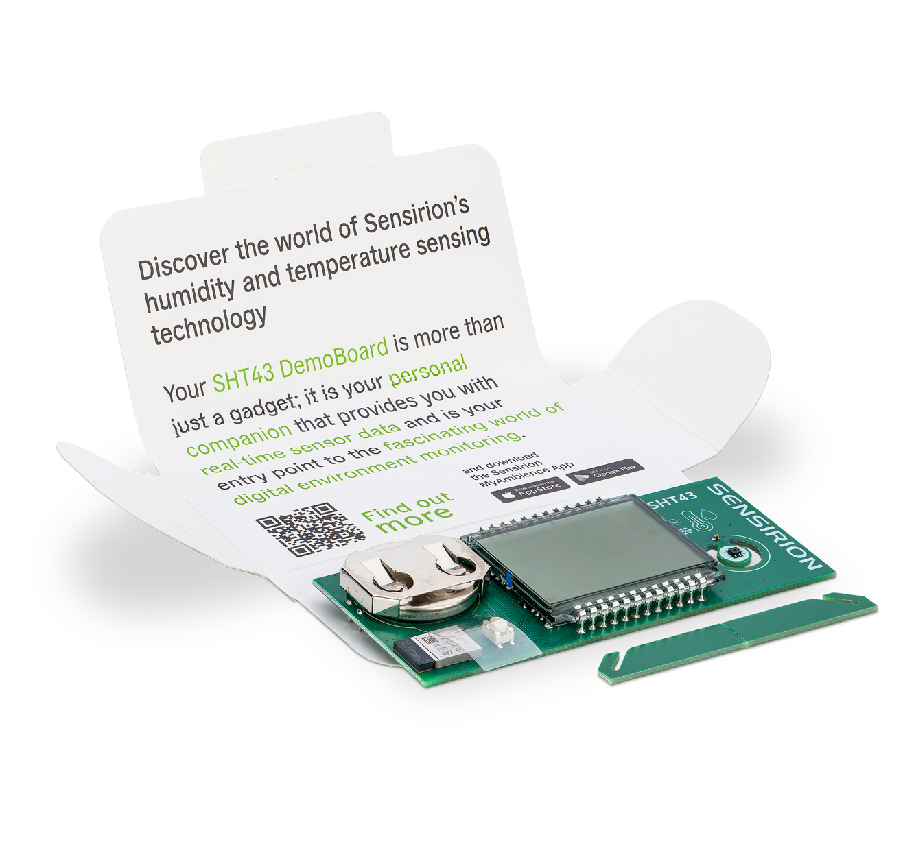
SHT43 Demoboard
Demonstrator refresh
Replacing our SHT4x SmartGadget, the SHT43 DemoBoard is a complete redesign of our demonstrator platform to highlight our latest technology and partnerships
SHT43: ISO 17025
certified
Updated chipset from ST
Design files available

Slide 3
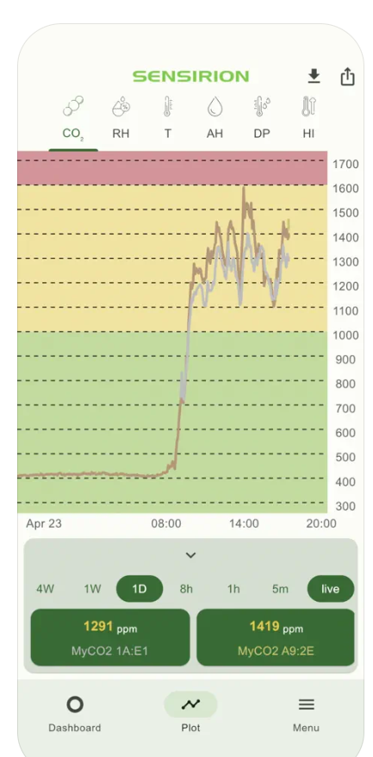


MyAmbience Mobile app
Access from your phone
Our MyAmbience Mobile app allows you to access sensor data and the ISO17025 calibration certificate via Bluetooth
Bluetooth Connectivity
Available on iOS and Android
Certificate download

Slide 4
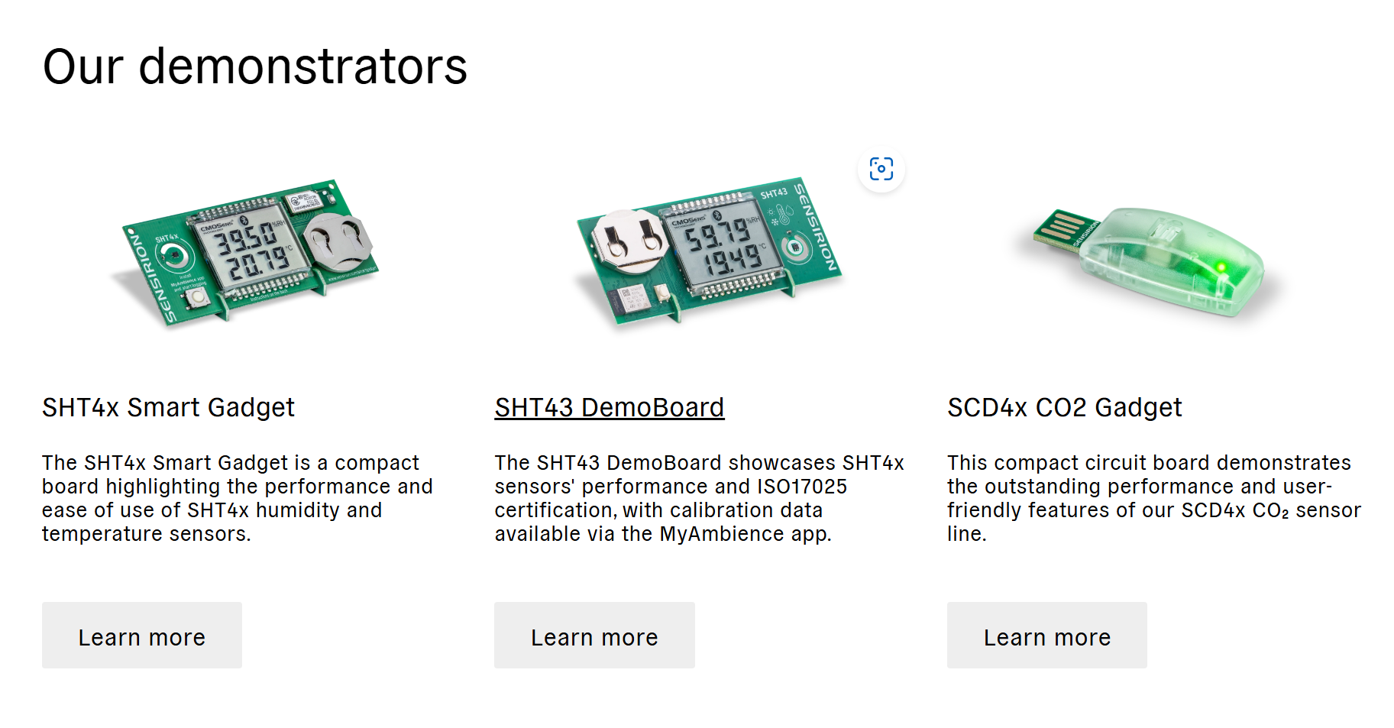
Find out more: https://sensirion.com/demonstrators

