Slide 1

SHT4x protective cover
Same performance expanding process options
PM Humidity and Temperature | February 2025

Slide 2
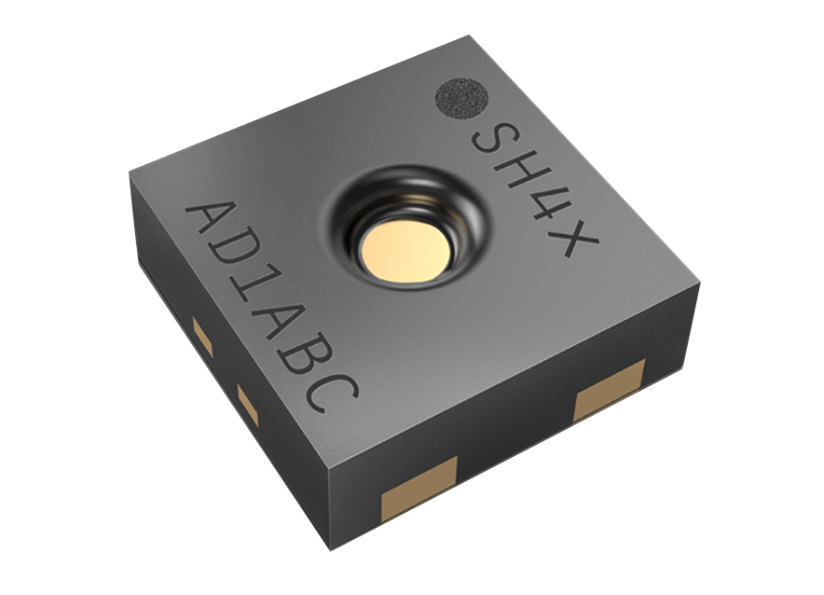
SHT4x Family
Top of class %RH/T sensors.
±1.8 %RH accuracy
0.4 μA average current consumption
±0.1 °C T accuracy
Integrated heater.
SHT4X sensor
Notes:
The SHT4X sensor family are top of the class humidity and temperature sensors
Among its incredible features we wanted to highlight its high accuracy, being below 2%.
The integrated heater, which allows for diagnostics and real time detection
The ultra low power consumption, being at an astonishing 0.4 microamps
And the 0.1°C accuracy

Slide 3

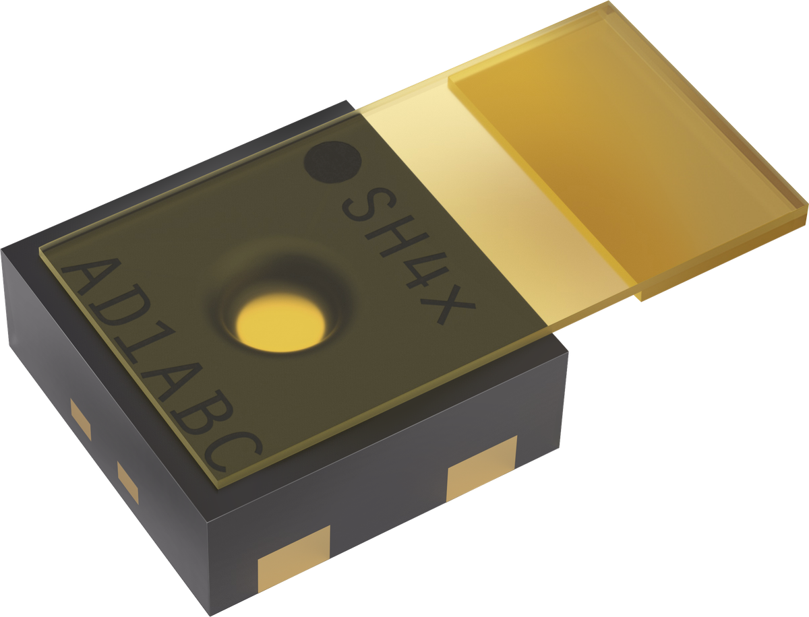
SHT4x Protective cover
Widening the processing possibilities.
The Polyamide protective cover makes the sensor compatible with aggressive chemicals and elevated temperature processes.
The easy to remove protective cover allows for seamless integration in assembly lines.
The cost-effective protective cover allows using brush-over and spray-over conformal coating procedures.
SHT4x sensor with the protective polyamide cover.
Notes:
Now, pairing the SHT4X family sensors we are pleased to announce the polyamide protective cover, which widens even further the processing possibilities.
The protective cover allows the sensor to be processed in assembly environments in which it could be exposed to high Temperatures and aggressive chemicals.
Thanks to its easy to peel design it can be seamlessly integrated in any assembly line
And finally, thanks to its cost effectivity allows using brush-over and spray-over conformal coating procedures which could be otherwise incompatible.
Thanks for your time, and I hope we get to work together soon.

