Slide 1

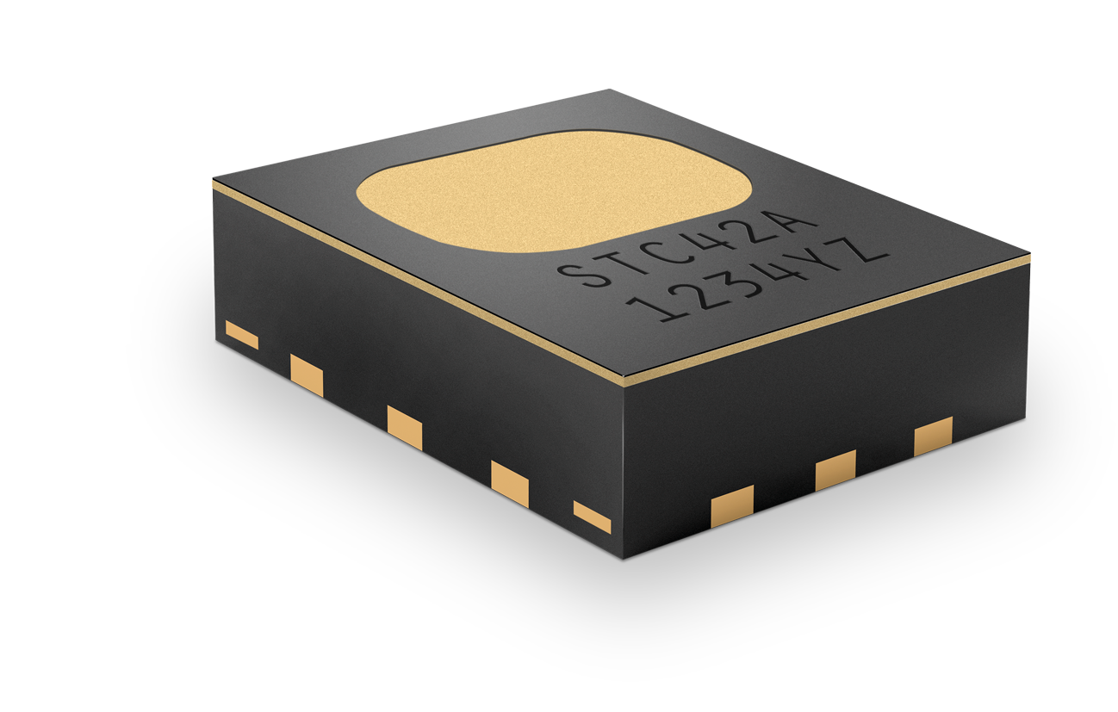
STC42A Hydrogen Sensor
Automotive Compliant (AEC-Q100 Grade 2)

Slide 2


Thermal Runaway & Propagation
Thermal Runaway
TR Propagation
USA
FMVSS 305a
CN
GB 38031-2025
World
GTR20 Phase2
Overcharge / Short circuit
Physical Damage
Overheating
Heat of neighboring cell
Conductive heat transfer
Heat from flame
Comply with Regulations: Warn 5 Minutes before Harm

Slide 3
STC42A Specifications
Optimized Hydrogen Gas Sensing for Thermal Runaway Applications
Accuracy: ± (0.4vol% + 2% of reading)
H₂ range: 0 – 40vol%
Typical response time: 1s (τ63)
1mm
0.1…60s sampling interval (cont.)
On-demand (single shot)
Operation:
Supply voltage: 3.3V, 5V DC
3.5mm
3mm
Avg current consumption: <0.7mA ¹⁾
Automotive compliant: AEC-Q100 grade 2 ²⁾
¹⁾ Continuous measurement mode at 1Hz - and <7µA in low-power mode at 0.03Hz.
²⁾ Qualification standard developed by the Automotive Electronics Council (AEC) that defines stress tests and reliability requirements for integrated circuits used in automotive applications.
3
© Copyright Sensirion, Switzerland

Slide 4
Key Advantages of the STC42A Sensor
STC42A Hydrogen Sensor combines advanced sensing performance with automotive‑grade robustness
Individual sensor calibration and on chip compensation
Low power mode via interrupt pin
Digital I2C interface for communication and
automatic AH compensation
Excellent and proven long-term stability
PFAS-free membrane
Robustness to shock and vibration
SMD soldering
Engineered and manufactured in Switzerland

Slide 5
Notes:
At Sensirion, we look forward to collaborating closely with our channel partners to identify and unlock new opportunities for the STC42A, driving innovation in the rapidly expanding hydrogen‑sensing market.

