Slide 1
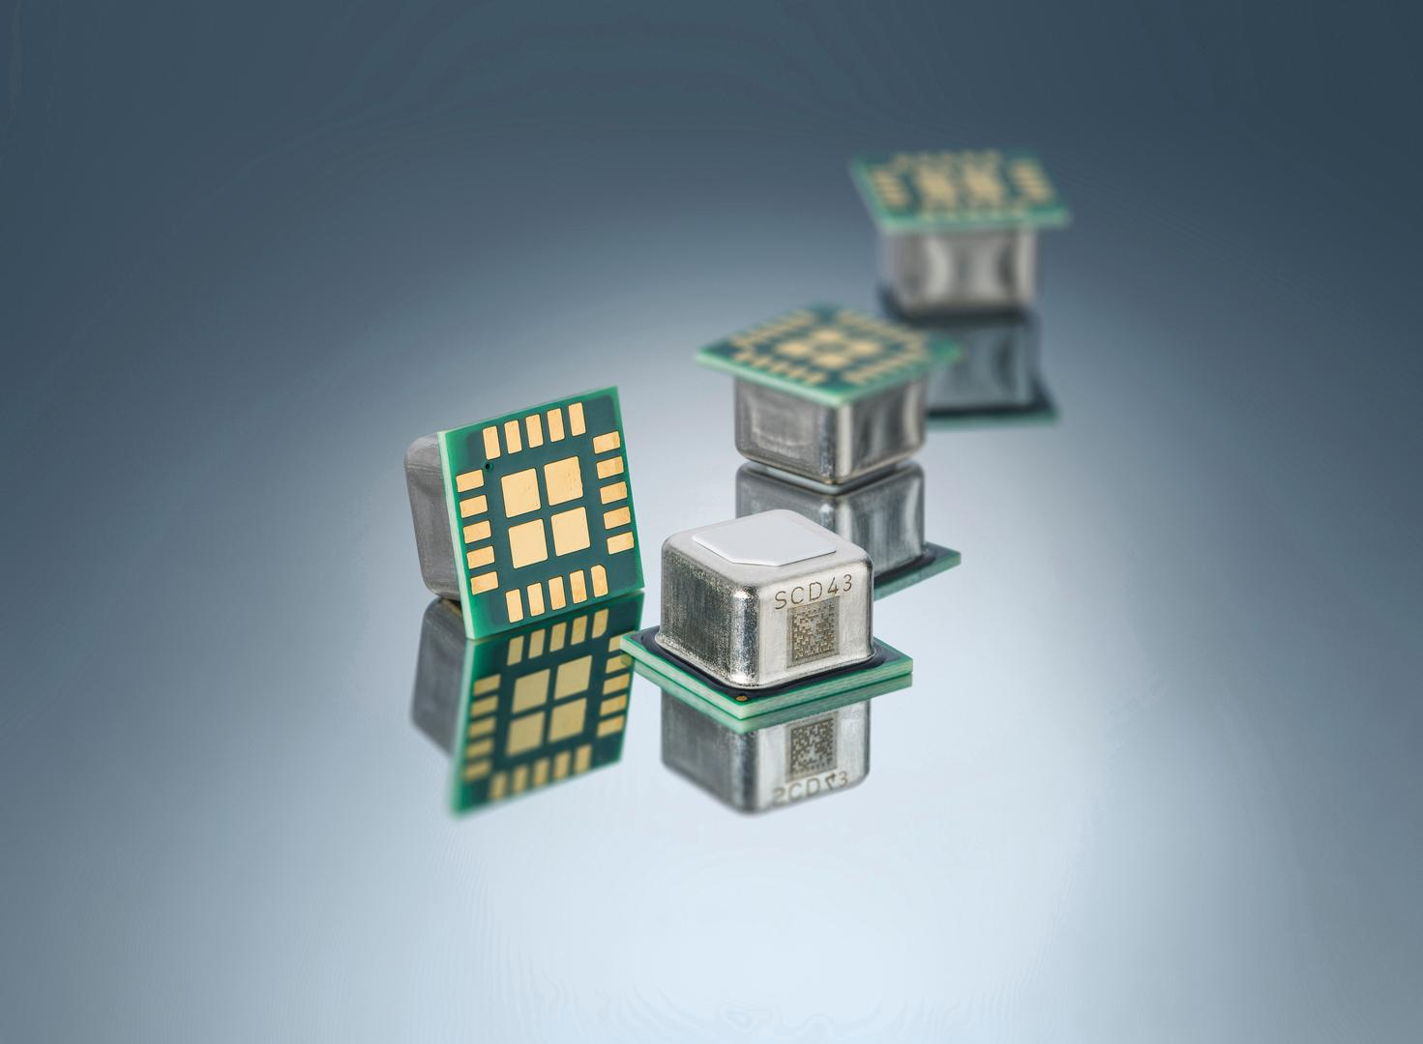

SCD43 CO₂ sensor
Upgraded Performance & Building Standard Compatibility
Notes:
Hello, my name is Kaitlin Howell and we at Sensirion are pleased to launch Sensirion’s next variant of photoacoustic NDIR CO2 sensor, the SCD43.

Slide 2



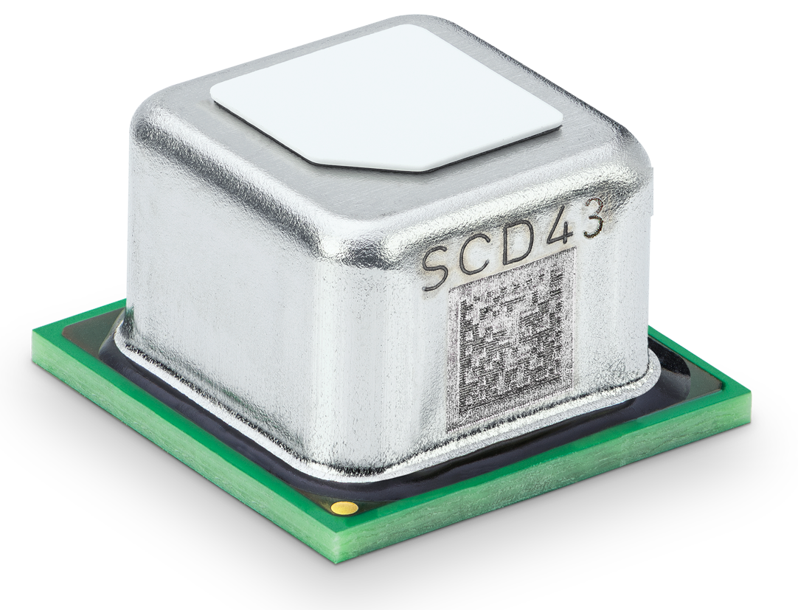




SCD43: Upgraded Performance & Standard Compatibility
Drop-in Upgrade for SCD40 / SCD41
All the popular features of SCD4x:
Compact & SMD solderable package
Excellent selectivity & robustness
Automatic Self-Calibration (ASC) eliminates need for manual field calibration
Multiple operation modes
Upgraded “Best-in-class” CO₂ accuracy: ± (30 ppm + 3 % m.v.) @ 400 – 5’000 ppm
Comprehensive Building Standard Compatibility incl. ASHRAE 62.1-2022 Addendum d
2
© Copyright Sensirion, Switzerland
Notes:
The SCD43 is targeting applications that require compatibility with ASHRAE 62.1-2022 Addendum D as well as other building standards such as California Title 24, RESET and WELL.
The SCD43 is a drop-in upgrade to the SCD4x family combines a best-in-class CO2 accuracy combined with the other SCD4x features, such as small size, SMD solderability and automatic self-calibration algorithm.

Slide 3


Context: ASHRAE 62.1 Addendum d
An update to the most important standard for demand-controlled ventilation (DCV)
ASHRAE 62.1 has released new accuracy requirements for CO₂ sensors:
→ Extended accuracy requirement to concentrations of up to 2500 ppm
→ Tightened accuracy overall, also at low concentrations («more accurate HVAC control»)
Addendum d officially released March 31st 2025:
« CO₂ sensors shall be certified by the manufacturer to be accurate within ±75ppm ±30ppm ±3% of reading at concentrations of 600, 1000, and 2500 ppm when measured at sea level at 77°F (25°C) (…) »
Notes:
The ASHRAE 62.1 Addendum D is an update to the standard for ventilation and indoor air quality in non-residential buildings.
This addendum has tightened the accuracy requirements and extended the accuracy range of CO2 sensors that are used for regulating ventilation.
The SCD43 is compliant with addendum D and a drop-in replacement for customers using SCD41 for compliance with the ASHRAE 62.1 standard.

Slide 4

Overview: SCD4x Product Variants
SCD40
SCD41
SCD43
 | Product variant for cost sensitive markets | Product variant for improved accuracy, extended range and/or single shot modes | Product variant for comprehensive building standard compatibility
Accuracy | ± (50 ppm + 5 % of reading) | ± (50 ppm + 2.5 % of reading)* ± (50 ppm + 3 % of reading)** ± (40 ppm + 5 % of reading)*** | ± (30 ppm + 3 % of reading)
Specified output range | 400 – 2’000 ppm | *400 – 1’000 ppm **1001 – 2’000 ppm ***2001 – 5’000 ppm | 400 – 5’000 ppm
Output range | 0 – 40’000 ppm
Form / footprint / interface | 10.1 x 10.1 x 6.5 mm (nominal), digital I²C interface
Operation modes | Periodic (5s) Low-Power Periodic (30s) | Periodic (5s) Low Power Periodic (30s) Single-shot
4
© Copyright Sensirion, Switzerland
Notes:
The SCD4x family now includes three variants to support a variety of applications, the SCD40, SCD41 and new SCD43.
The SCD40 targets cost-sensitive markets with a competitive accuracy and two operation modes.
The SCD41 targets applications complying with the requirements of California Title 24, RESET and WELL building standards through higher accuracy, larger accuracy range and an additional single shot mode for lower power operation.
The SCD43 achieves best-in-class accuracy to additionally comply with ASHRAE 62.1-2022 Addendum D.

Slide 5

Notes:
We at Sensirion look forward to bringing SCD43 to our customers with our channel partners.

