Slide 1


STC31-C: The latest Sensirion CO₂ Sensor
Minimal Size.
Breathtaking Potential.
Notes:
We are pleased to announce Sensirion’s latest CO2 sensor, the STC31-C. It is replacing its predecessor, the STC31 with a breathtaking package of the same minimal size, new features and a new interesting price point to enable new applications for our partners and customers.

Slide 2
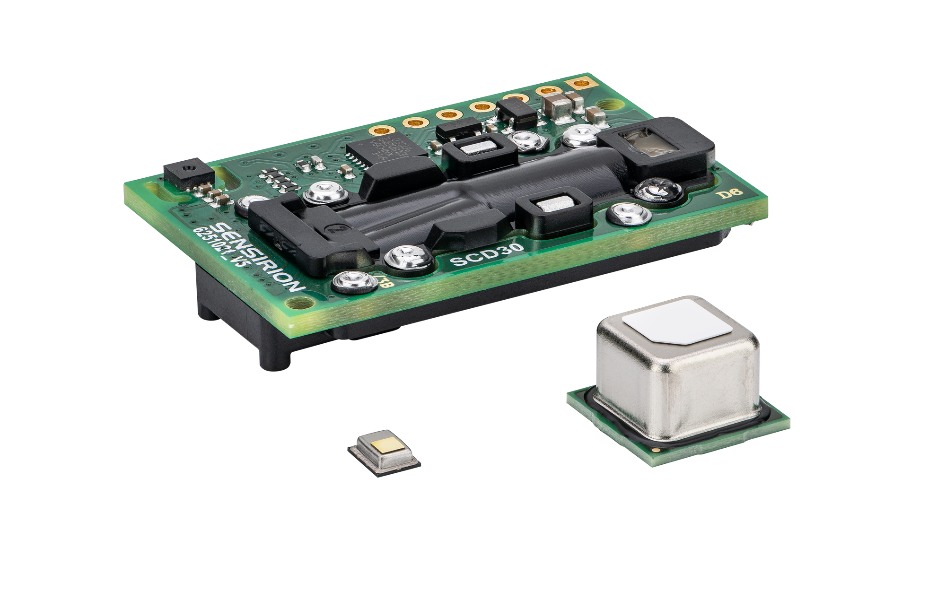
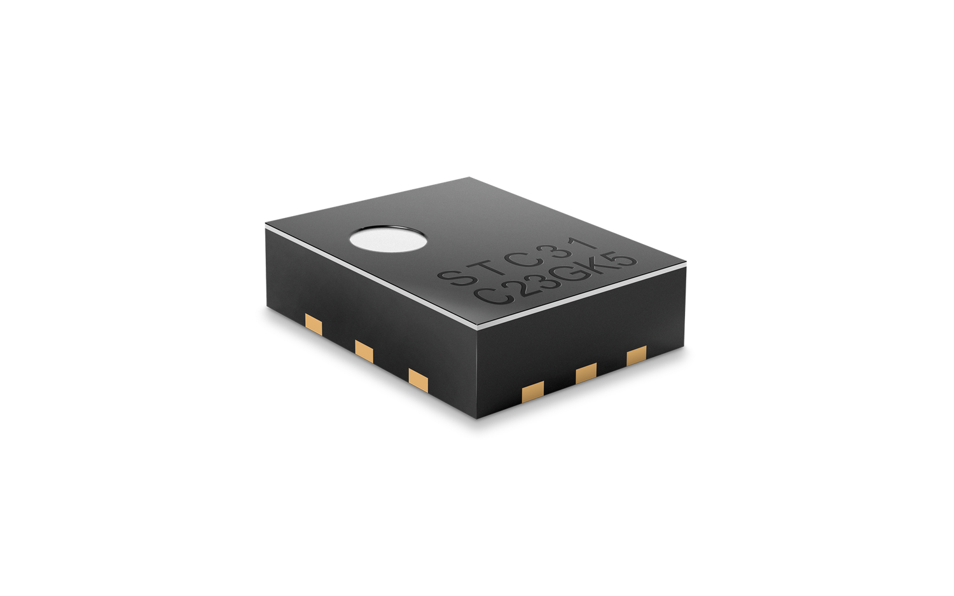

STC31-C
Minimal Size.
Breathtaking Potential.
SCD30
Backward-compatible successor to STC31: Addressing new applications with a lower price point and a new revolutionary measurement mode.
Optimized for applications with human breath as well as storage and transportation of fresh produce and grain.
More than
100x
smaller than NDIR sensors
0 – 100% CO₂
measurement range
Low
RH, P, O₂
cross sensitivity
± 0.2 – 2.0 vol%
achievable accuracy
STC31-C
Notes:
The STC31-C is the successor to the currently available STC31. The full backward compatibility allows easy transition for existing customers. The lower price point and the new low-cross-sensitivity measurement mode are sure to enable new applications and expanding in established applications.
Human breath measurement as well as storage and transportation of fresh produce and grain are key applications for this new sensor.
The STC31-C is based on the thermal conductivity sensing principal and has the following features:
It is more than 100x smaller than common NDIR sensors
It measure over the full range from 0 – 100% CO2 in air or nitrogen.
With an achievable accuracy of down to 0.2 vol% in well controlled application and up to 2 vol% in more demanding applications.
Especially interesting is the new low-cross-sensitivity measurement mode. It reduces the sensitivity to changes of the sample gas like relative humidity, pressure and oxygen concentration. This not only enables applications like breath measurements for the first time but also provides our customers with a very robust measurement mode for many applications.

Slide 3

Sensirion CO₂ Sensing Portfolio
The right sensor for every application
SCD30 Transmissive dual channel NDIR sensor with the highest accuracy for the most demanding IAQ applications: ±(30 ppm + 3%).
SCD4x
World’s smallest optical CO₂ sensor fulfilling accuracy specifications for several IAQ standards. Two variants available to meet a range of use cases.
STCC4
Unmatched form factor and low cost paired with optimized accuracy for general air quality monitoring: ±(100 ppm + 10%)
STC31-C
Smallest CO₂ sensor for high concentration applications in consumer and medical breath measurement as well as produce transportation, storage and industrial applications.
Notes:
The introduction of the STC31-C to Sensirion’s CO2 sensing portfolio extends the possibilities for high concentration measurements in breath, produce storage and other industrial applications.
While the SCD30, the SCD4x and the STCC4 cover indoor air quality applications with many options the STC31-C rounds off the CO2 sensing portfolio for applications that need high CO2 sensing, offering the same strength our customers are used to: innovation, miniaturization and industrialization for mass production.

Slide 4


STC31-C
Minimal Size.
Breathtaking Potential.
Designed and manufactured in Switzerland
Small form factor for cost- and space-effective integration
SMD assembly and tape & reel packaging enable high-volume applications
Digital I²C interface for straight-forward sensor communication
Sensors and Evaluation Kits
Datasheet and Design Guide with extensive implementation knowhow
→ All Available now!
Notes:
Other features that add to the value proposition of STC31-C:
Swiss Engineering and manufacturing
Small form factor for cost- and space-effective integration
SMD assembly and tape & reel packaging, enabling high-volume applications
And a digital I²C interface for straight-forward sensor communication
The evaluation kit is available as of now for testing and development and the sensors can be ordered in volume on reel.
Besides the standard datasheet, the Design Guide provides insides into our extensive integration knowhow and guides the customer through testing, optimization and development.
We at Sensirion look forward to finding opportunities for STC31-C in high CO2 sensing applications together with our channel partners.

Slide 5


