Slide 1


SEK-SGP4x-Sensor
SGP40 and SGP41 Evaluation Kit
Notes:
We are pleased to announce Sensirion’s latest VOC and NOx sensor evaluation kit, the SEK-SGP4x-Sensor. This kit is

Slide 2
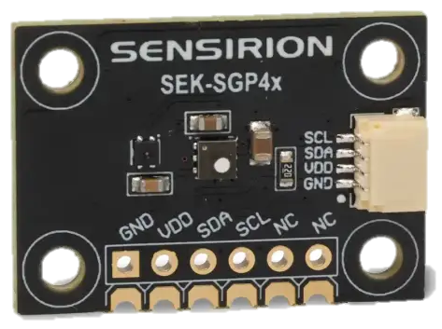

SEK-SGP4x-Sensor
SGP40 and SGP41 Evaluation Kit
Introducing SEK-SGP4x-Sensor – designed for accessing raw sensor signals (SRAW) and suitable for developers who need to evaluate raw data or tune custom sensing algorithms.
3.3 VDD
& I2C interface
27 x 19 x 1.6 mm³
SGP4x & SHT41 onboard
4-pin Qwiic connector
Notes:
Introducing SEK-SGP4x-Sensor – designed for accessing raw sensor signals (SRAW) and suitable for developers who need to evaluate raw data or tune custom sensing algorithms.
The board features direct access to the SGP4x pins, enabling direct I2C communication with the sensor.

Slide 3

SEK-SGP4x-Sensor
Evaluate without writing code
In just few simple steps, you will be collecting valuable data without needing any coding or soldering skills.
Step 1:
Order a SEK-SensorBridge via our distribution network.
Step 2:
Download the SEK-ControlCenter viewer software (available for Windows, Linux and MacOS).
Step 3:
Connect the SGP4x development board to your computer by using a SEK-SensorBridge and start measuring.
Notes:
In just few simple steps, you will be collecting valuable data without needing any coding or soldering skills.
Step 1:
Order a SEK-SensorBridge via our distribution network.
Step 2:
Download the SEK-ControlCenter viewer software (available for Windows, Linux and MacOS).
Step 3:
Connect the SGP4x development board to your computer by using a SEK-SensorBridge and start measuring.

Slide 4
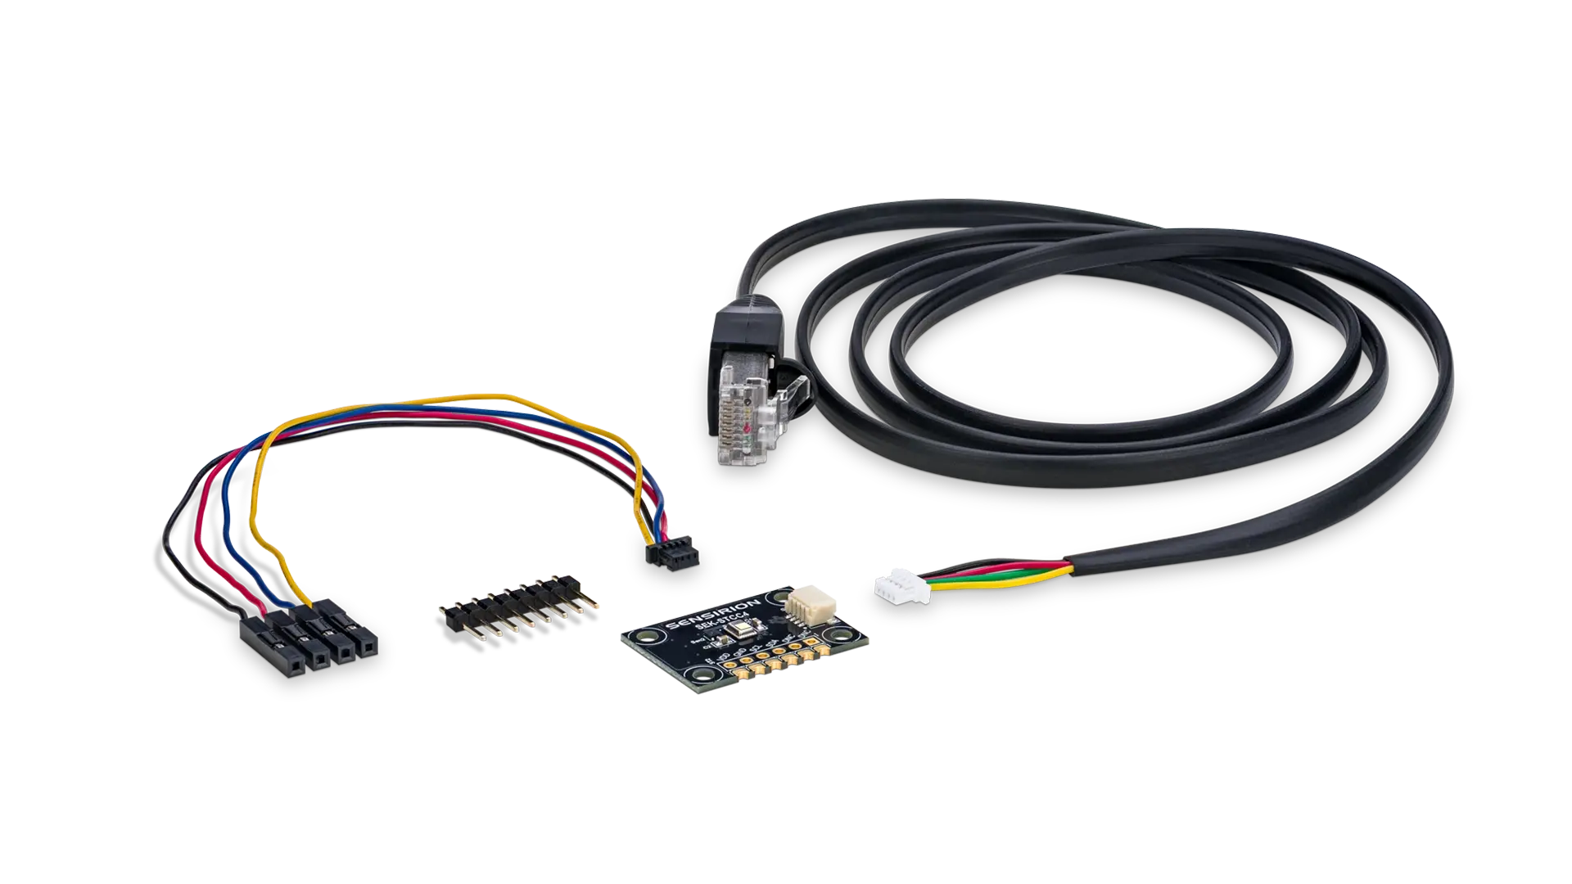

SEK-SGP4x-Sensor
What the evaluation kit holds
SGP4x development board
SGP4x VOC + NOx sensor (works either as a SGP40, or as a SGP41) and SHT41 humidity and temperature sensor
I2C interface
Supply voltage VDD: 3.3 V
Size: 27 x 19 x 1.6 mm3
Adapter cable to connect the SGP4x development board to SEK-SensorBridge.
Jumper wire set (4-pin Qwiic cable female) to connect the SGP4x development board to embedded platforms like Arduino, Raspberry Pi, etc. A 10-pin 0.1" pitch-gender changer is also provided.
Notes:
We are Sensirion, look forward finding opportunities for the SEK-SGP4x-Sensor with our channel partners.

